Slide 1
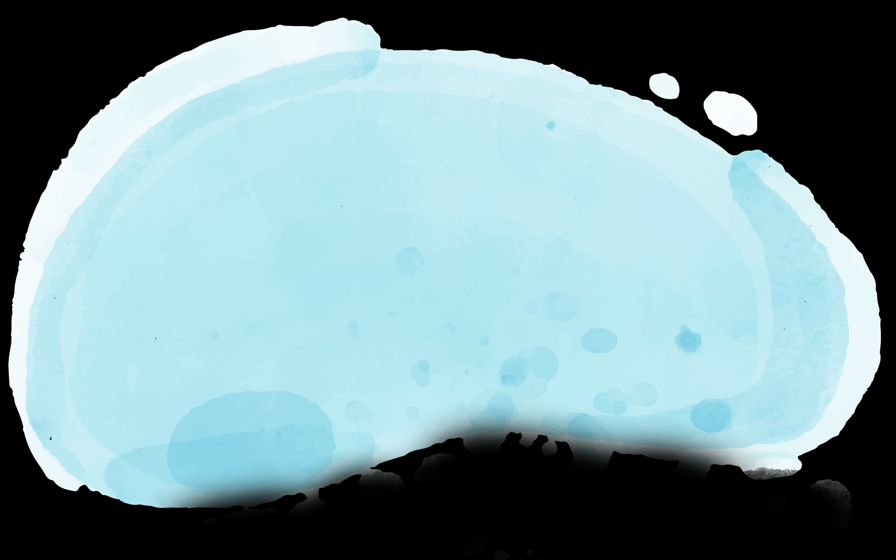
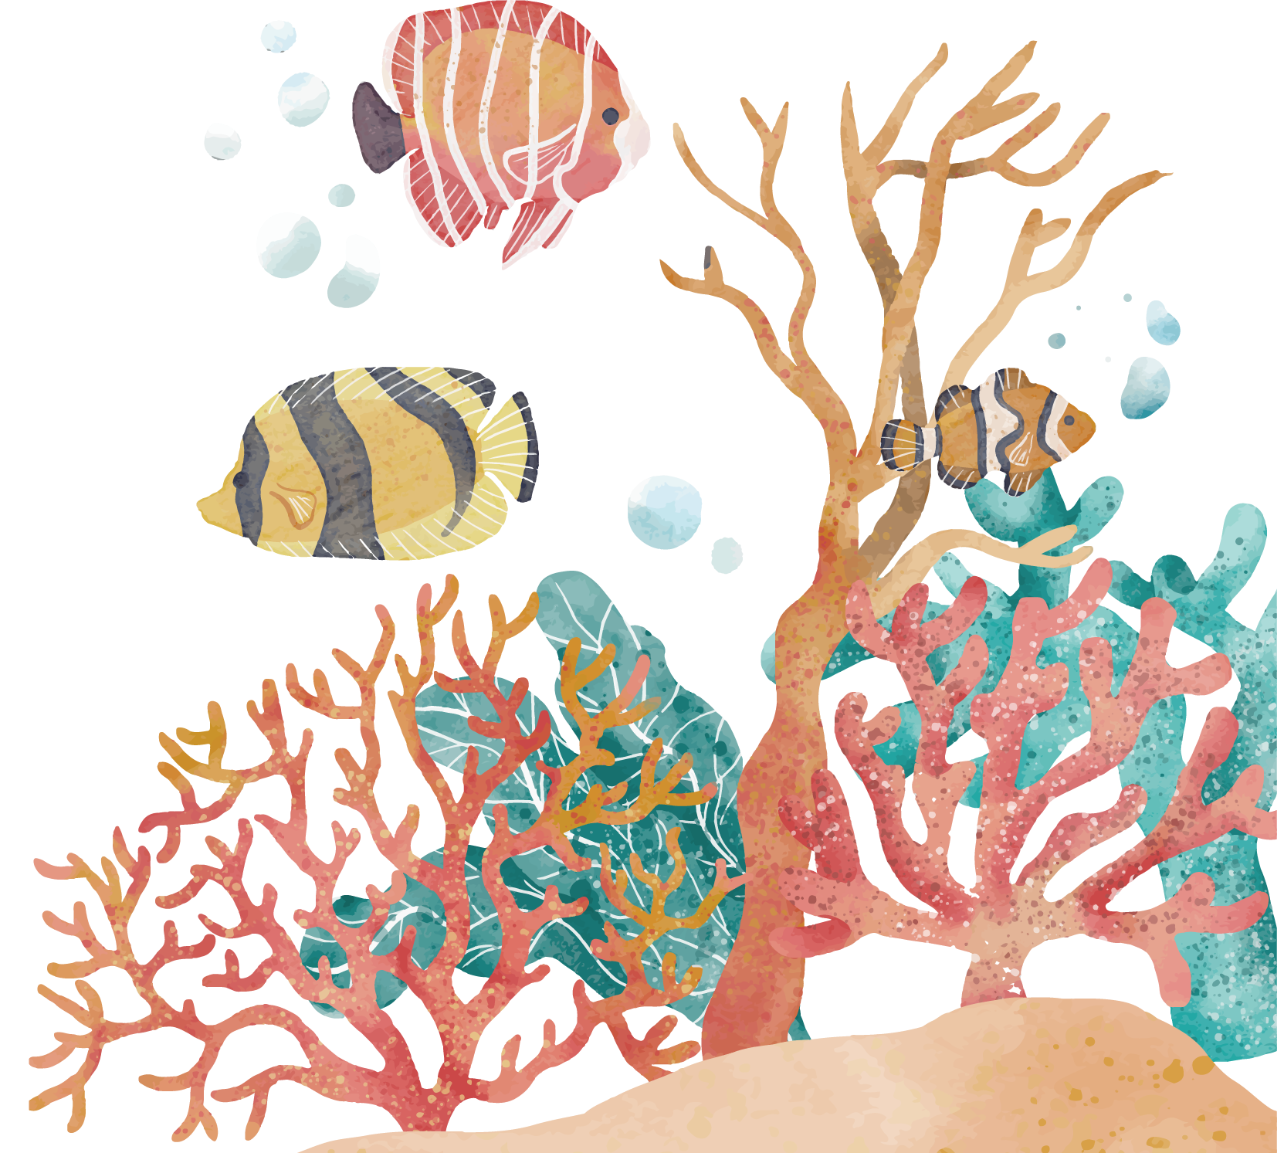
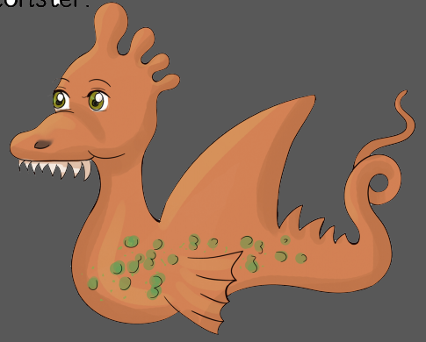
The Sea Monster
Prepared By: T. Masooma Alajmi
ee
ea
Grade 2 – Semester 2 – 2020/2021

Slide 2
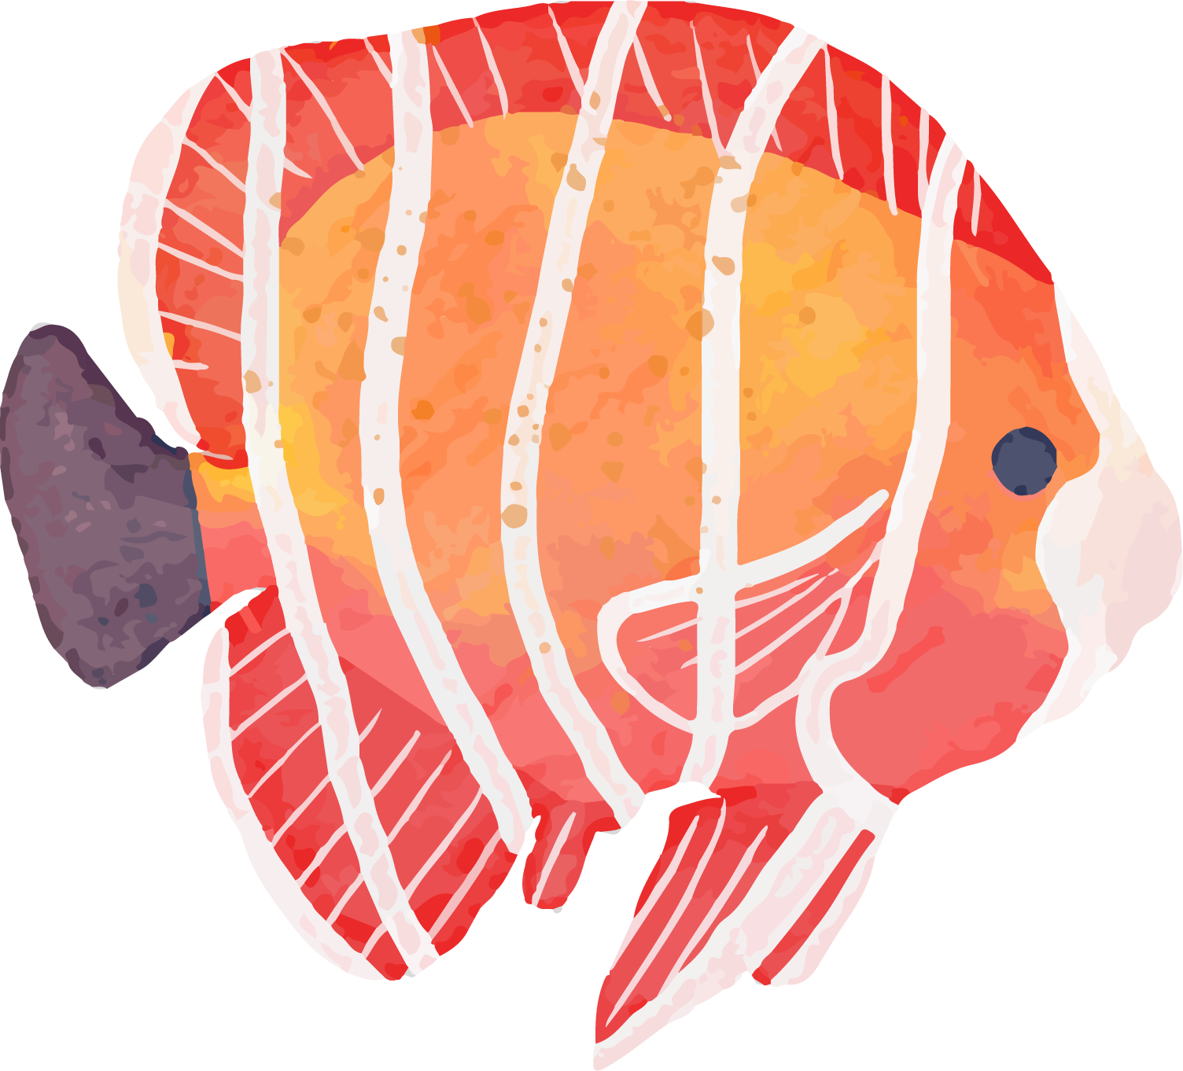
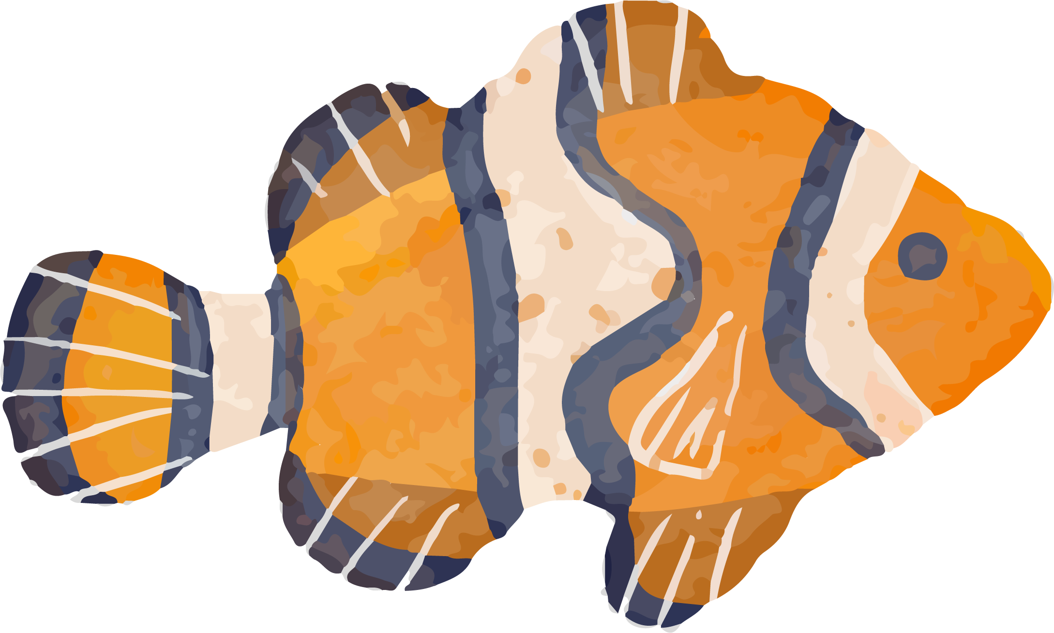
Lesson Timeline
The start of the lesson : 12: 00 p.m. – 12: 02 p.m.
The Lesson with activities: 12: 02 p.m. - 12: 50 p.m.
Note: The H/W will be mentioned after the activities.

Slide 3
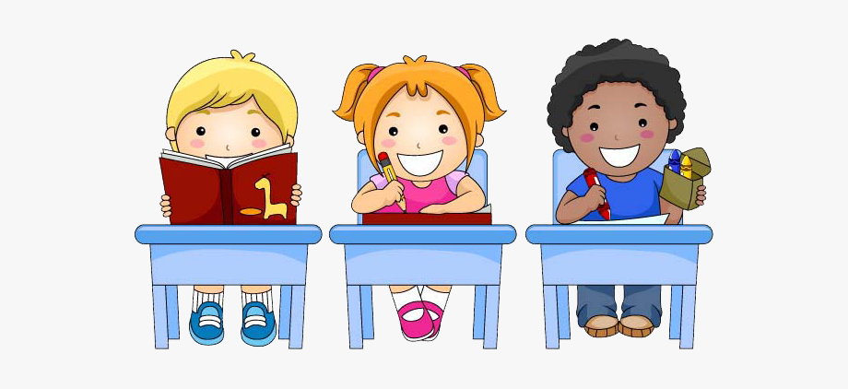
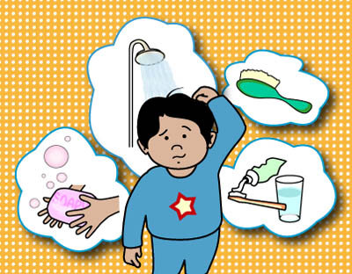
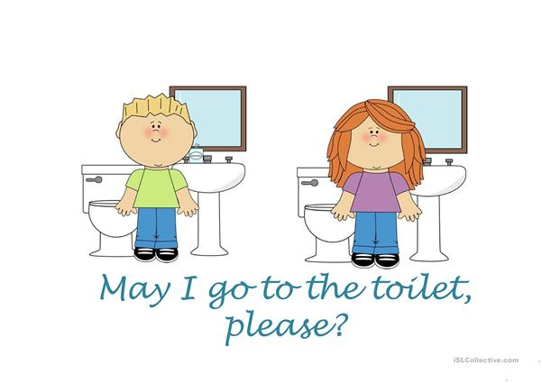
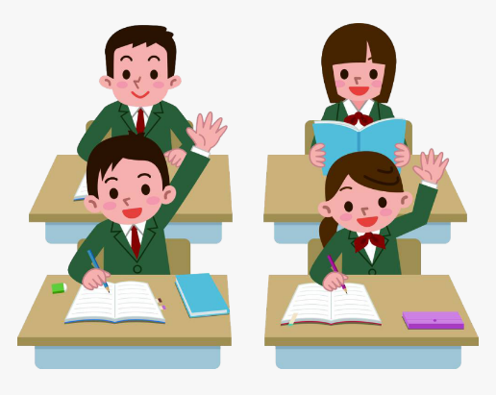
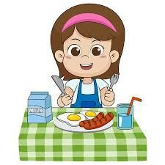
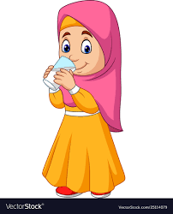
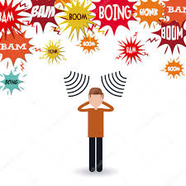
Lesson Rules
I ask for permission to answer.
I attend on time.
I take care of my personal hygiene.
I ask for permission to go to the toilet and to drink water.
I eat food before attending the lesson.
I sit in a quiet place.
I participate during the lesson.

Slide 4
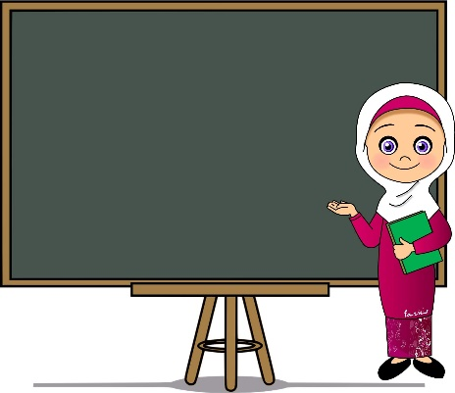
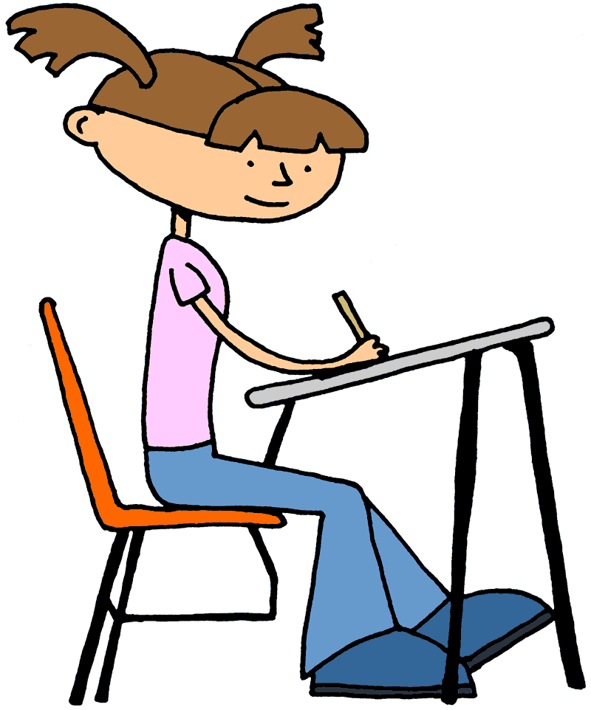
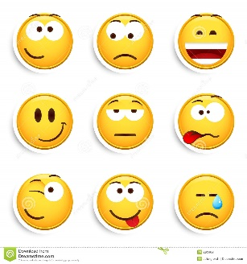
Positive Digital Behaviour
Use the educational platforms approved by the Ministry of Education
Write the proper Arabic
Attend the lesson and submit the homework on time.
Listen to the teacher’s instructions.
Don’t laugh at your classmates and don’t send any expressive stickers

Slide 5
السلوك الرقمي الإيجابي
استخدام
المنصات التعليمية
المعتمدة في
وزارة التربية والتعليم
الالتزام بالحضور
وتسليم الواجبات
حسب الوقت المحدد
عدم إرسال ملصقات
تعبيرية أو الضحك على
الزملاء
الالتزام
بتوجيهات المعلمة
الكتابة باللغة
العربية السليمة

Slide 6
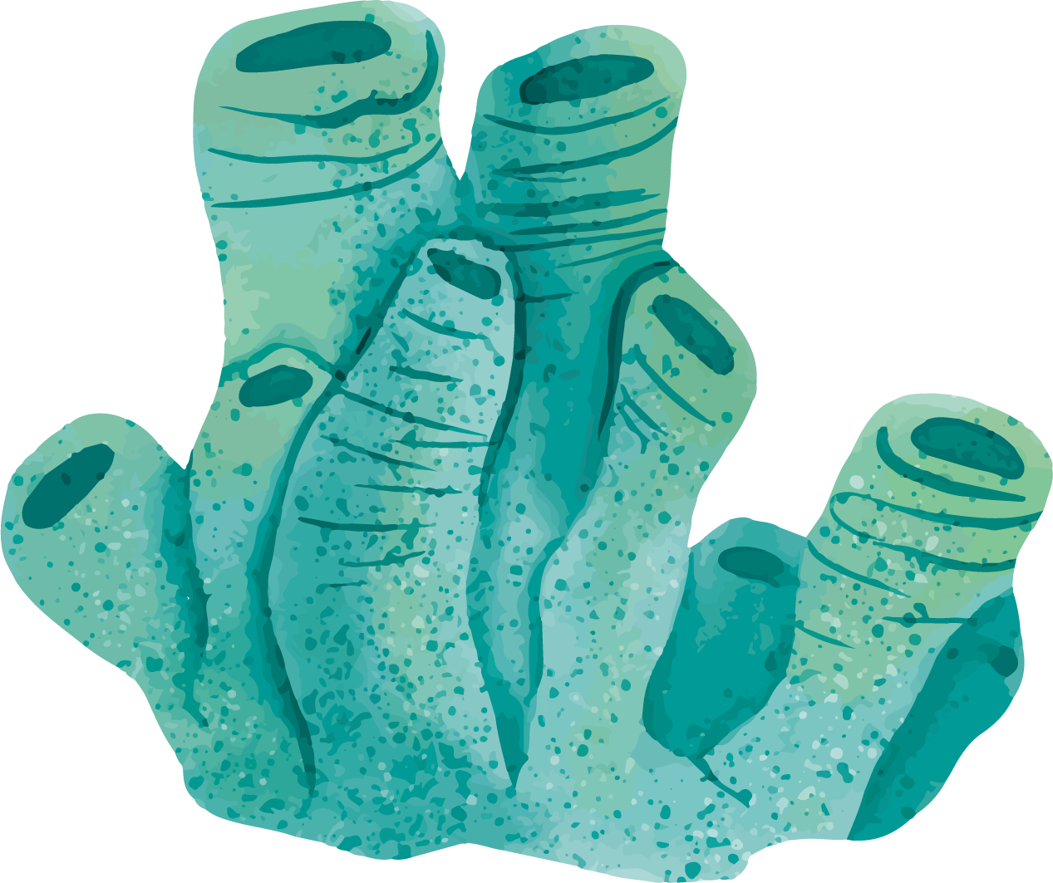
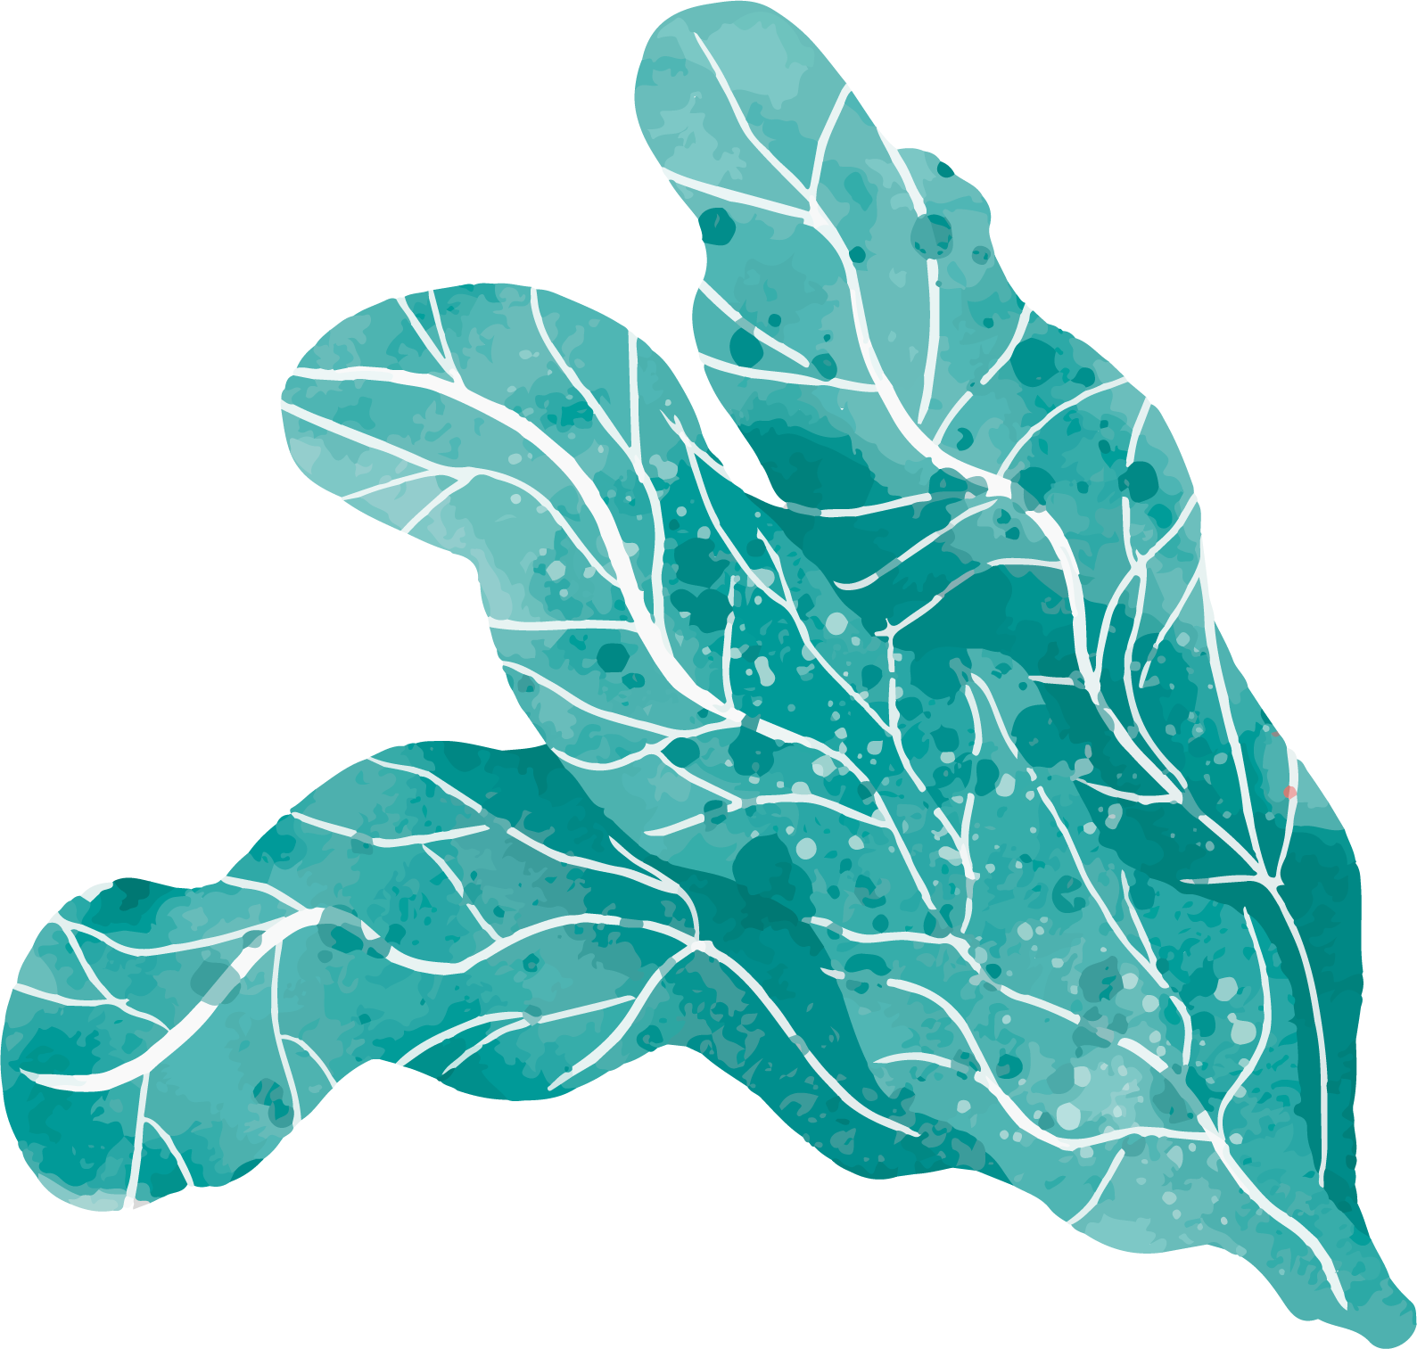
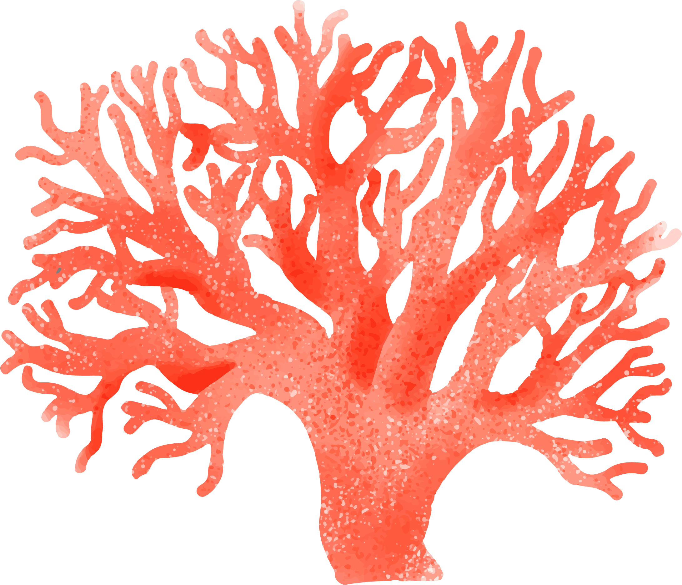
Lesson Aims
identify the alternative spelling ea for the sound ee
read a short text with words containing the alternative spelling.
identify words in the text containing the alternative spelling.
blend and segment words containing the alternative spelling.
1
2
Speaking , Reading & Writing
Reading
3
4
Reading & Speaking
Speaking & Reading

Slide 7
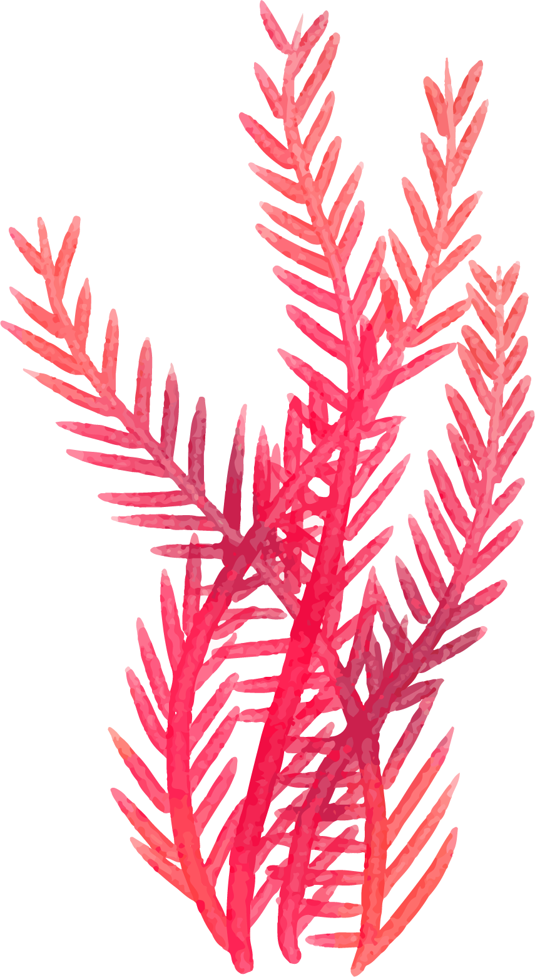
Revision

Slide 8
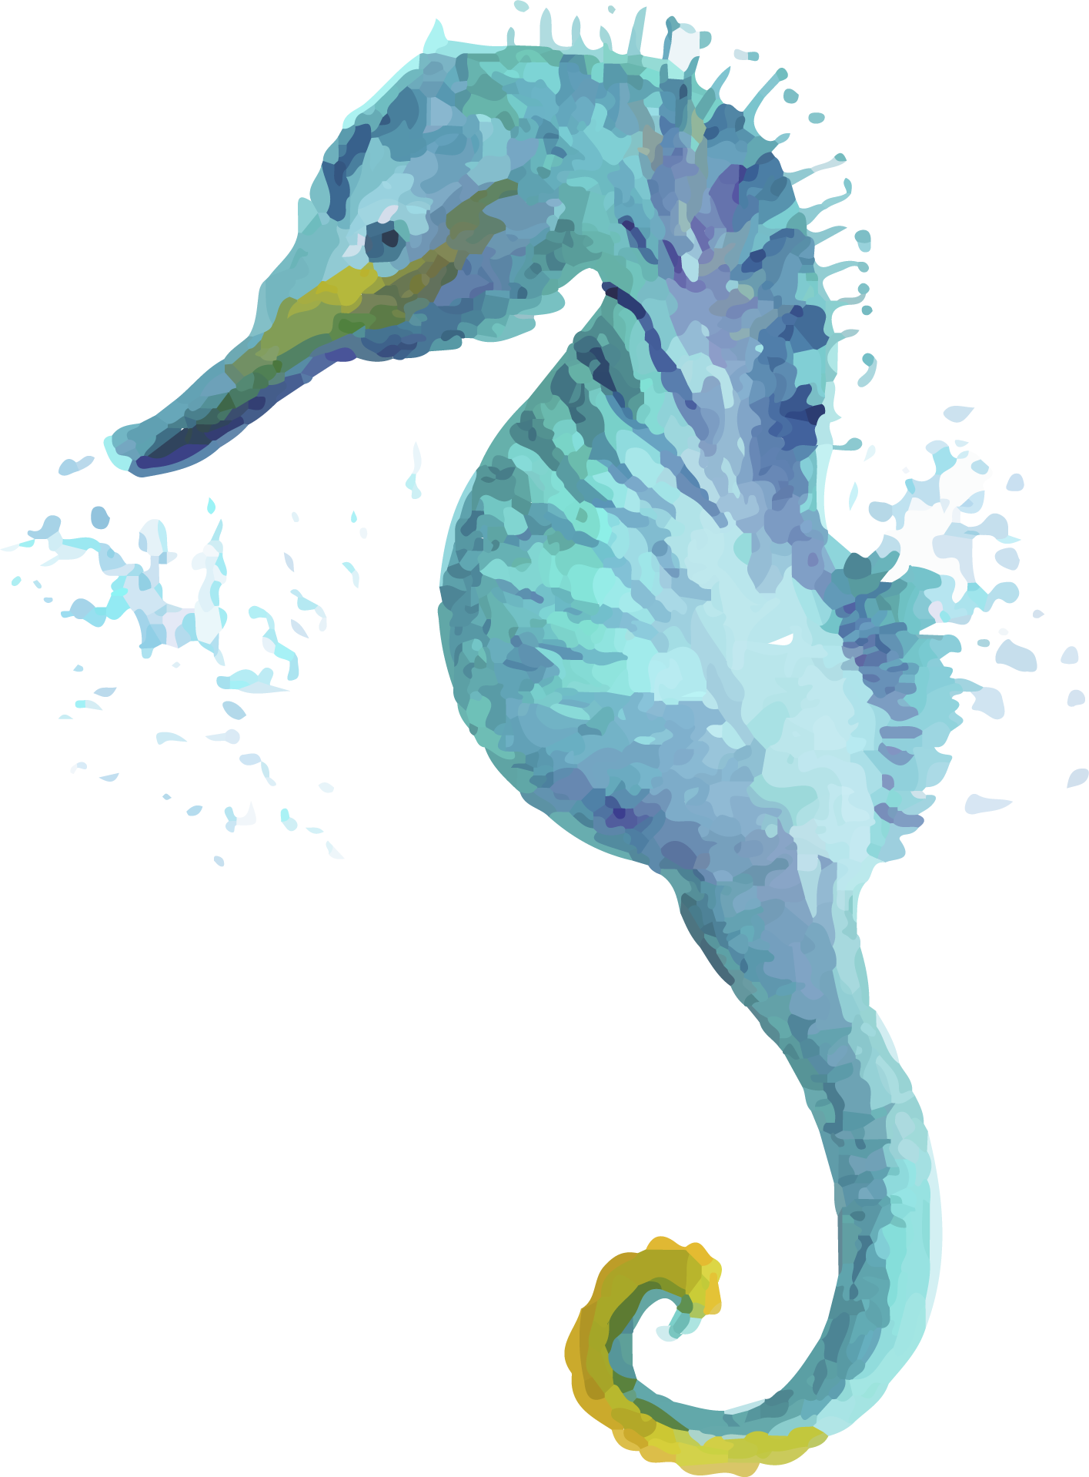
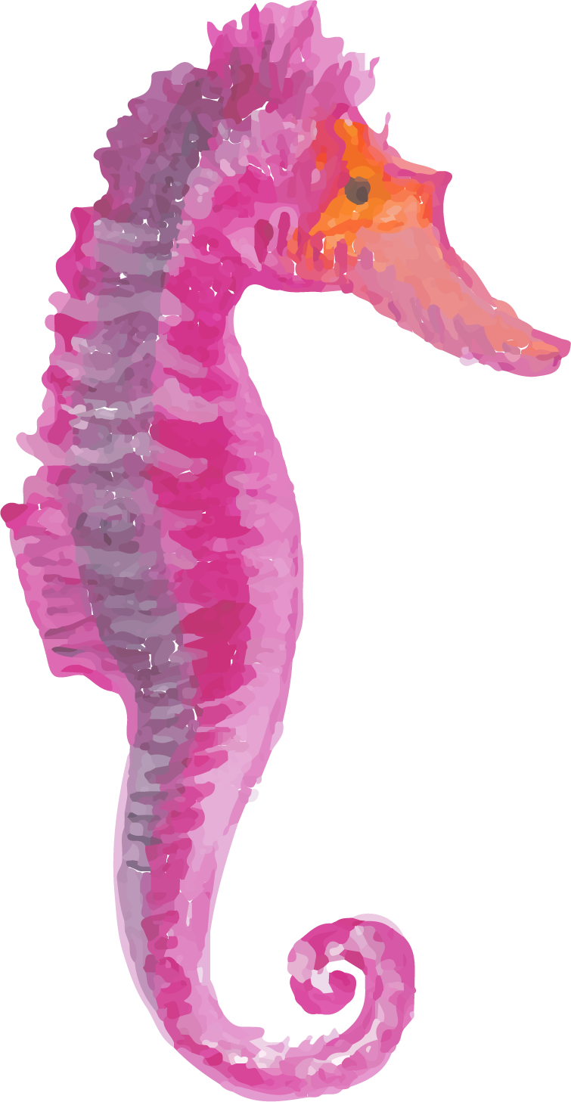
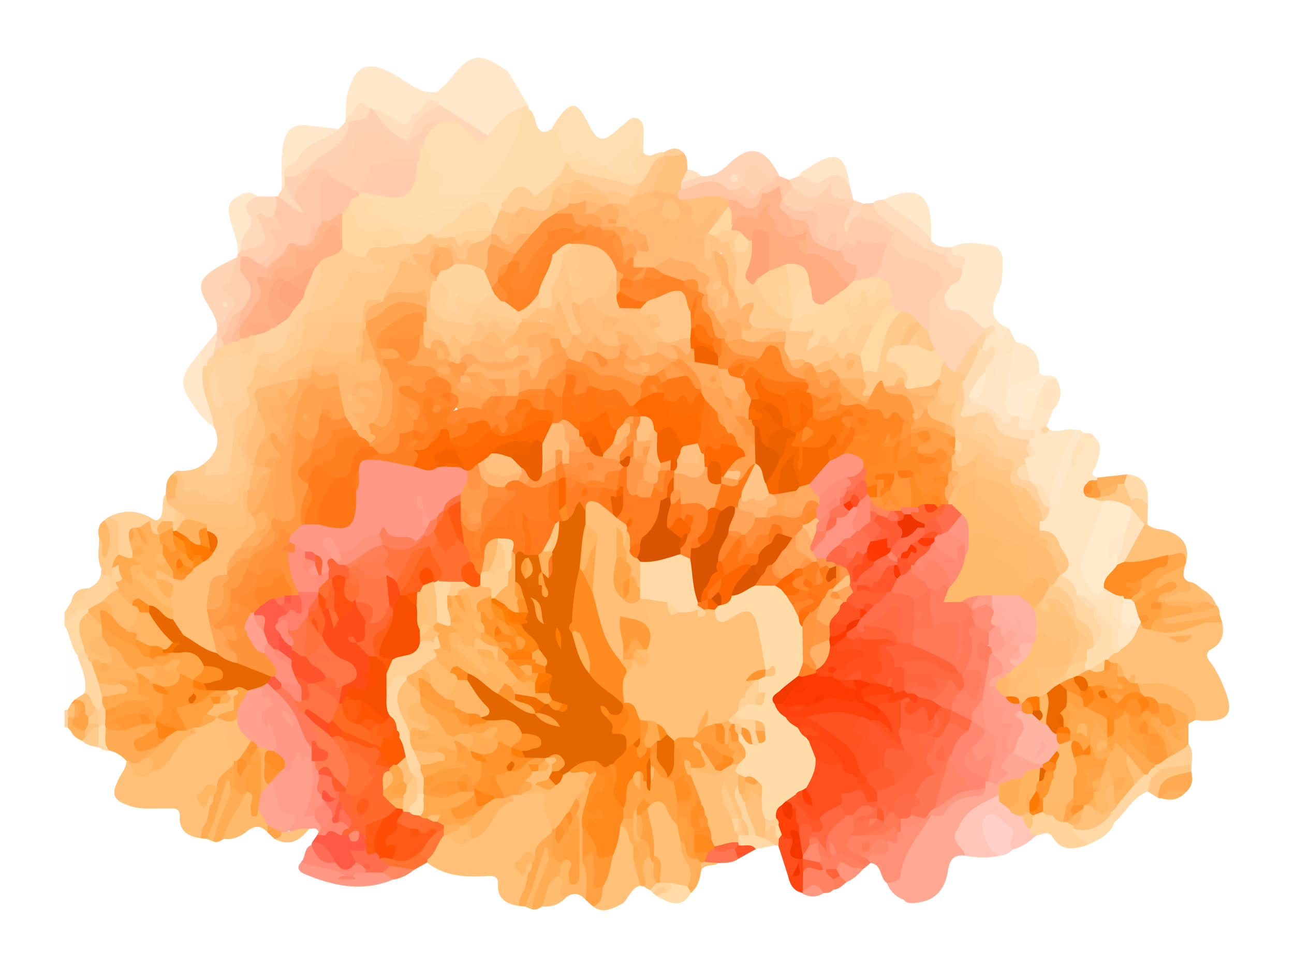
Let us intridouce the alternative spelling(s) of ee
Long Vowel Letter ee/ea - English4abc - Phonics song - YouTube
What are the other words those have /ee/ sound, but they spell in different ways?
Watch the video and tell the teacher.

Slide 9
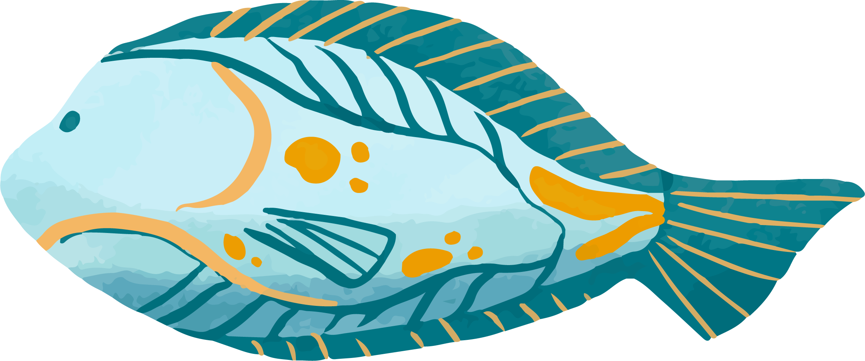
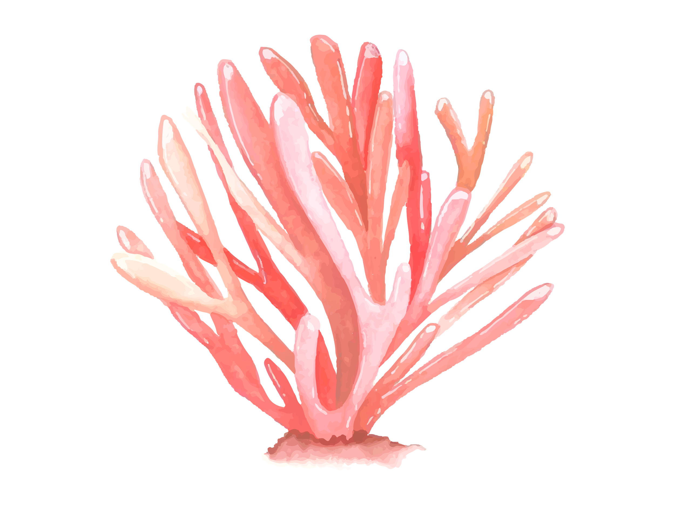
Alternative Spelling(s)
ee
ea
feet
reed
tea
seat

Slide 10
Monster

Slide 11
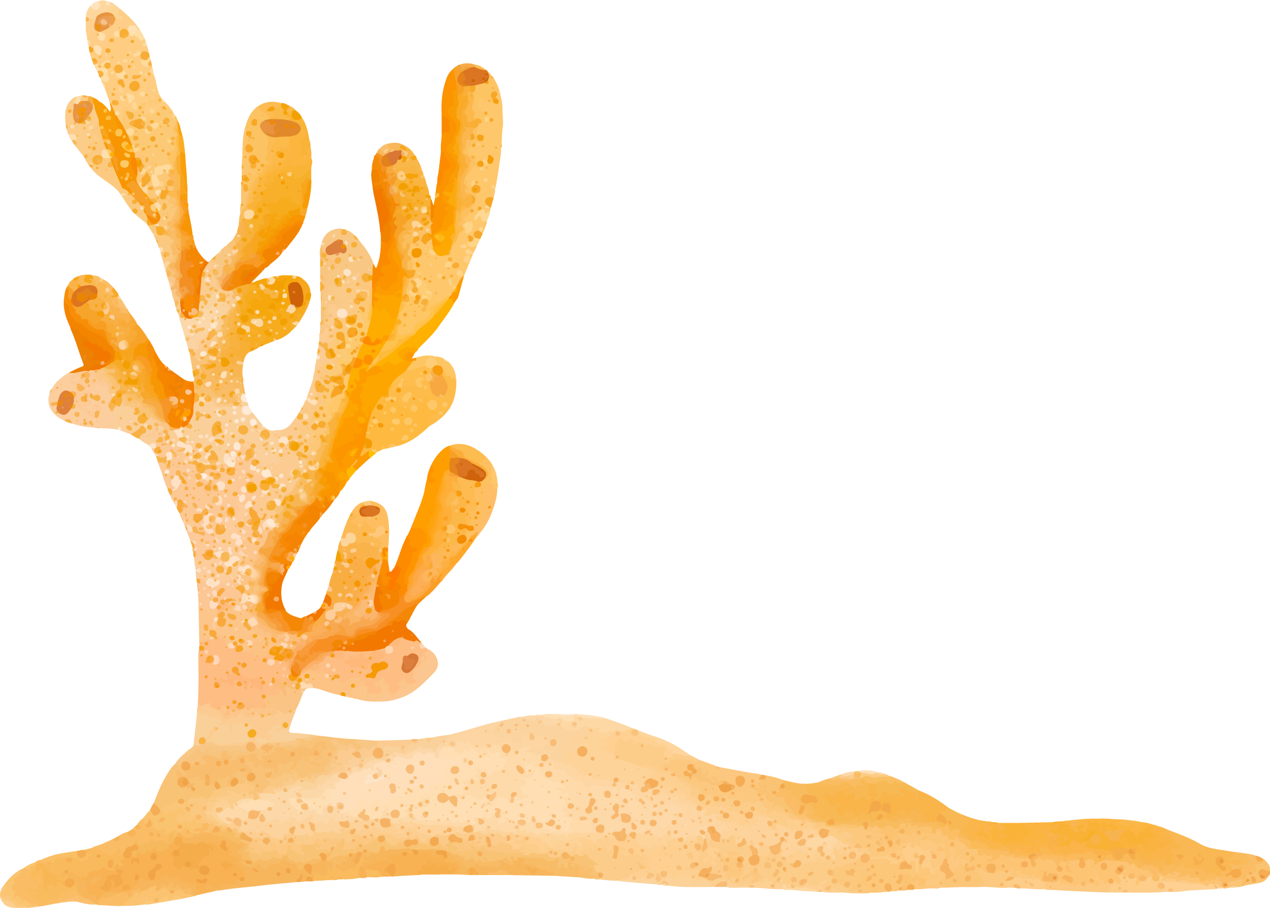
The Sea Monster
Deep under the sea, lives a big sea monster.

Slide 12
The Sea Monster
It has green scales, sharp teeth,

Slide 13
The Sea Monster
a big fin and a tail like a snake.

Slide 14
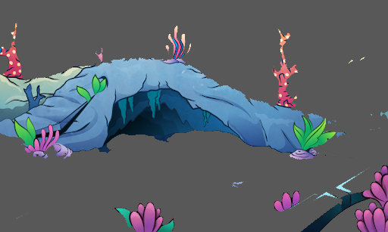
The Sea Monster
It lives in a dark cave.

Slide 15
The Sea Monster
It swims between the seaweed

Slide 16
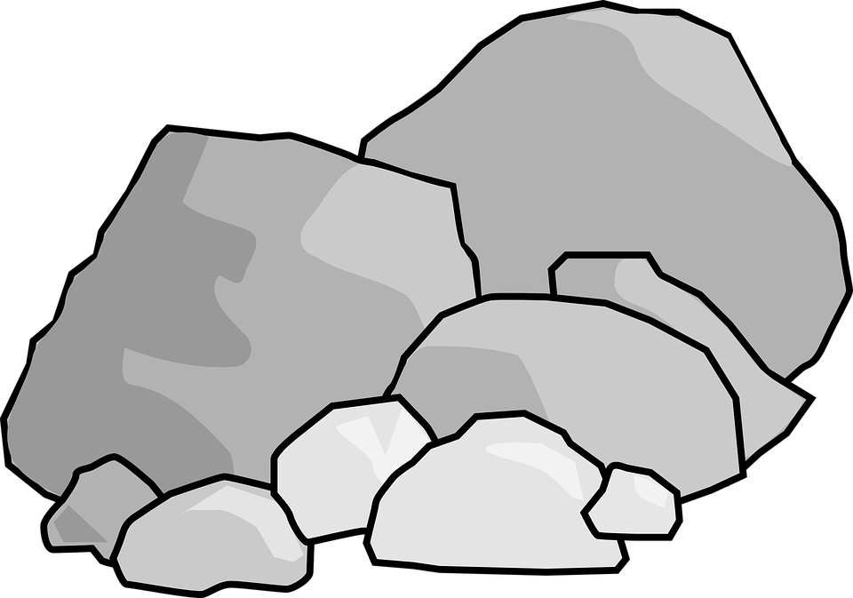
The Sea Monster
and hides under rocks.

Slide 17
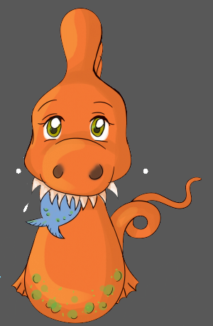
The Sea Monster
When it sees a little fish…… CHOMP!

Slide 18
The Sea Monster
The sea monster eats it in one bite!

Slide 19
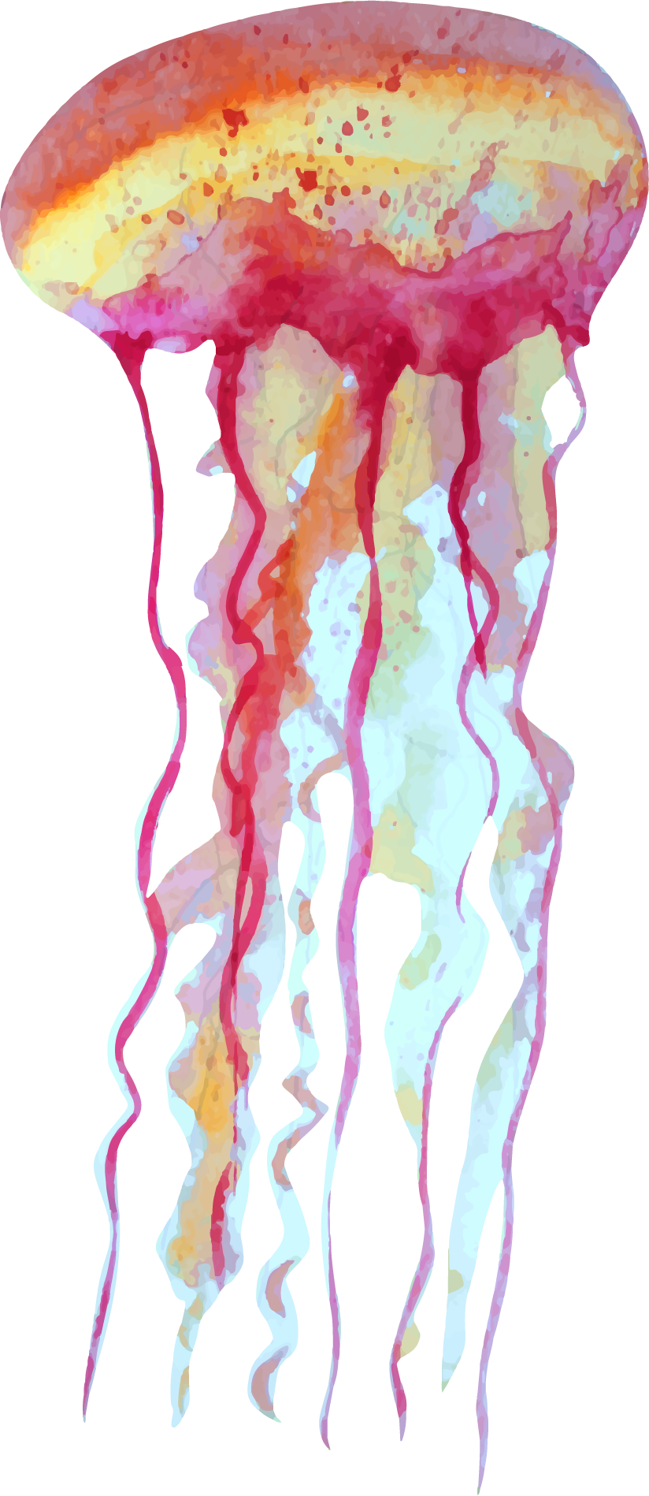
The Sea Monster
ee
ea
Deep under the sea, lives a big sea monster.
It has green scales, sharp teeth, a big fin
and a tail like a snake.
It lives in a dark cave.
It swims between the
seaweed and hides under
rocks. When it sees a little
fish…… CHOMP!
The sea monster eats it in one bite!

Slide 20
Write:
ee | ea
deep | sea
green | eat
teeth – between – weed - see | -

Slide 21
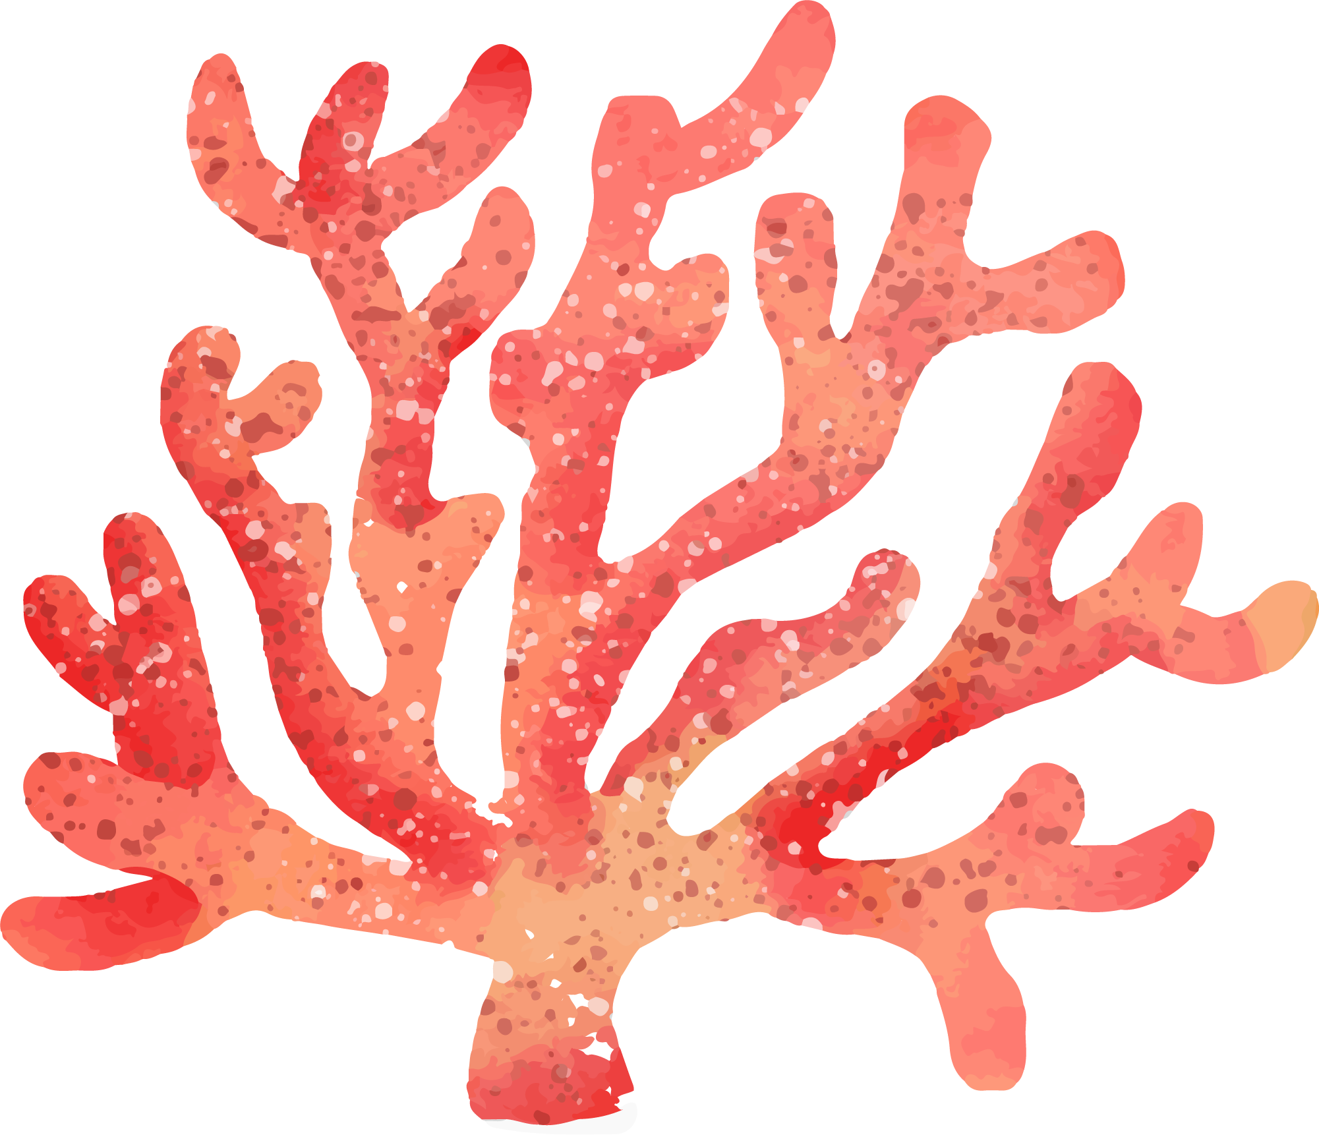
JP Booklet

Slide 22
Activity 1 – Pg. 6
teeth
fin
scales
tail

Slide 23
Tricky Words
Deep under the sea, lives a big sea monster.
It has green scales, sharp teeth, a big fin
and a tail like a snake.
It lives in a dark cave.
It swims between the
seaweed and hides under
rocks. When it sees a little
fish…… CHOMP!
The sea monster eats it in one bite!

Slide 24
Blending
s
ea
sea
This Photo by Unknown Author is licensed under CC BY

Slide 25
Blending
r
ea
d
read

Slide 26
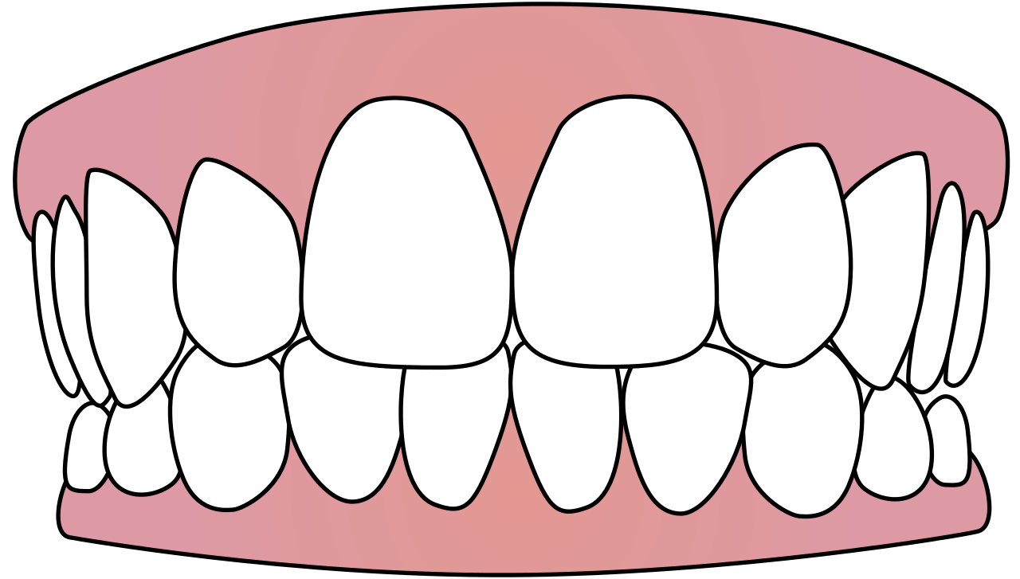
Blending
t
ee
th
teeth

Slide 27
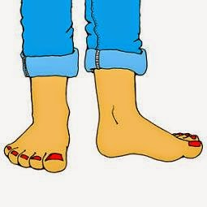
Blending
f
ee
t
feet

Slide 28
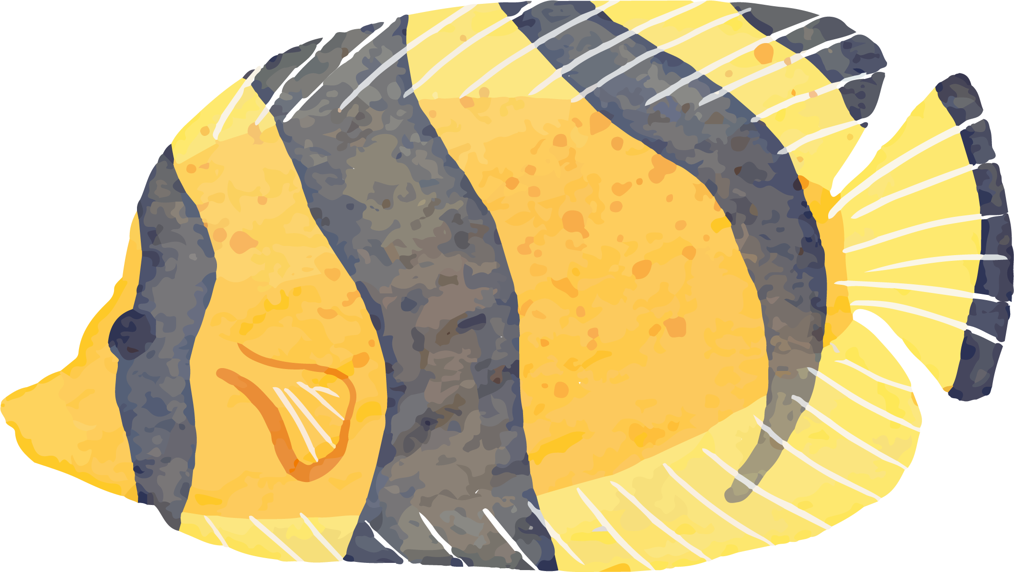
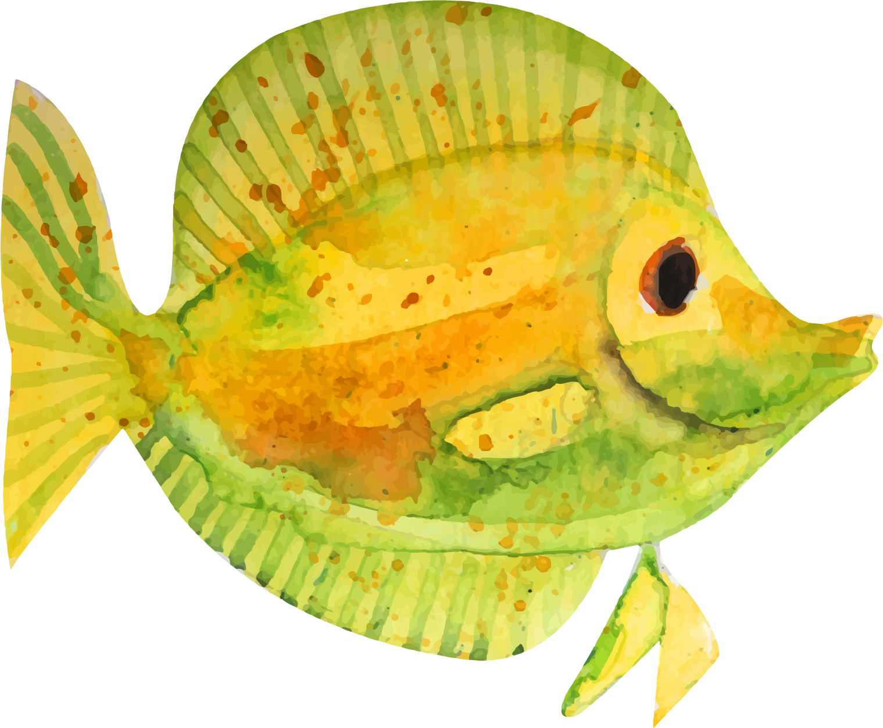
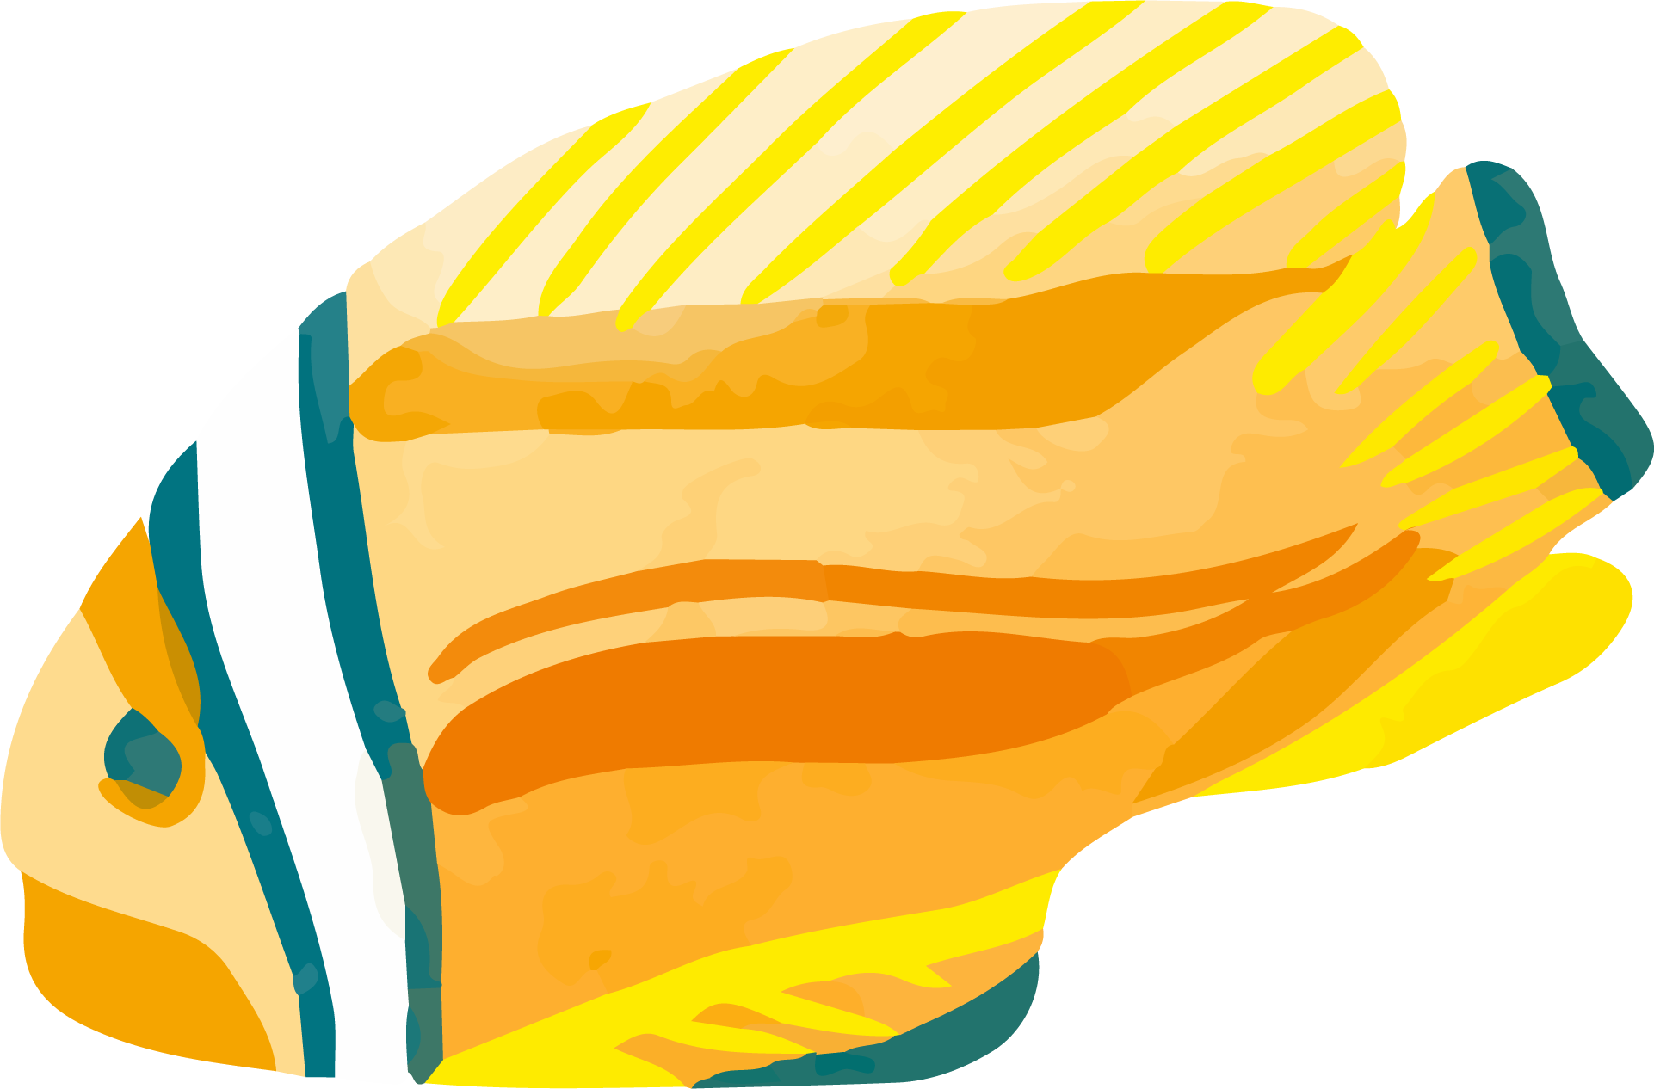
Homework
Phonics Booklet - Activity 2 – Pg. 6

Slide 29
The Activity
Hit words with
ee - ea
https://wordwall.net/play/13653/882/636

Slide 30
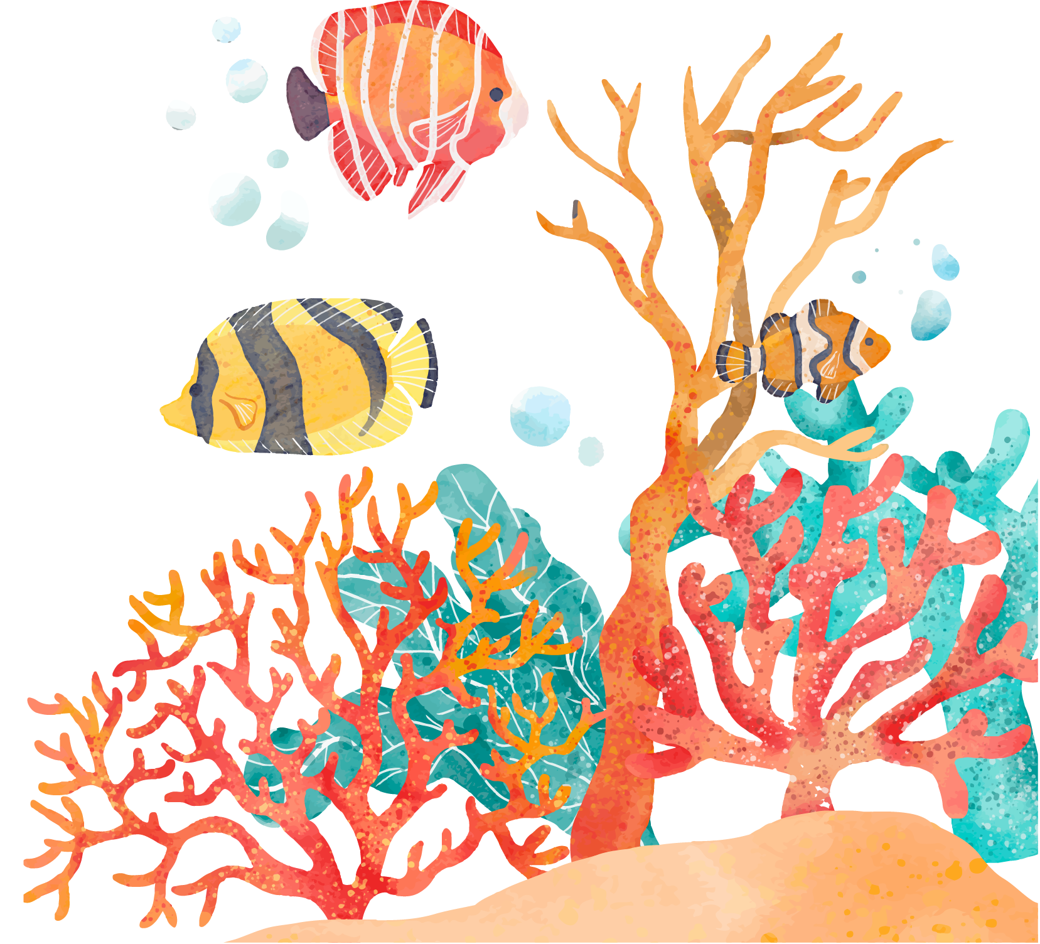
THANKS!

Slide 31
What is hidden behind ?
Click the question box and then click on the cloud to check your answer

Slide 32
ou
mouth

Slide 33
ee
green

Slide 34
er
teacher

Slide 35
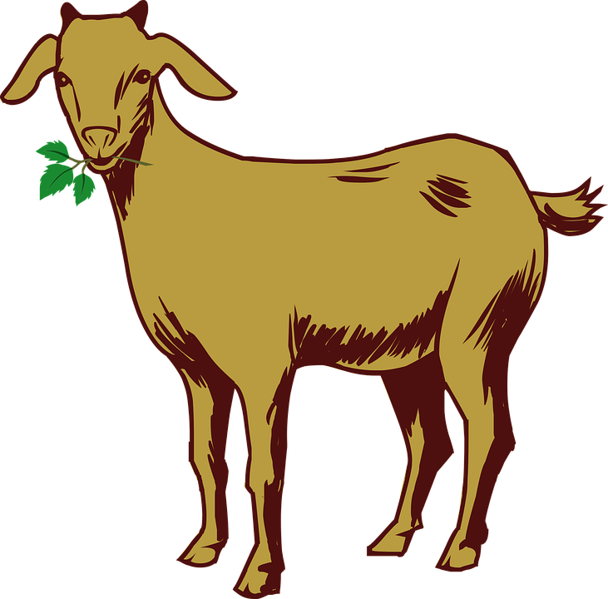
oa
goat

Slide 36
ee
teeth

