Slide 1
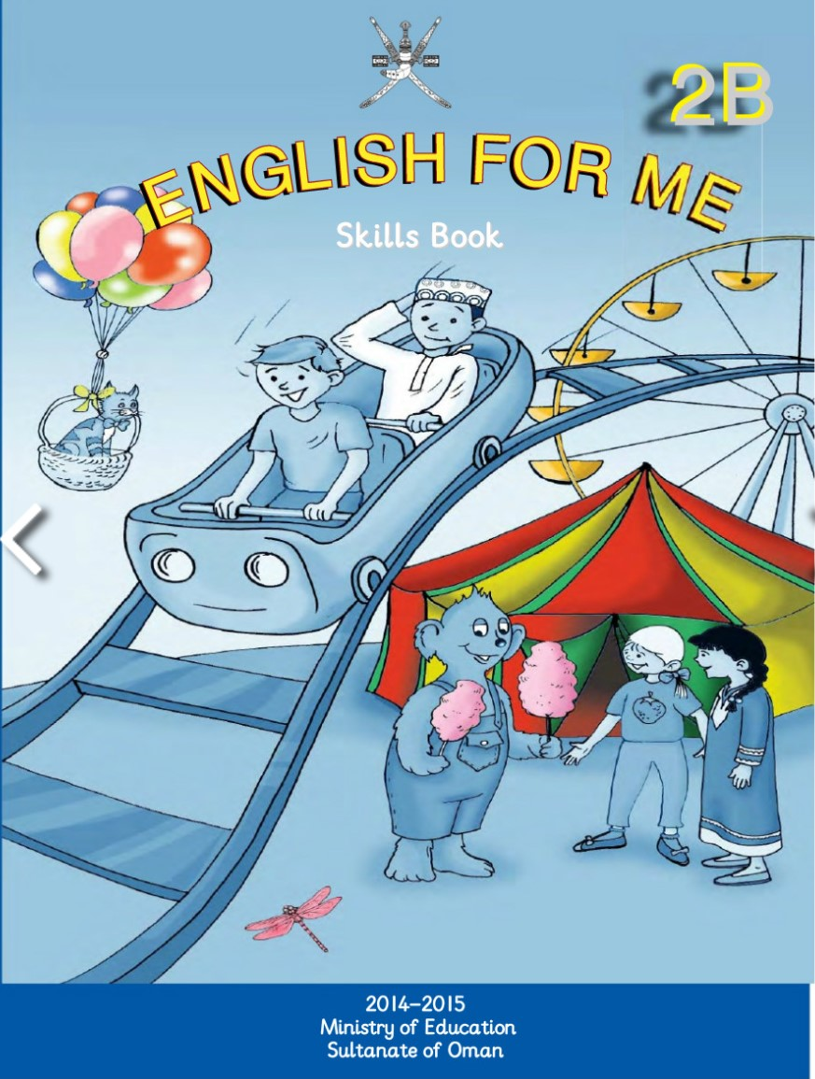
Grade Two
Unit 1: Free time
Semester two
Lesson(5-6)
AL-Ofoq School for Basic Education(1-4)
Done by teacher: Mead AL-qudhi

Slide 2
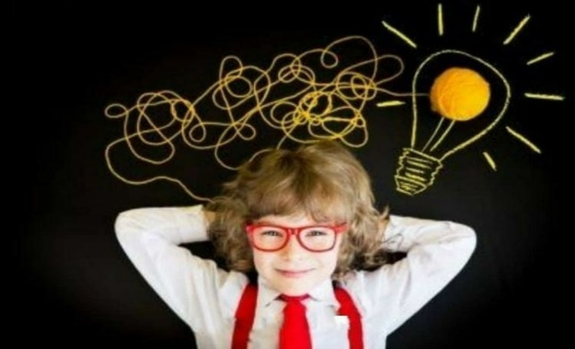
My Online Classroom Rules:-

Slide 3
Sunday
1
Our beautiful day
………….
Monday
2
Tuesday
3
Wednesday
4
Thursday
5

Slide 4
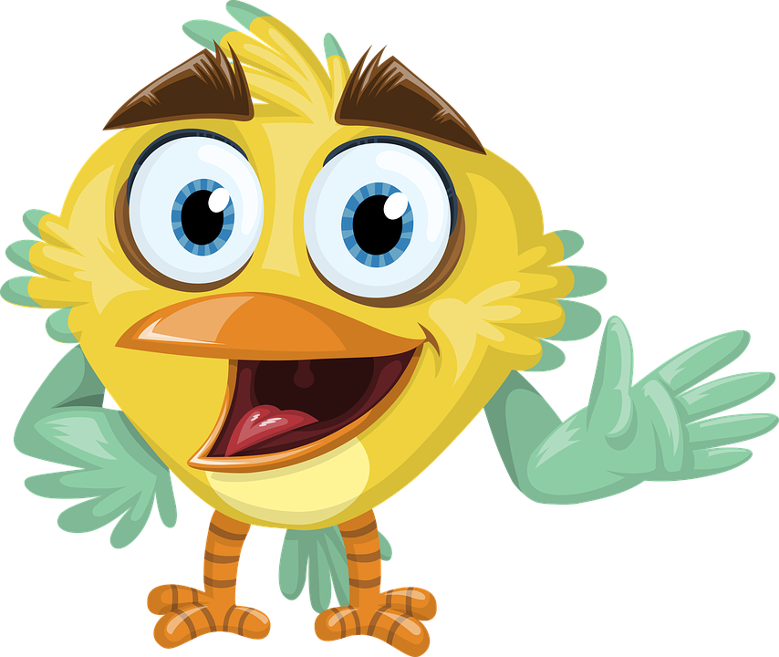
March مارس
Date today
……?
9
10
11
12
13
14
15
16
17
18
19
20
21
22
23
24

Slide 5
Ss will be able to:-
1- listen and join in with the song about letters
2- listen and play game ( I spay with my little eye).
3- identify objects and write the initial letter of the object.
4- read and write the words.

Slide 6
*Let's Play a game:-
https://wordwall.net/resource/11024891https://wordwall.net/resource/11024891

Slide 7
Now let’s watch a video about ABC:-

Slide 8
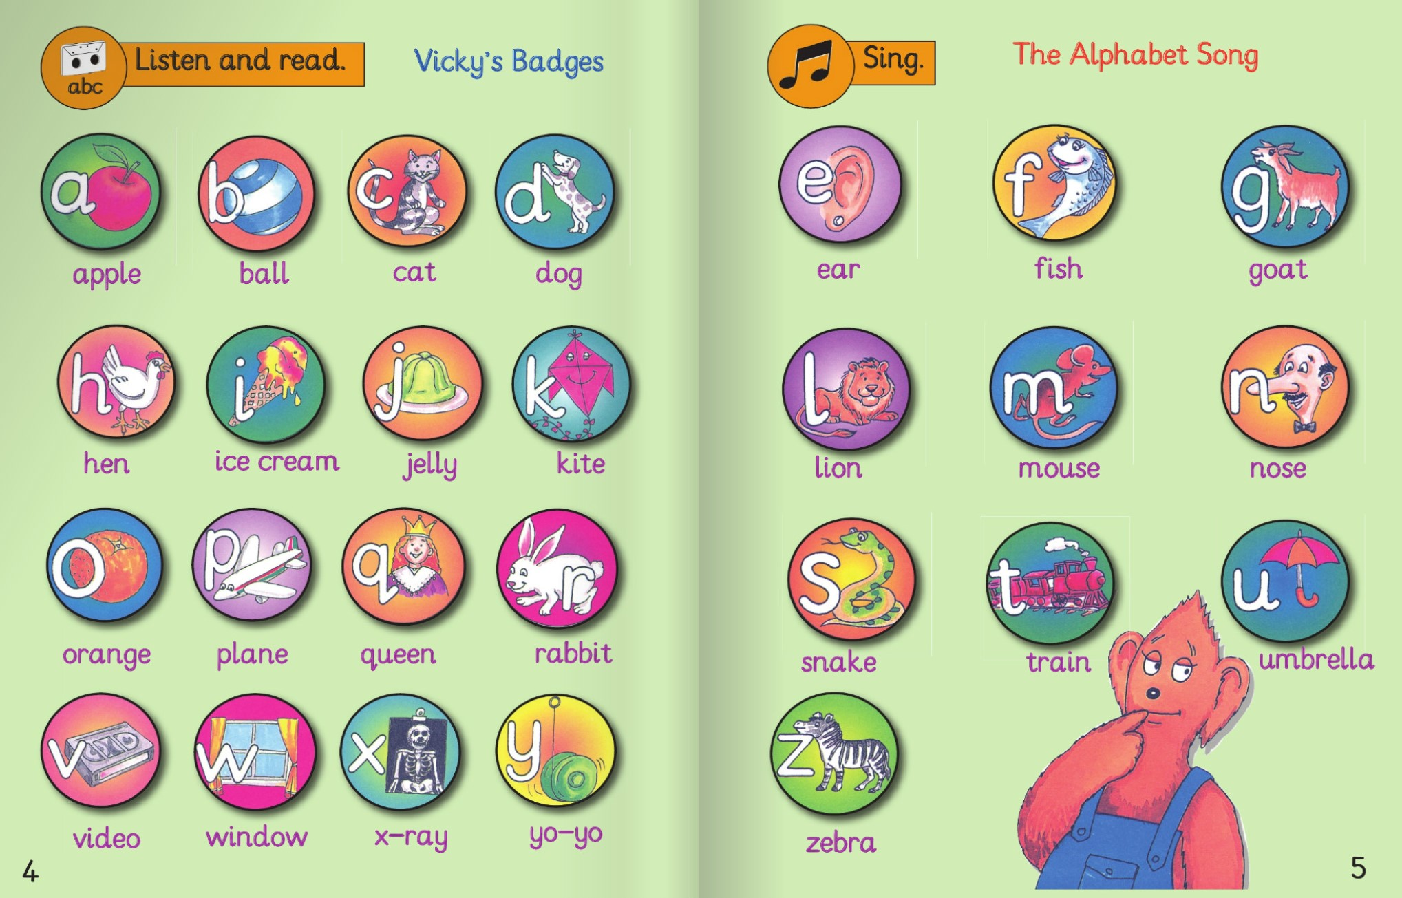
Listen and point to the letter:-

Slide 9
umbrella

Slide 10
ice cream

Slide 11
ball

Slide 12
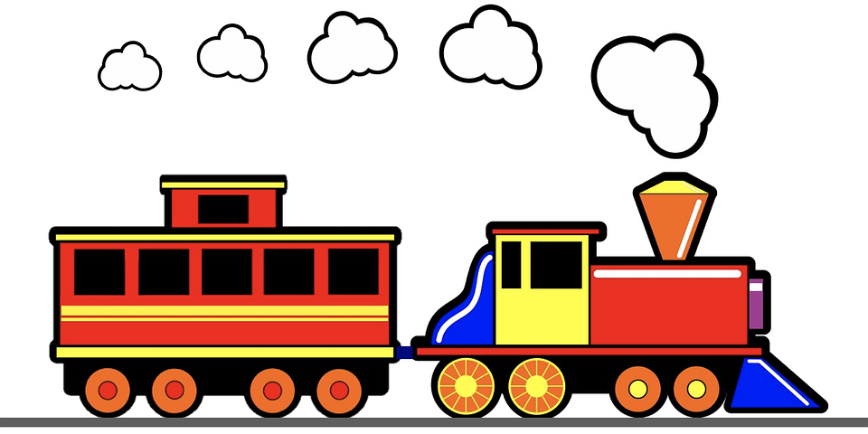
train

Slide 13
jelly

Slide 14
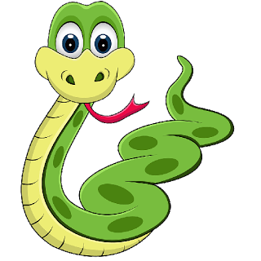
snake

Slide 15
duck

Slide 16
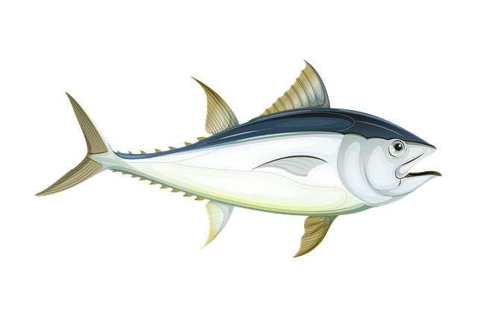
fish

Slide 17
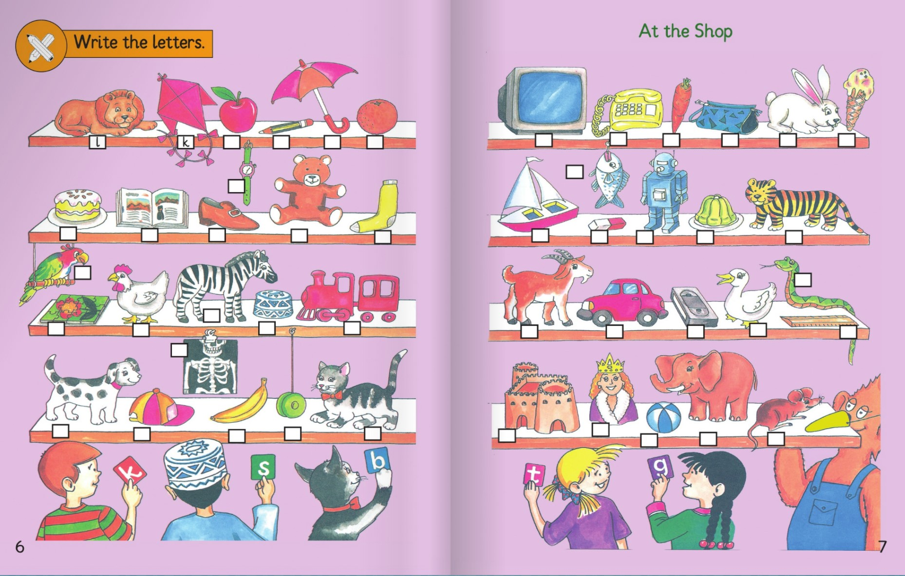
Open your class book page 6 – 7 :-

Slide 18
What is it?
It is a
lion
It is a
sock
It is a
hen
It is a
Yo-yo

Slide 19
*Name each item in the shop and write the first letter of each word in the boxes:-
a
p
u
o
t
t
c
p
r
i
w
f
c
b
s
t
s
b
r
r
j
t
p
s
z
c
j
h
t
g
c
v
d
r
x
d
c
b
y
c
f
q
b
e
m

Slide 20
1- Find a toy on the first shelf.
2-Find two toys on the second shelf.
3- Find three toys on shelf three.
4- Find two toys on the last shelf.
a kite
a teddy bear
a robot
a puzzle
a train
a car
a yo-yo
a ball

Slide 21
* Now lets hear Paul and Sami play a game of (I spy with my little eye):-

Slide 22
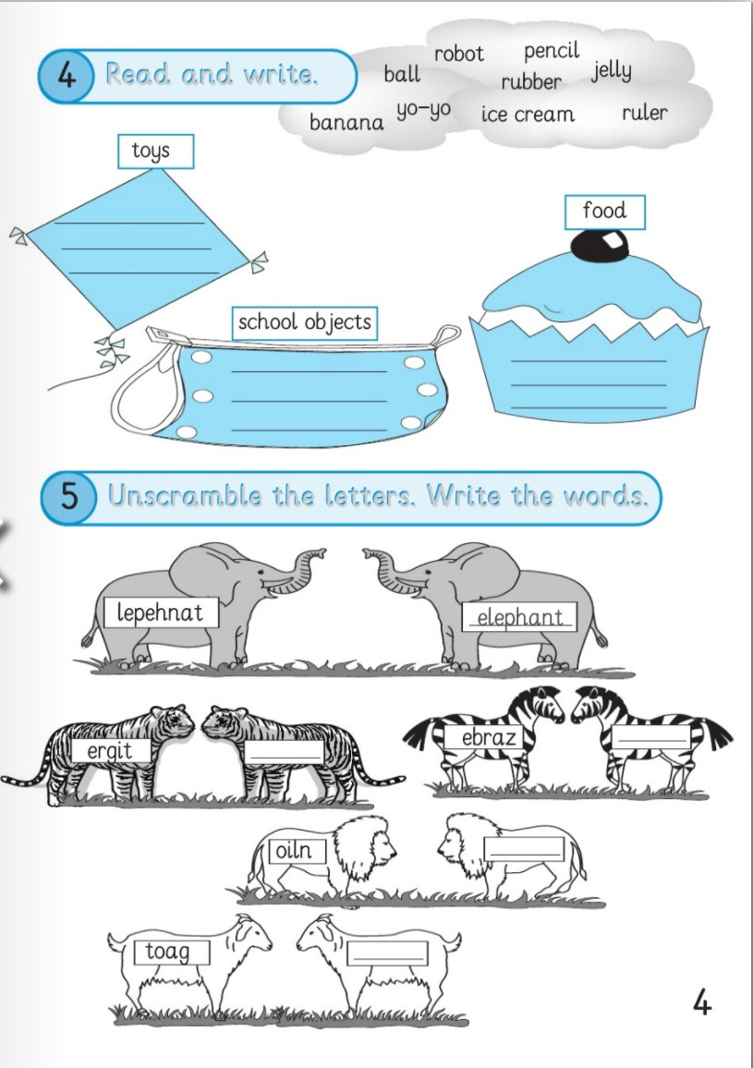
Open your skills book page ( 4 ) activity 4:-

Slide 23
https://www.liveworksheets.com/2-vc673353oe

Slide 24
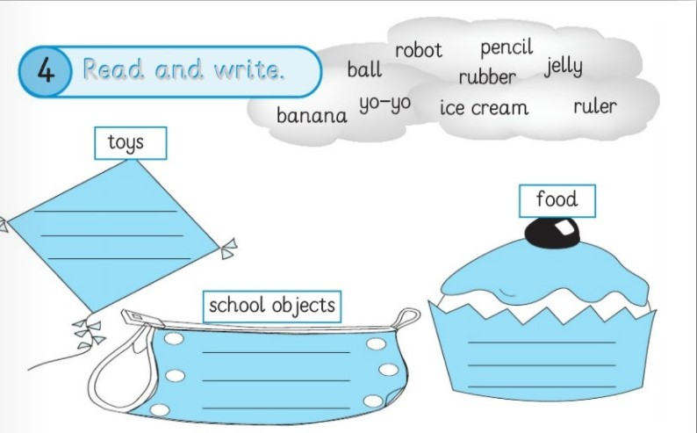
robot
ball
yo-yo
jelly
pencil
banana
rubber
ice cream
ruler

Slide 25
Homework:-
z
e
b
a
r
r
t
g
e
i
i
n
l
o
o
t
g
a

Slide 26
Thank you…
Thank you..

