Slide 1
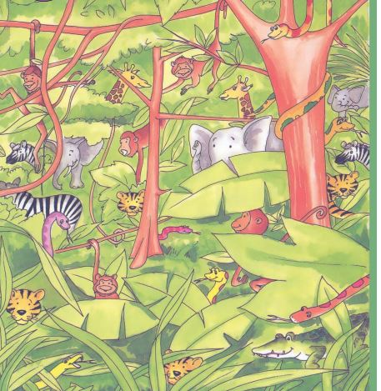
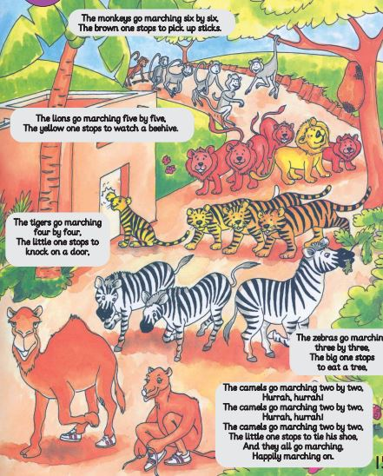
English for me
Unit 2 b
Animals
Lesson 6-8
Grade Two

Slide 2
Lessons Rules
Turn off the microphone
Listen to the teacher
Turn off the camera

Slide 3
Objectives
Ss will be able to:
1- Identify body part that do not belong to animals.
2- Write body part .
3- Contrast animals abilities.
4- Talk about actions animals can and cant do.
5- Read whole sentences.
6- Understand the morals of a story
-

Slide 4
Warm up
Animal song
https://youtu.be/30ePPeUbwSs
Animal song
https://youtu.be/wCfWmlnJl-A

Slide 5
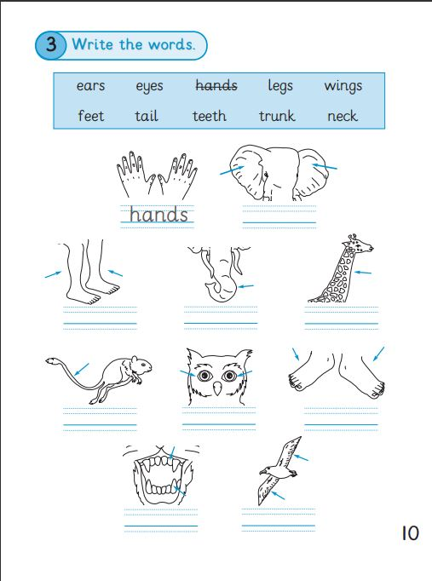
SB. P10
ears
legs
trunk
neck
tail
Feet
eyes
teeth
Wings

Slide 6
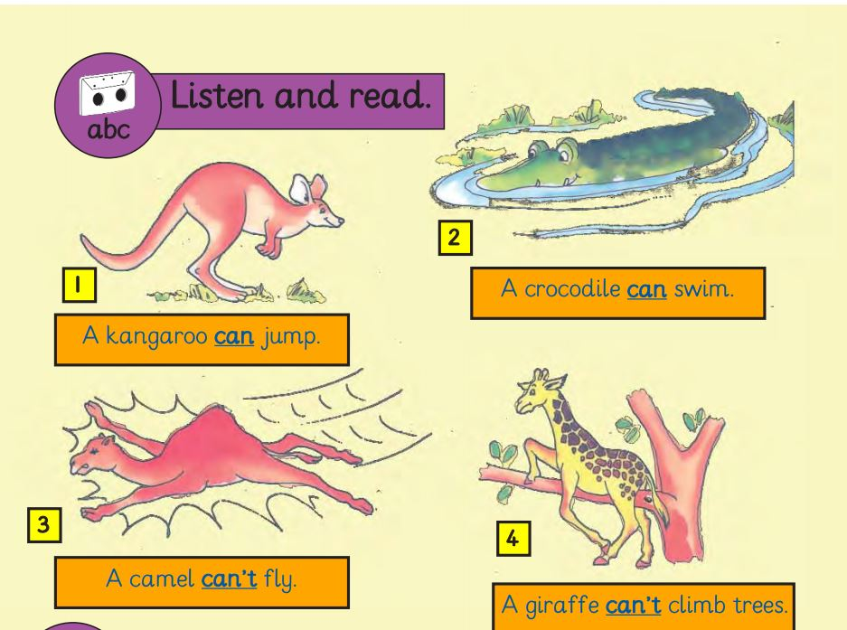
listen
CB.P 16

Slide 7
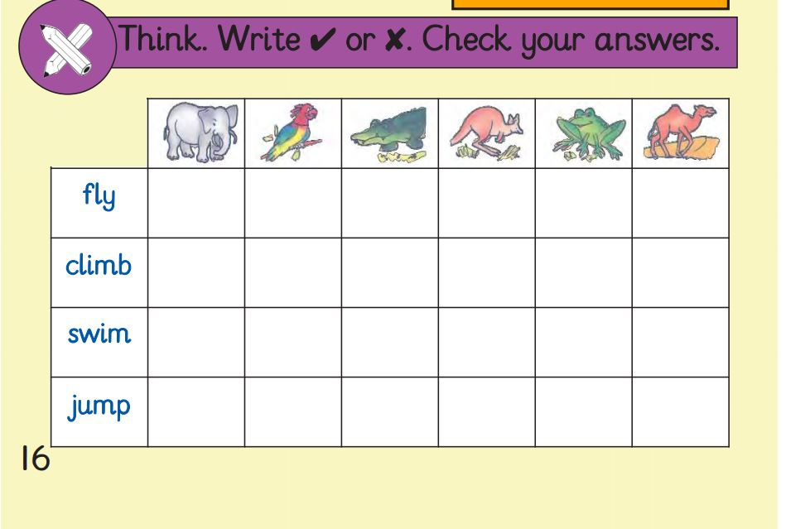
Write:
Can
Or
can’t

Slide 8
Check your
answers
By listening to Biff _ CB .P.16

Slide 9
Listen to the story
https://youtu.be/eMXmMHVNx4U

Slide 10
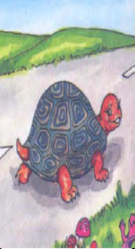
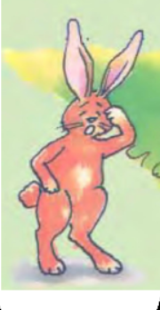
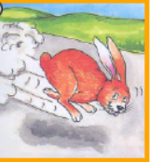
New words
tortoise
hare
fast
slow

Slide 11
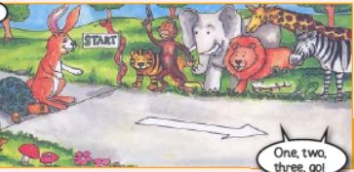
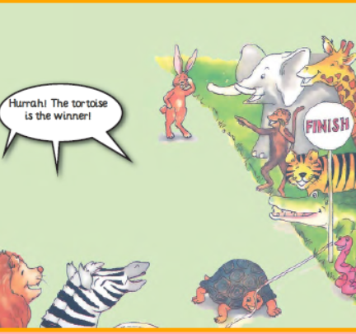
start
finish

Slide 12
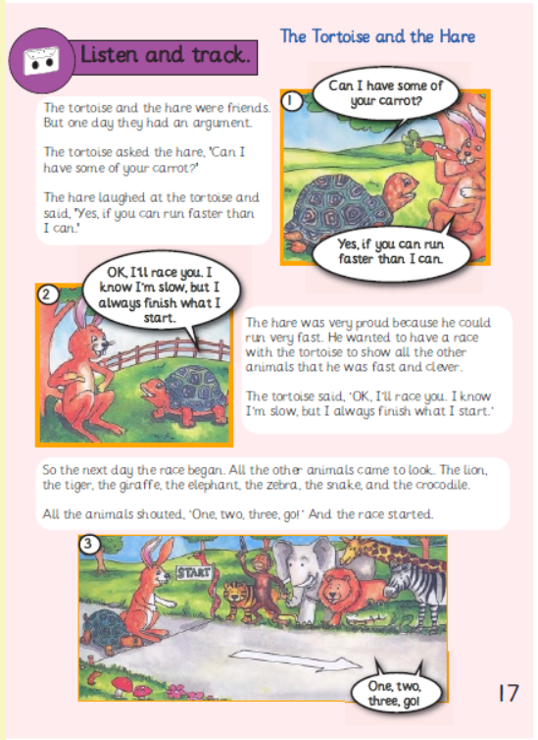
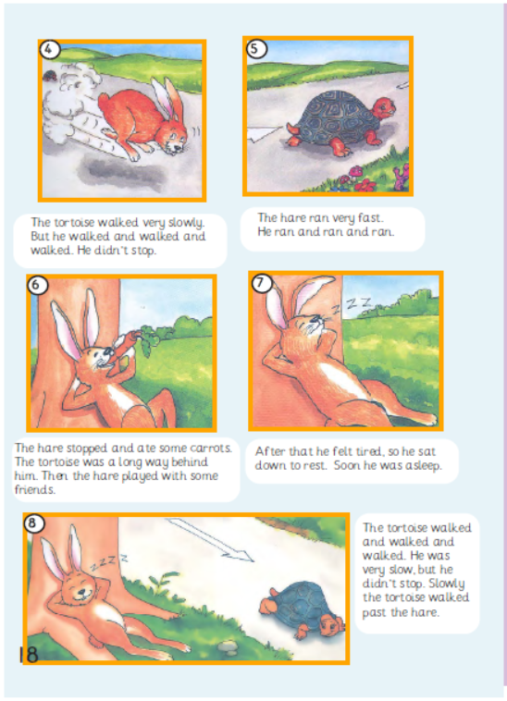
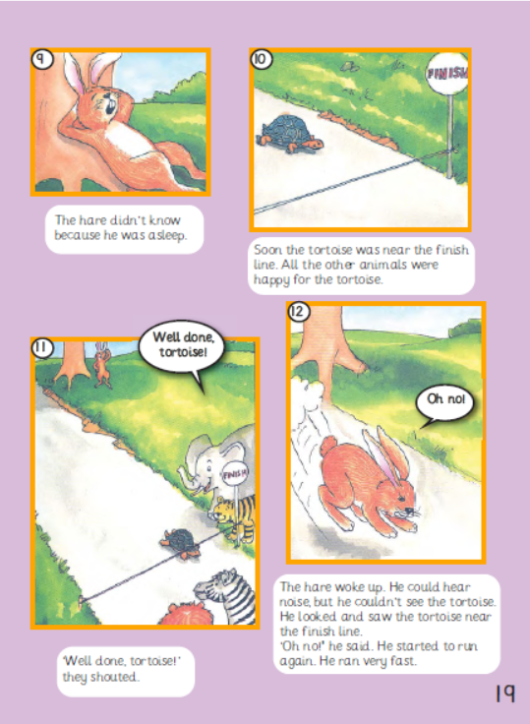
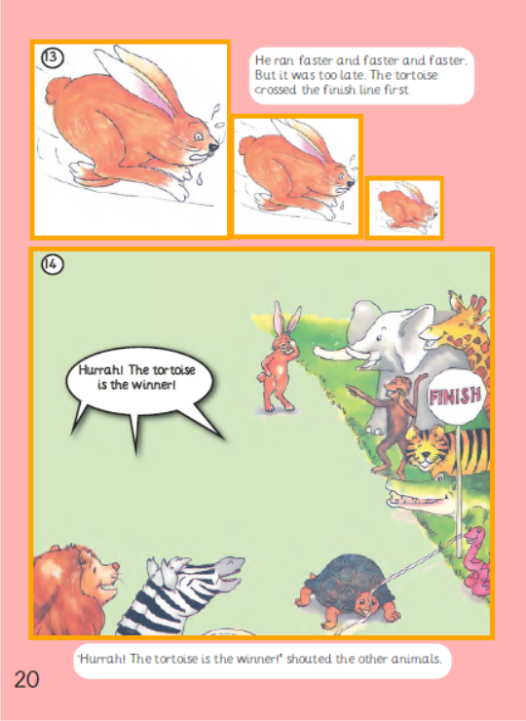
Now look at the story and listen

Slide 13
Skills Book

Slide 14
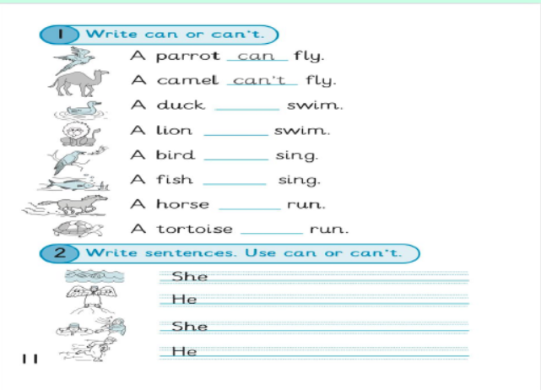
H.W - P.11

