Slide 1
Sultanate of Oman
Ministry of Education
Grade two
Jolly phonics
Magic e

Slide 2
Lesson Aims:
Students will be able to:
Revise the sounds ai ,ie, oa and ue.
Recognize words containing magic e.
Blend and read words spelt with a-e, i-e, o-e and u-e.
Distinguish between long and short vowels in words.
Read and correctly pronounce words spilt with a-e, i-e, o-e and u-e.
Complete tasks on phonics booklets.

Slide 3
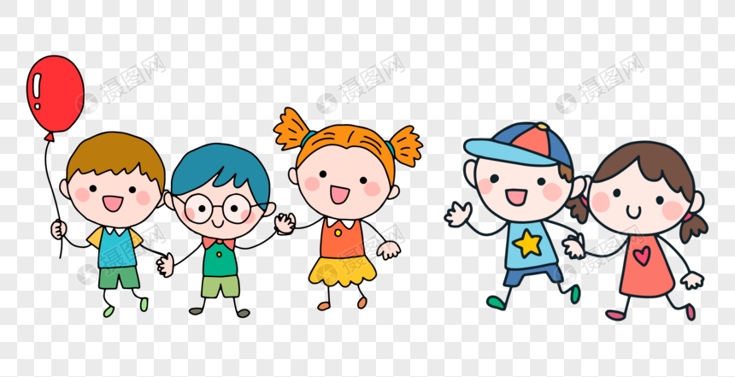
Warm-up
(
Open the link
https://www.youtube.com/watch?v=WsiRSWthV1k

Slide 4
revise the letter sounds
Tell me what are these sounds?
oa
ie
ai
ee
ue

Slide 5
introduction to magic e
tap
Read this word
tape
We call it the magic e
When we add e at the end of the word the a sound change to ai sound

Slide 6
tape
ai

Slide 7
The magic e change these short vowels to long vowels
a
ai
u
ue
i
ie
o
oa
e
ee

Slide 8
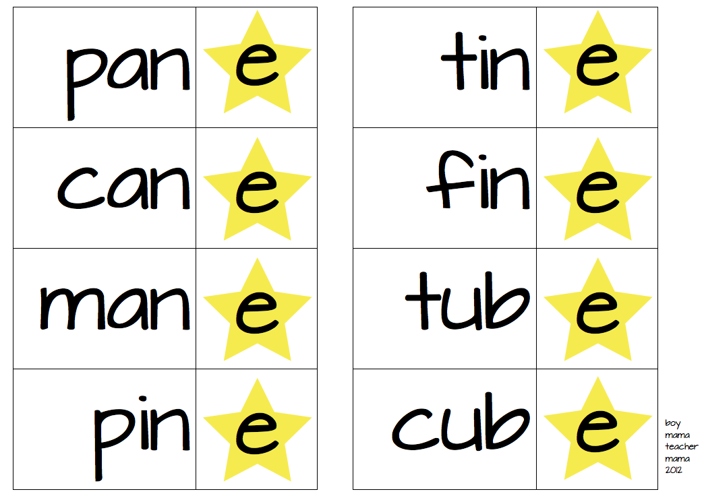
Read these words

Slide 9
This short video will help you more… enjoy it
https://www.youtube.com/watch?v=c3oA4wfUBak

Slide 10
Blending practice
Now practice reading these words
cake
rose
slide
tube

Slide 11
Count the sounds
3
Read the word and tell me
how many sounds are in it?
nose n - oa - s
cube c - ue - b
bike b – ie - k

Slide 12
Make the word
Open the link , here the word and write
https://www.liveworksheets.com/ix11647pu

Slide 13
Long or short sounds
Short sounds like in
long sounds like in
a cat
u cup
i big
o hop
e red
ai cake
ue tube
ie tide
o rose
e these

Slide 14
Do this activity to practice more
https://www.liveworksheets.com/jk728790ir

Slide 15
Worksheet activity
Now open your phonics booklets and do the activities

