Slide 1
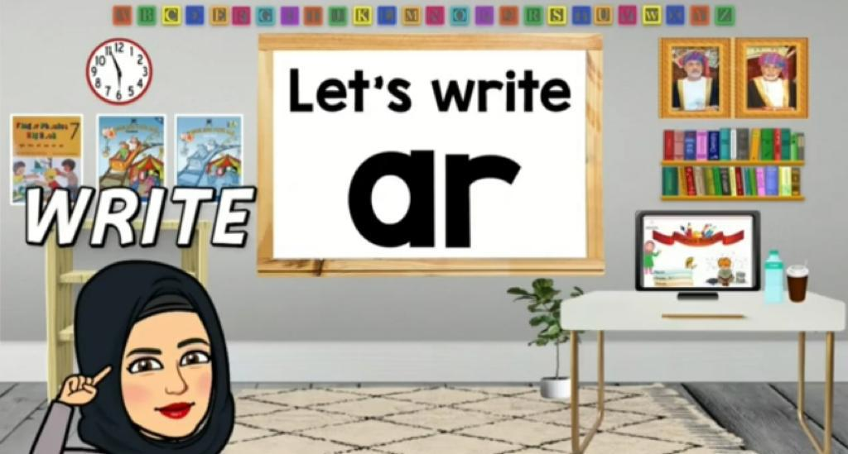
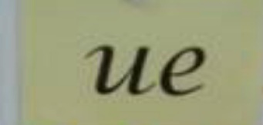
Jolly Phonics Lesson

Slide 3
Learning Outcomes:
To read simple text
*To practice blending and segmenting skills.
* To recognize the tricky word

Slide 4
Warming up
What sound do these actions resemble?
ou
ue
er
ai
oa
oi
ie

Slide 6
What is the common sound among these words?
star
cloud
tie
foil
boat
sue
snail

Slide 11
Comprehension questions:
1- What are they doing on Sunday?
2. What are they doing on Monday?
3- What are they doing on friday?

Slide 12
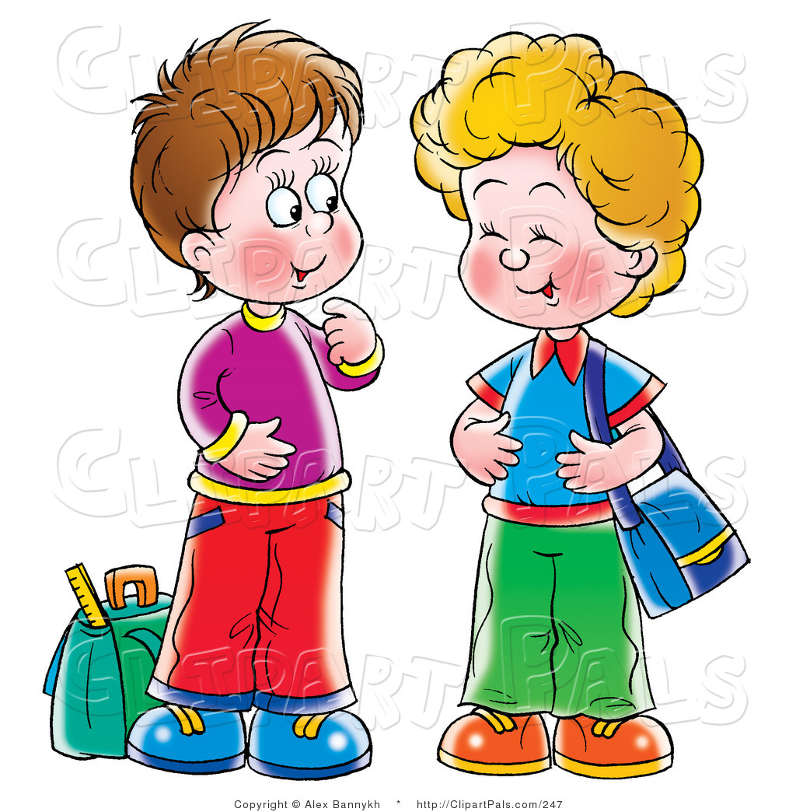
Haitham
Saif

Slide 13
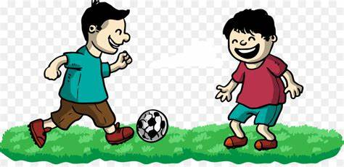
p
l
ay

Slide 14
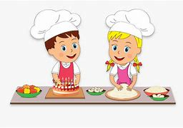
c
a
k
e

Slide 15
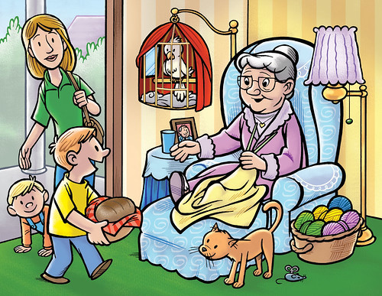
v
i
s
i
t

Slide 16
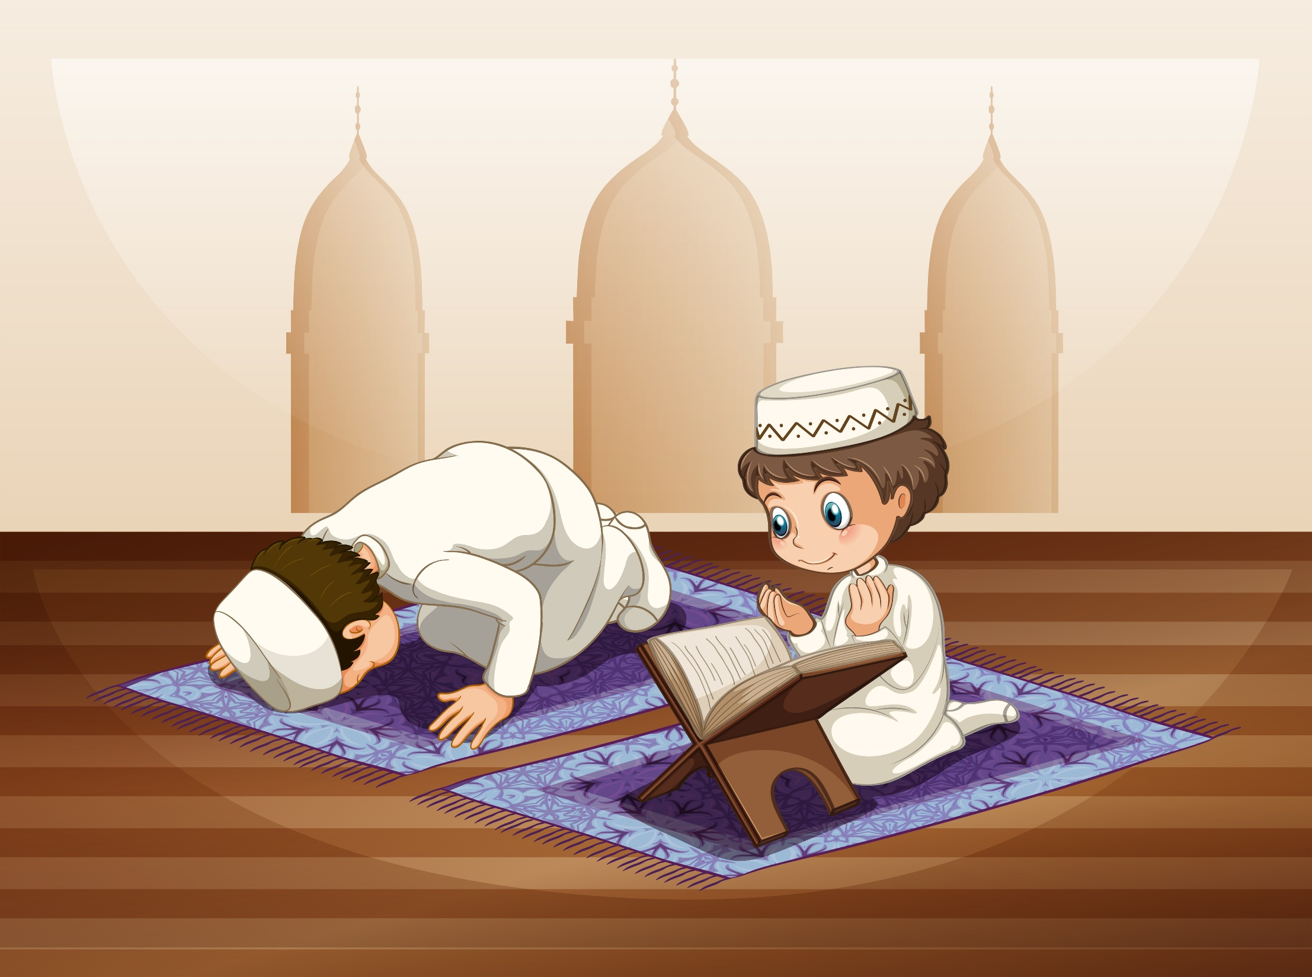
p
r
ay

Slide 17
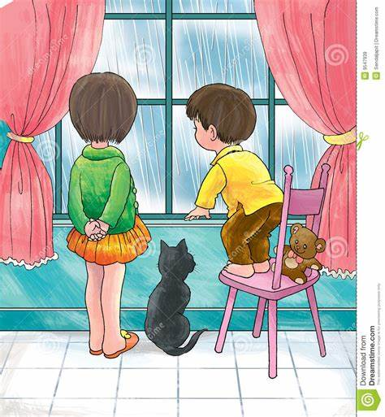
s
t
ay

Slide 18
g
o

Slide 21
Saif and Haitham are happy. There is no school for one week.It is a hoiday.
NEXT!

Slide 22
On Sunday they play football all day.
NEXT!

Slide 23
On Monday they make a cake.
NEXT!

Slide 24
On Thursday they visit there grandmother in Nizwa.
NEXT!

Slide 25
On Friday they pray in mosque.
NEXT!

Slide 26
On Saturday it rains and they stay at home all day.
NEXT!

Slide 27
On Sunday oh no its time to go to school again.
NEXT!

