Slide 1
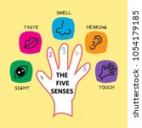
U3:Five senses

Slide 2
Learning objectives:
1- Identify five senses.
2- Revise parts of the body.
3- Understand the meaning of adjectives(happy, sad……).
4-Understand the concept of opposites.

Slide 3
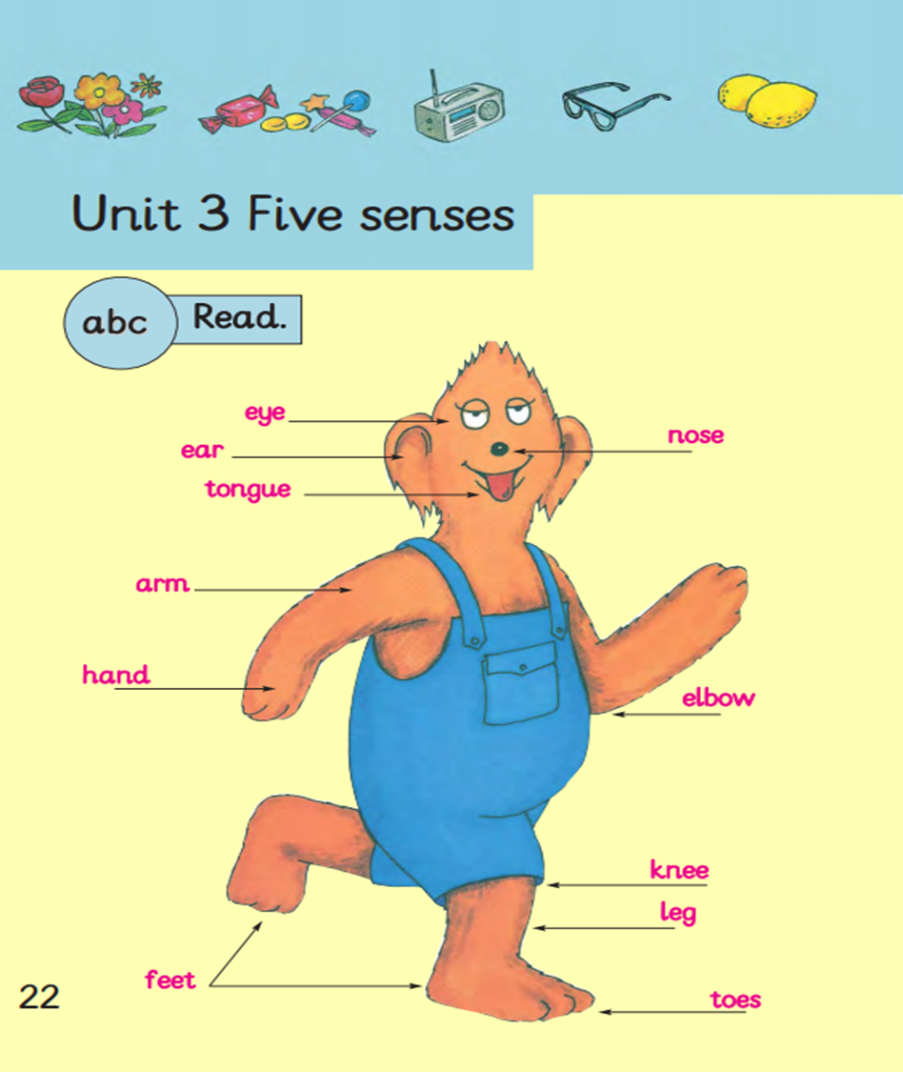
* Look at Biff’s picture and read the words.
* listen to the song.

Slide 4
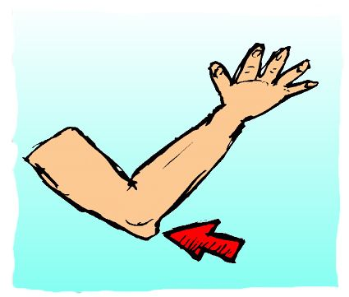
New words to learn
elbow
tongue

Slide 5
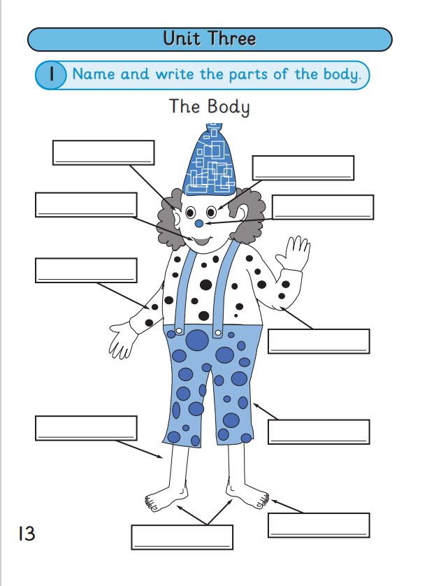
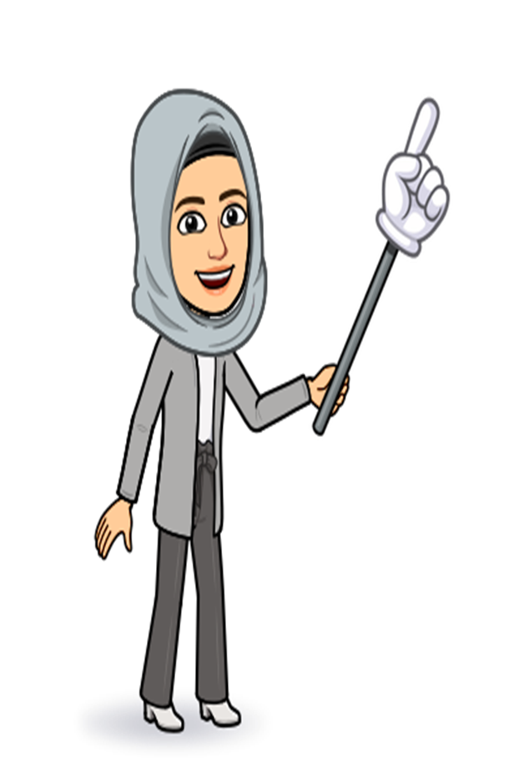
Look at the picture of the clown ,name and write the parts of the body.

Slide 6
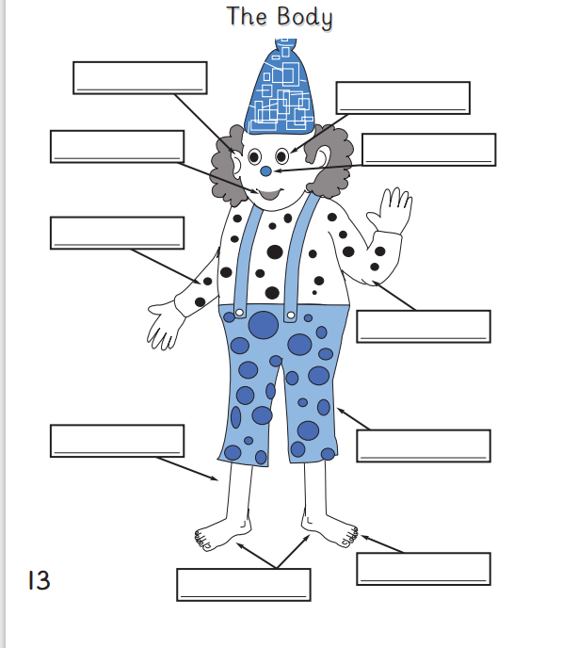
Check your answers.
ears
eyes
mouth
nose
arm
elbow
leg
knee
toes
feet

Slide 7
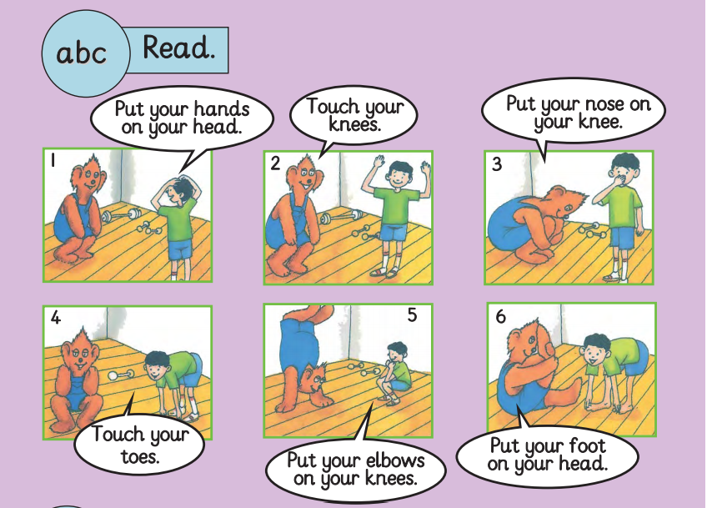
Name the characters you see in the pictures?
What are Biff and Sami doing?
Let’s read the sentences.

Slide 8
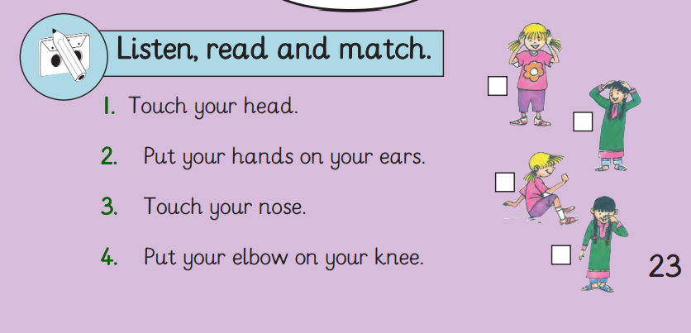
Look at Vicky and Maha.
Read and match.
2
1
4
3

Slide 9
Let’s watch the video

Slide 10
The five senses are:
Five Senses

Slide 11
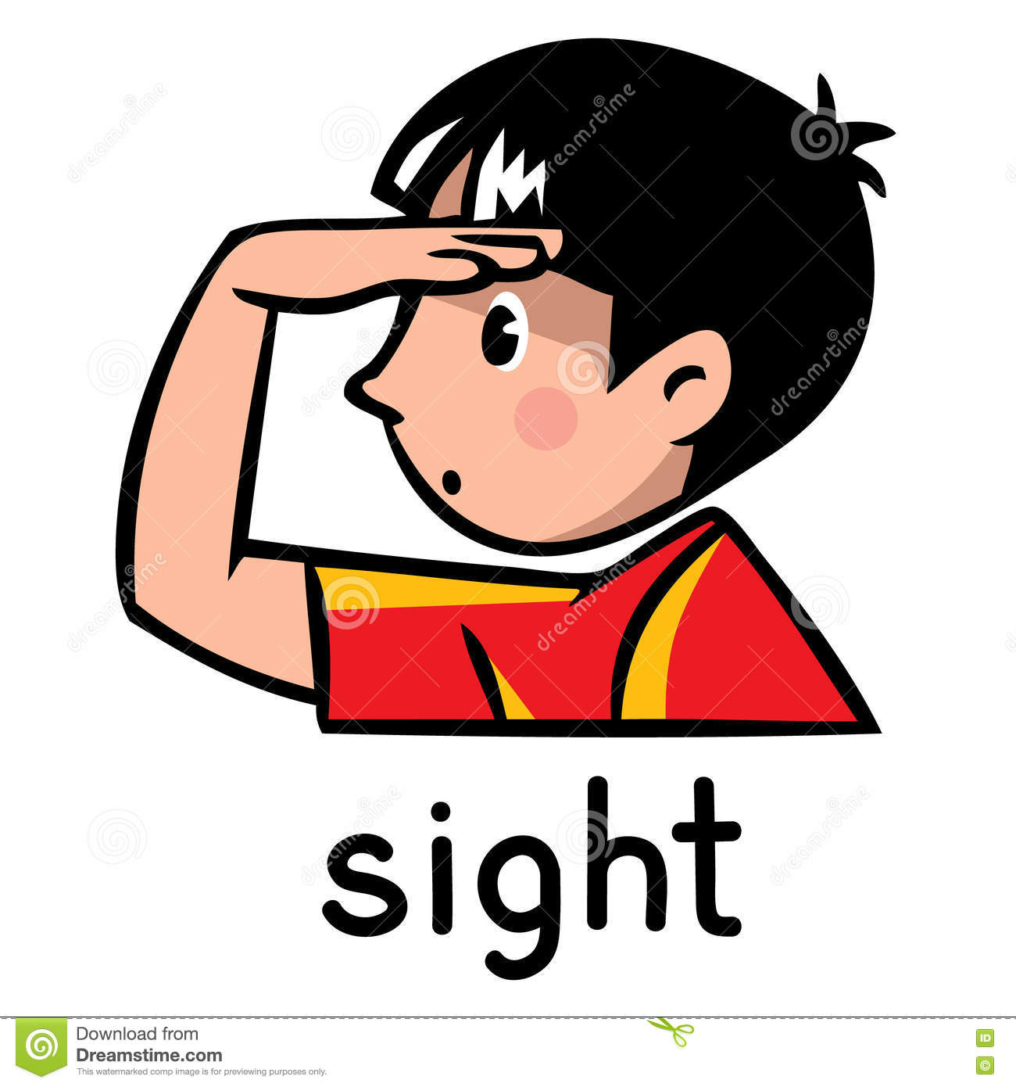
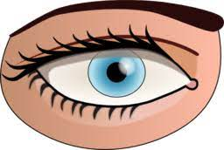

Slide 12
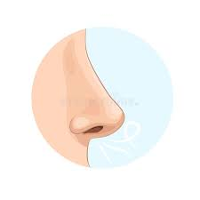

Slide 13
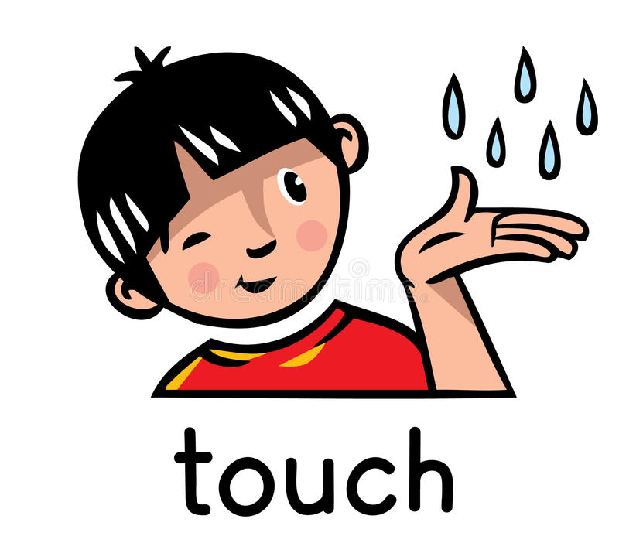

Slide 16
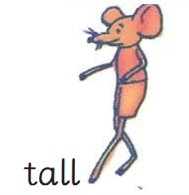
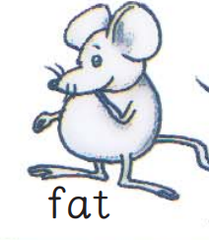
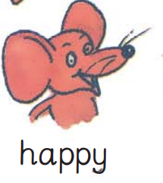
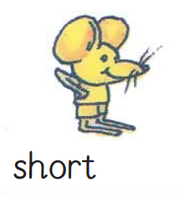
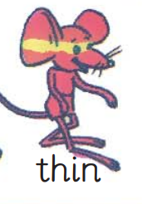
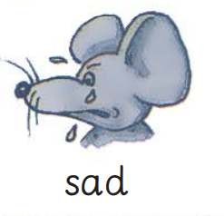
Words to learn

Slide 17
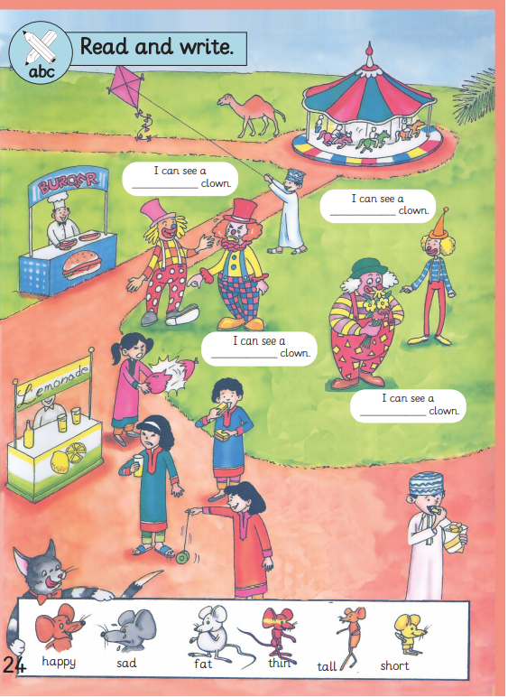
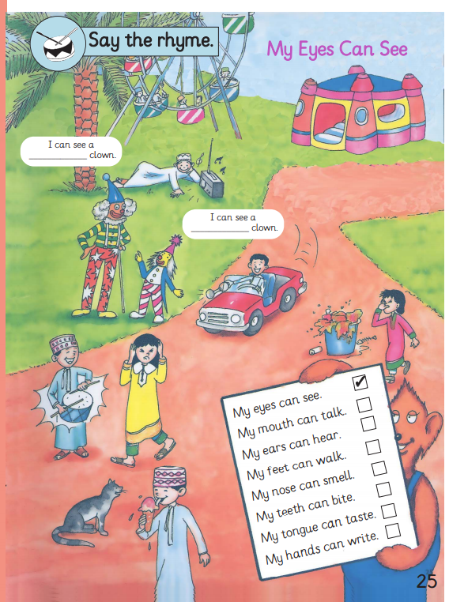
*What can you see?
*How many clowns can you see?
Read and write

Slide 18
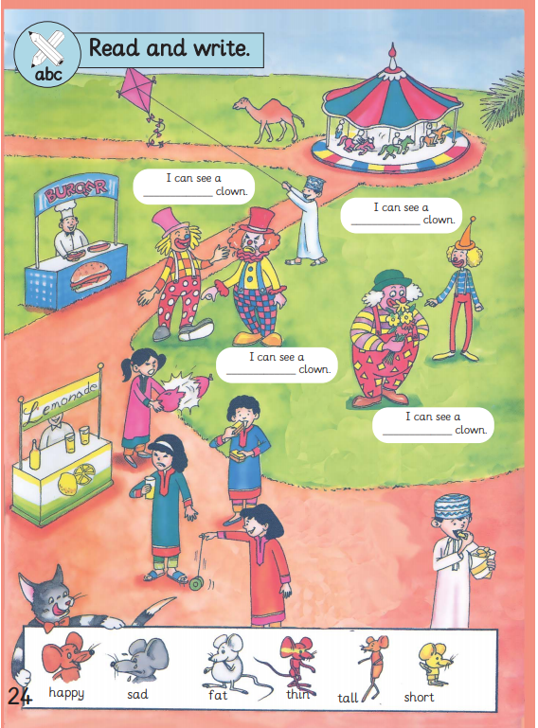
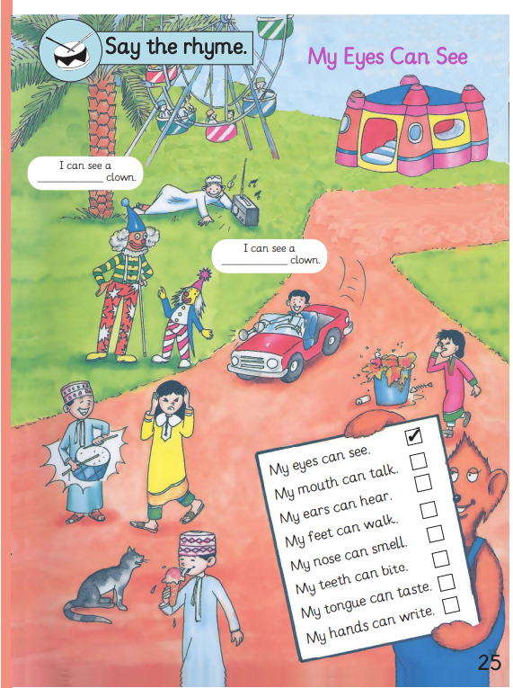
Check your answers.
happy
tall
thin
short
sad
fat

Slide 19
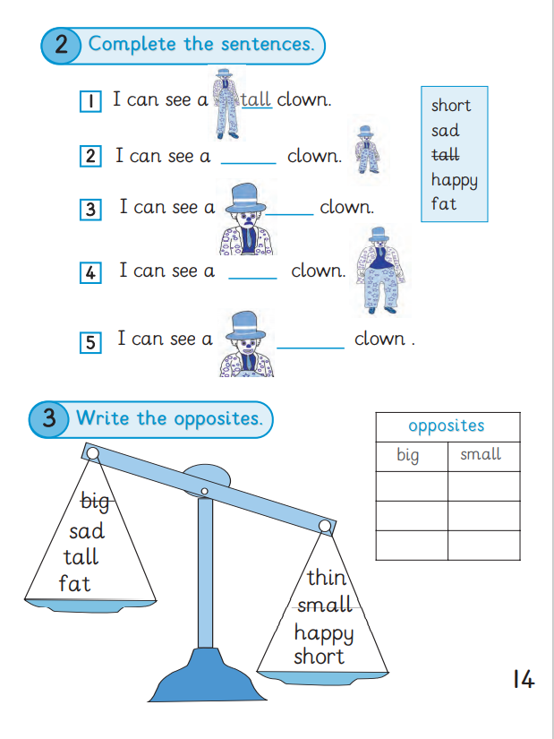
Look at activity number 2 and complete the sentences.
Activity number 3 and write the opposites.
opposites: مضاد
tall _ short

Slide 20
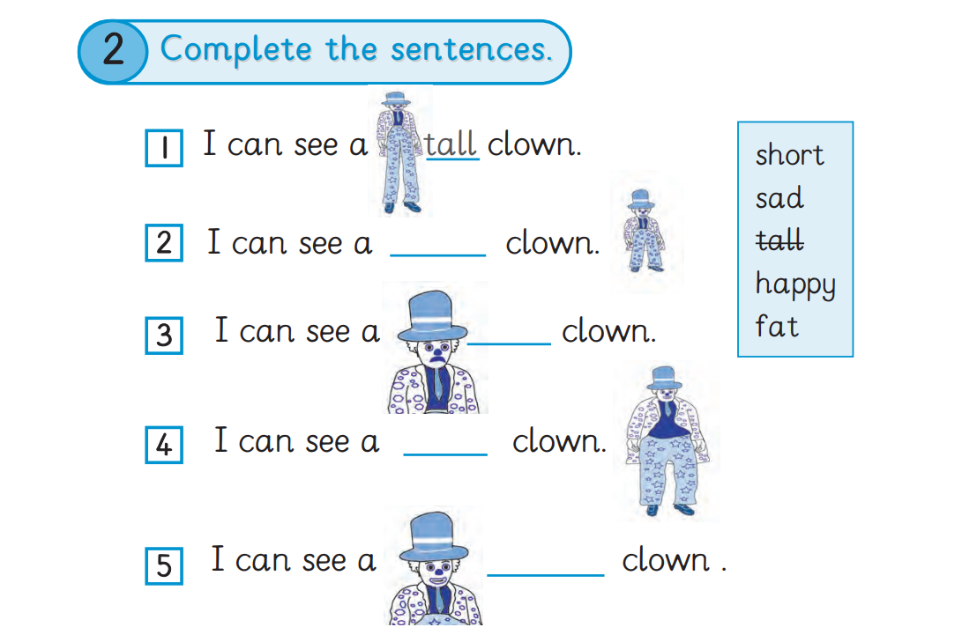
Check your answers.
short
sad
fat
happy

Slide 21
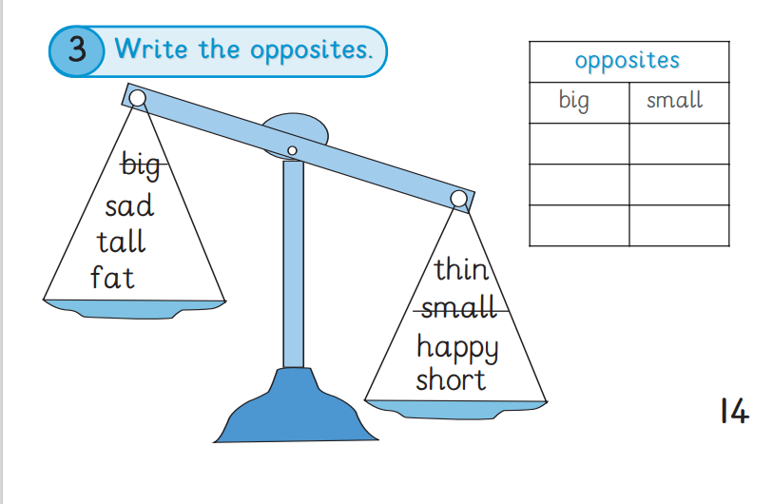
Check your answers.
sad
happy
tall
short
fat
thin

