Slide 1
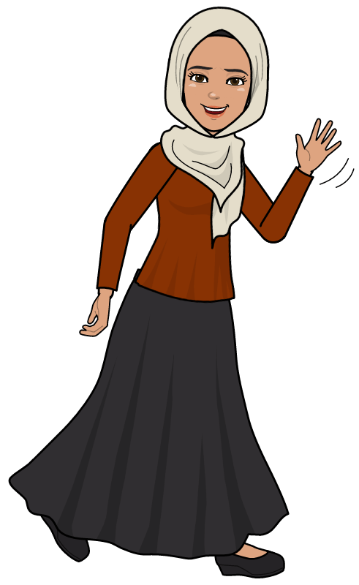
Grade 2B
Unit 3
Lesson 6-10
Fatma Al.Muslhi

Slide 2
Objectives
1- Talk about sounds made by objects.
2- Listen to sounds and match.
3- Read and match sentences to pictures.
4- Understand the meanings hard, soft, rough, smooth.
5- Categories objects according to how they feel.
6- Complete sentences about how different foods smell.
7- Understand and use sweet , sour or salty.
8- Transfer information from a chart to sentences.
Fatma Al.Muslhi

Slide 3
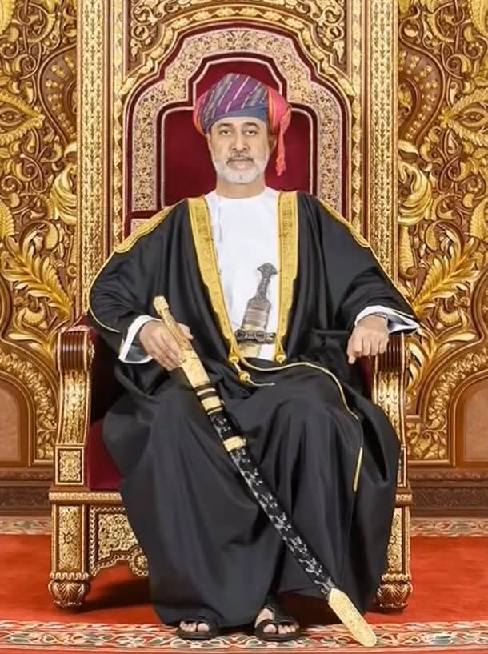
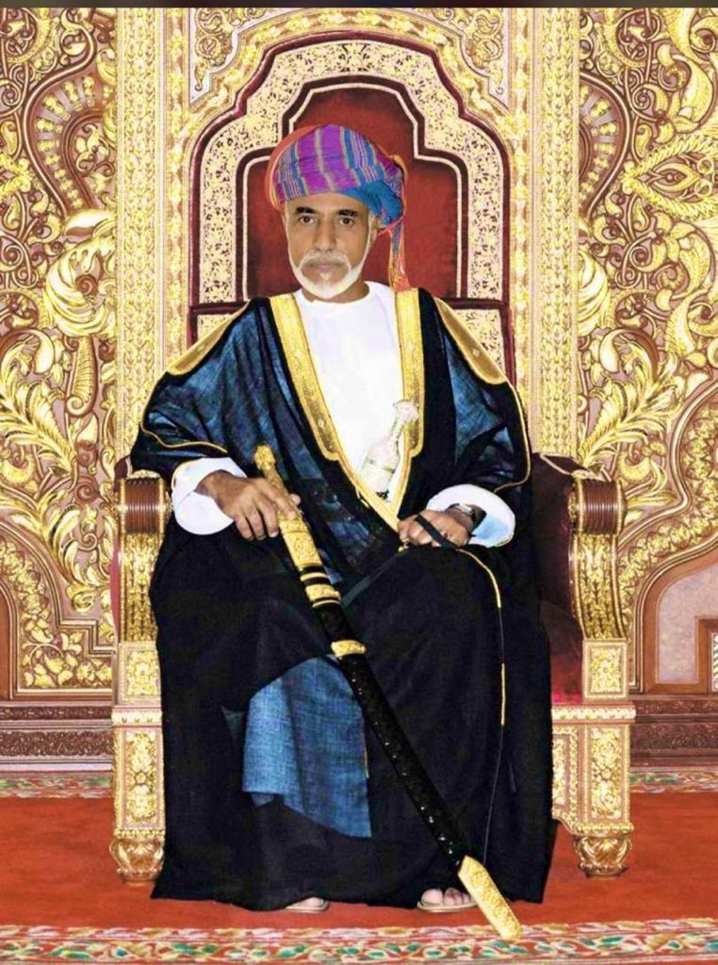
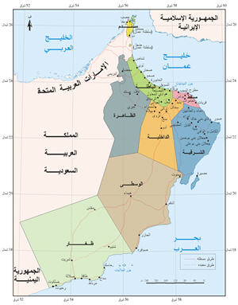
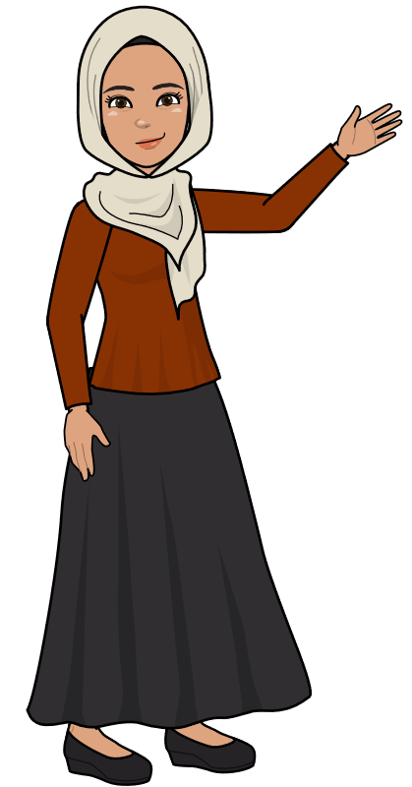
Five Senses
Fatma Al.Muslhi
T. Fatma Al.Muslhi

Slide 5
I can taste
1
I
--
ANSWER
prepositions
2
L
emon
ANSWER
3
O
n
ANSWER
4
V
icky
ANSWER
5
E
lephant
ANSWER
Animals
6
M
ango
ANSWER
People Names
7
U
nder
ANSWER
8
M
ohammed
ANSWER
9
M
onkey
ANSWER
10
Y
ogurt
ANSWER

Slide 6
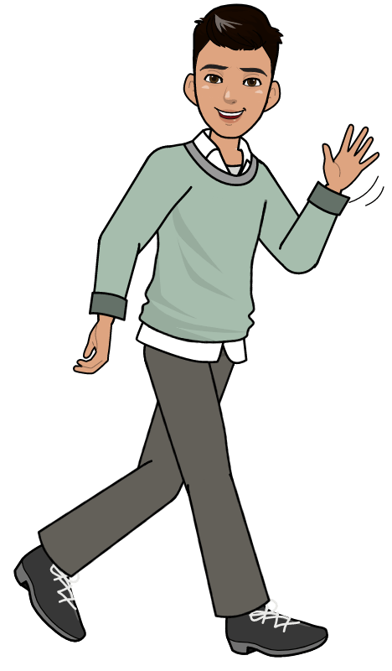
Learn with Naser

Slide 7
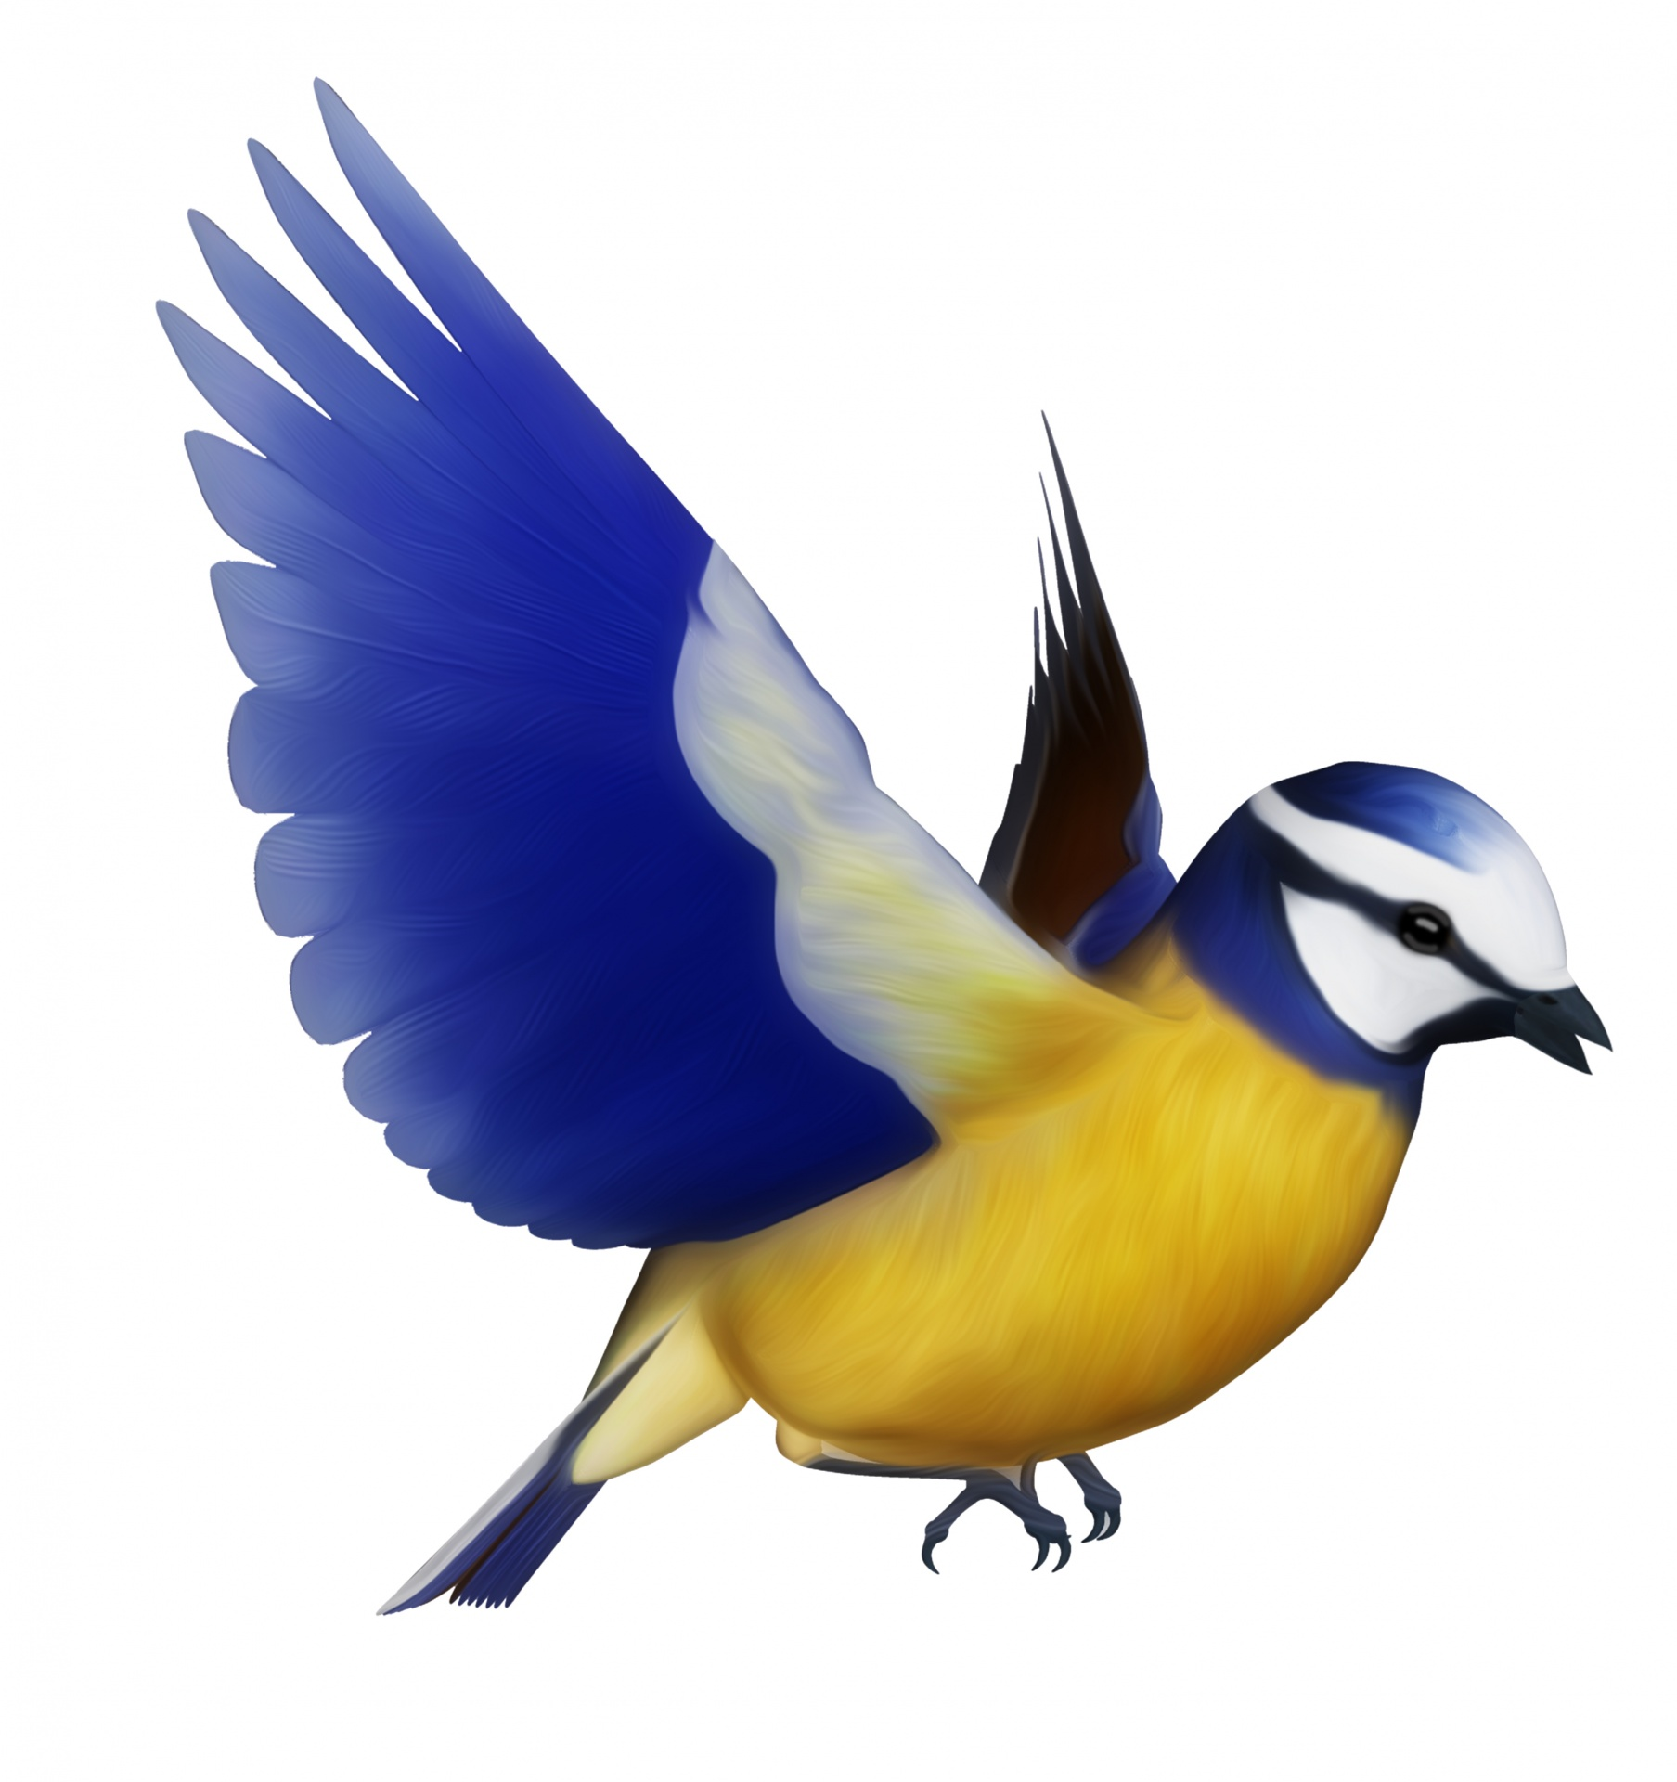
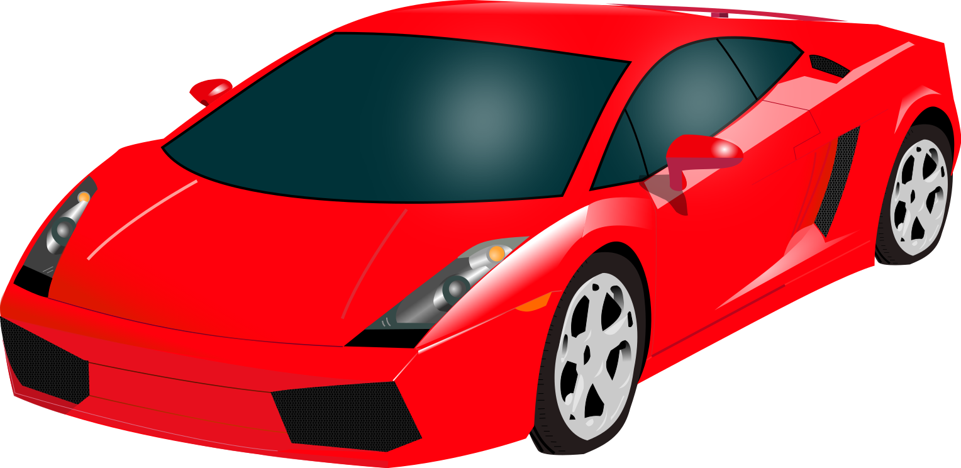
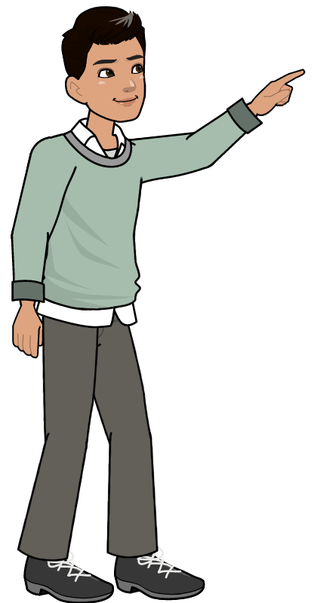
car
bird
ball
bee
sea

Slide 8
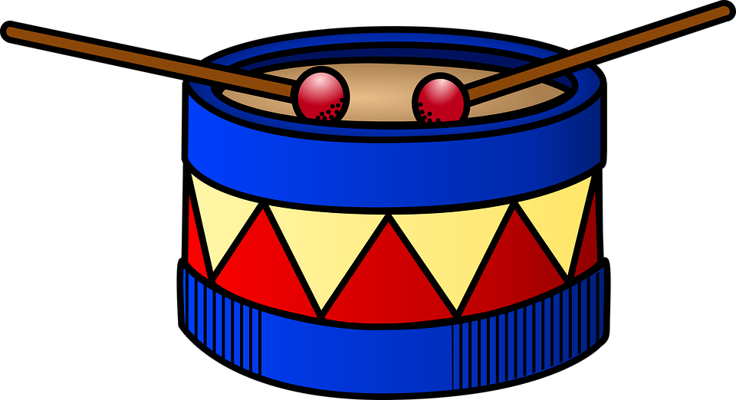
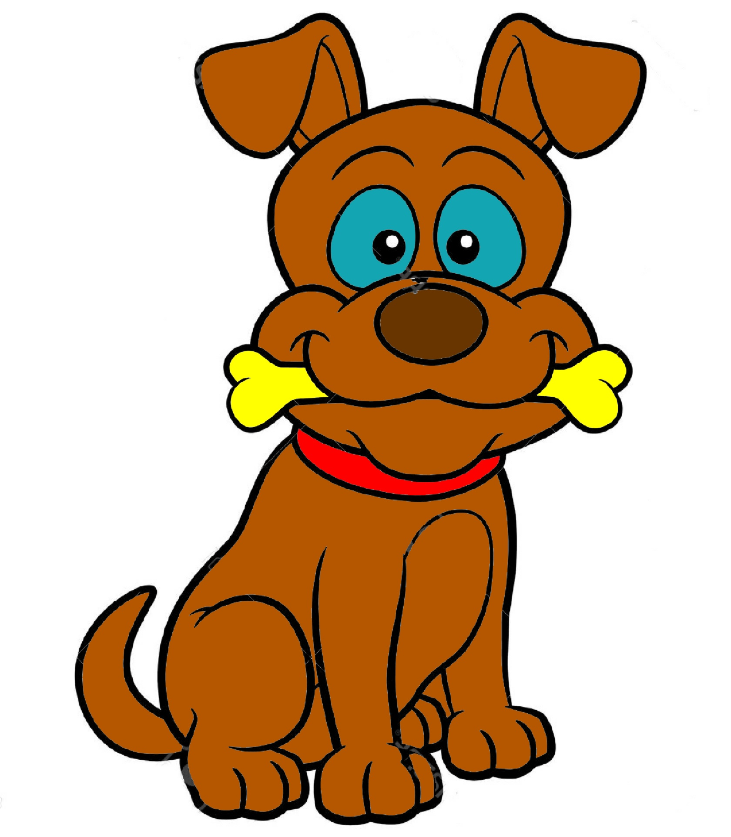
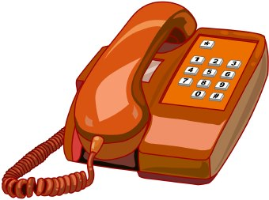
thunder
radio
drum
dog
telephone

Slide 9
I can hear…

Slide 10
Fatma Al.Muslhi

Slide 11
Fatma Al.Muslhi

Slide 12
Fatma Al.Muslhi

Slide 13
Fatma Al.Muslhi

Slide 14
Fatma Al.Muslhi

Slide 15
Fatma Al.Muslhi

Slide 16
Click on the pictures
to show the ticks.
Fatma Al.Muslhi

Slide 17
Fatma Al.Muslhi

Slide 18
Fatma Al.Muslhi

Slide 19
5
6
4
1
2
3
Fatma Al.Muslhi

Slide 20
Fatma Al.Muslhi

Slide 21
Fatma Al.Muslhi

Slide 22
Fatma Al.Muslhi

Slide 23
Fatma Al.Muslhi

Slide 24
Fatma Al.Muslhi

Slide 25
Fatma Al.Muslhi

Slide 26
drum
a
dog
hear
a
radio
can
hear
a
cat
I
can
hear
a
car
Fatma Al.Muslhi

Slide 27
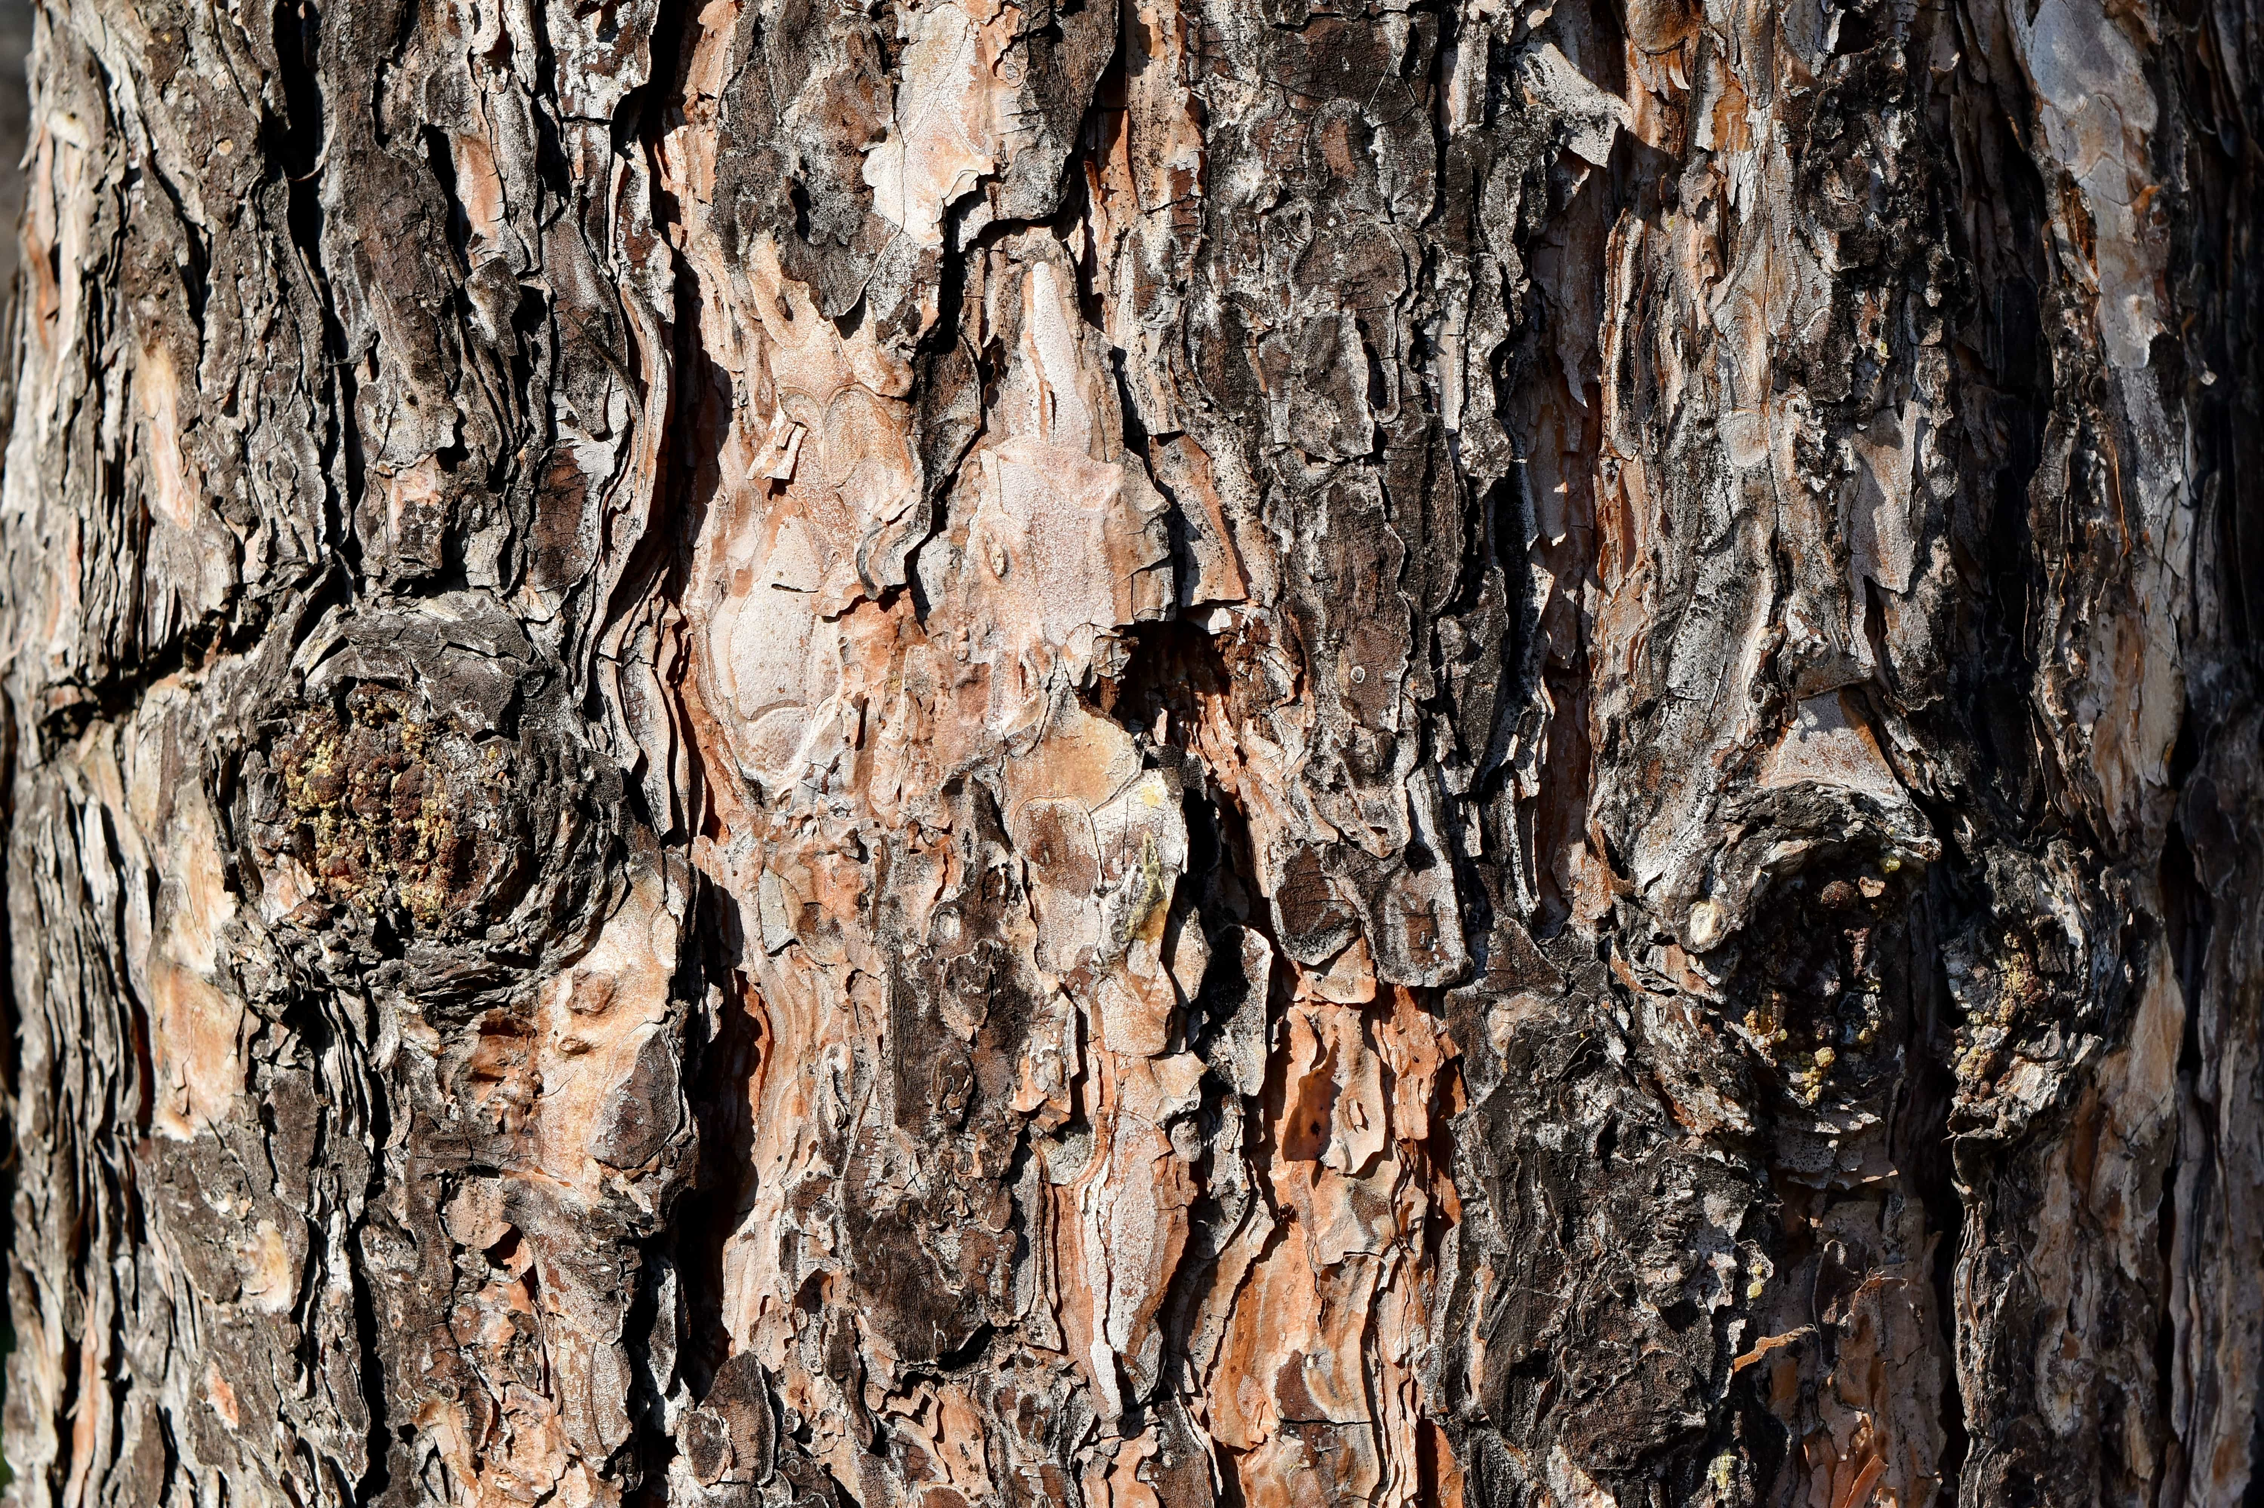
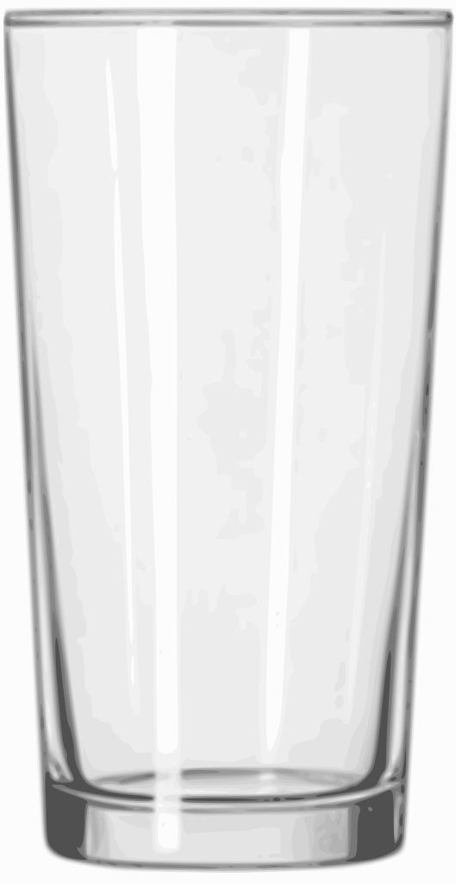
rough
hard
smooth
soft

Slide 28
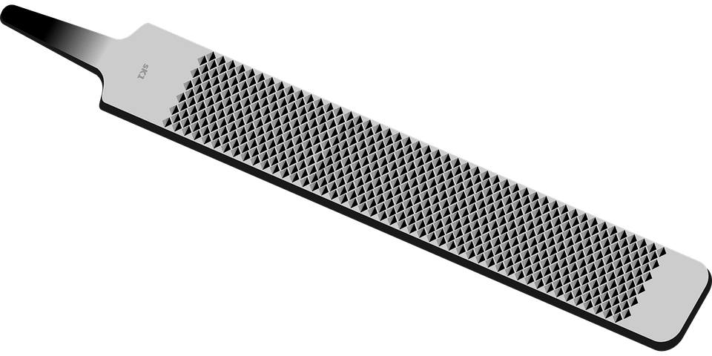
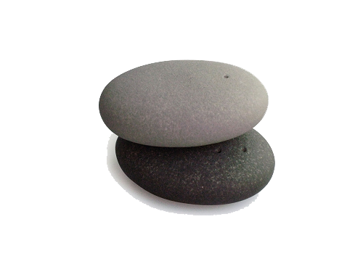
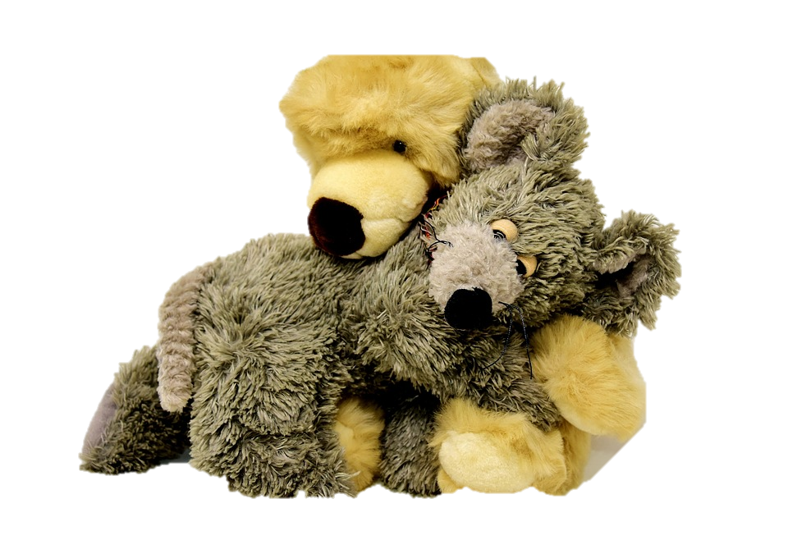
hard and rough
hard and smooth
Soft and smooth

Slide 29
Fatma Al.Muslhi

Slide 30
Fatma Al.Muslhi

Slide 31
Fatma Al.Muslhi

Slide 32
Fatma Al.Muslhi

Slide 33
Fatma Al.Muslhi

Slide 34
Fatma Al.Muslhi

Slide 35
Fatma Al.Muslhi

Slide 36
Fatma Al.Muslhi

Slide 37
Fatma Al.Muslhi

Slide 38
Fatma Al.Muslhi

Slide 39
Fatma Al.Muslhi

Slide 40
scarf
road
balloon
tree
cotton
brick
cat
Click on the pictures to show the words
Fatma Al.Muslhi

Slide 41
Fatma Al.Muslhi

Slide 42
It tastes …

Slide 43
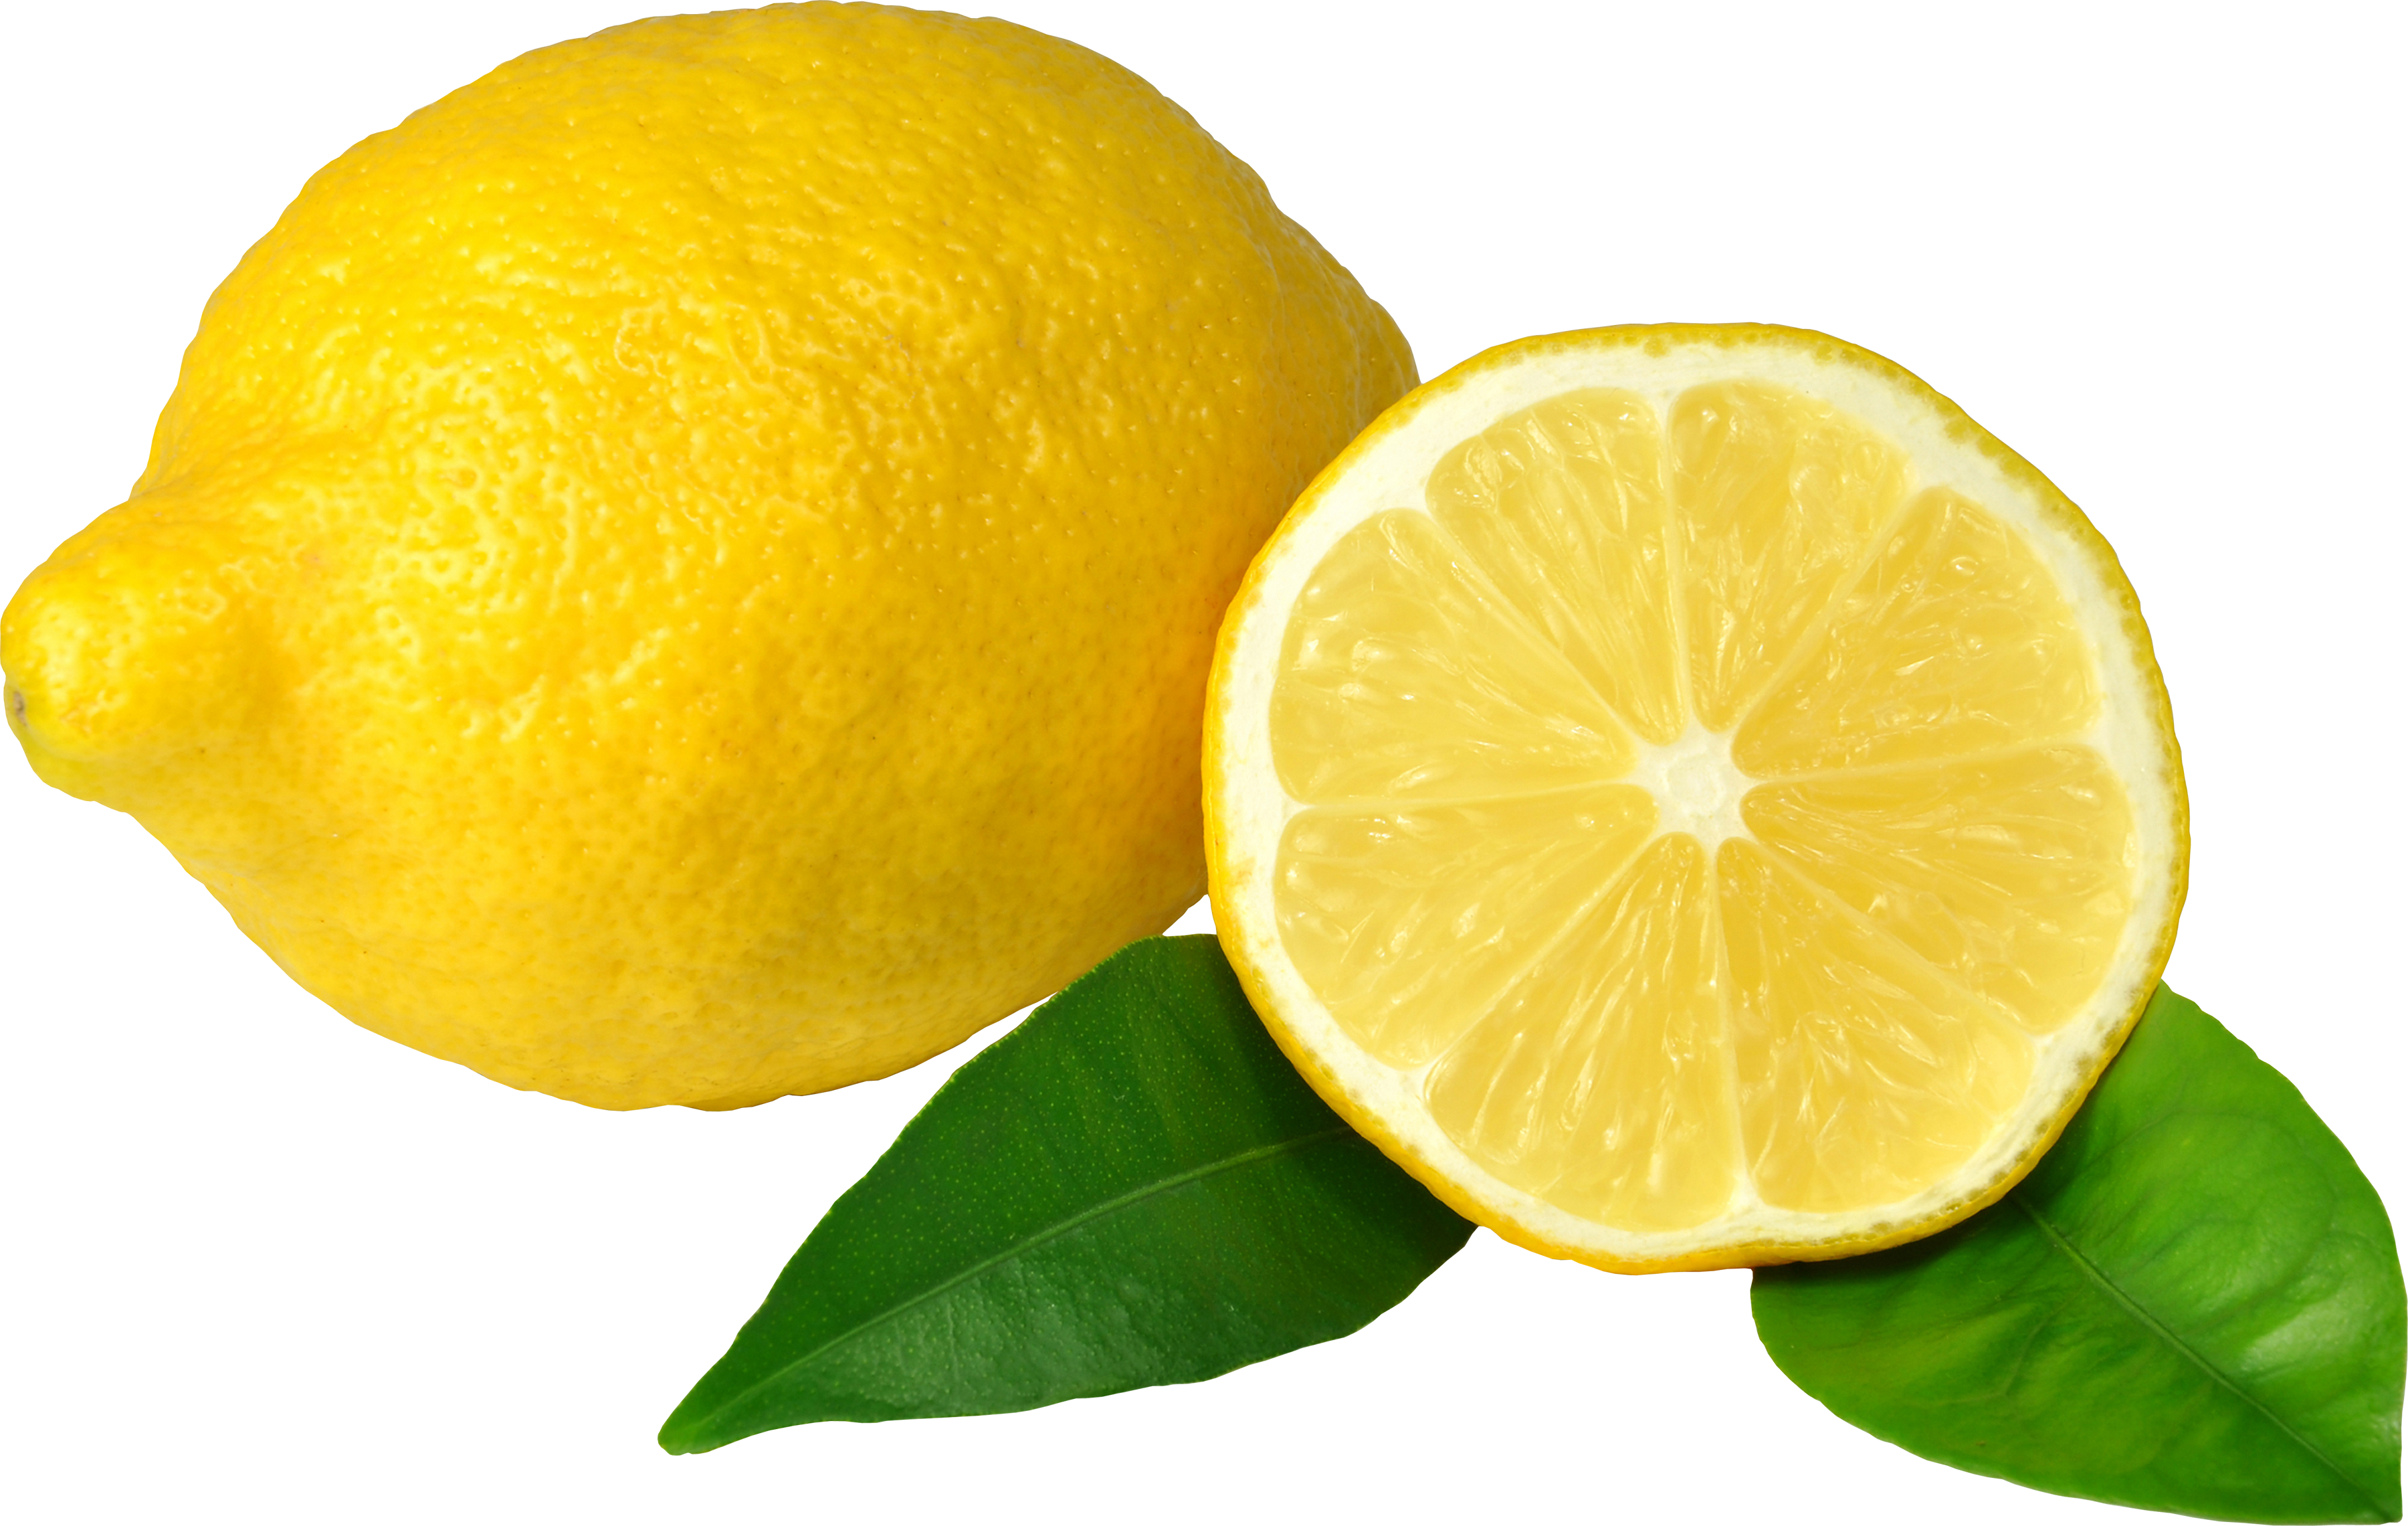
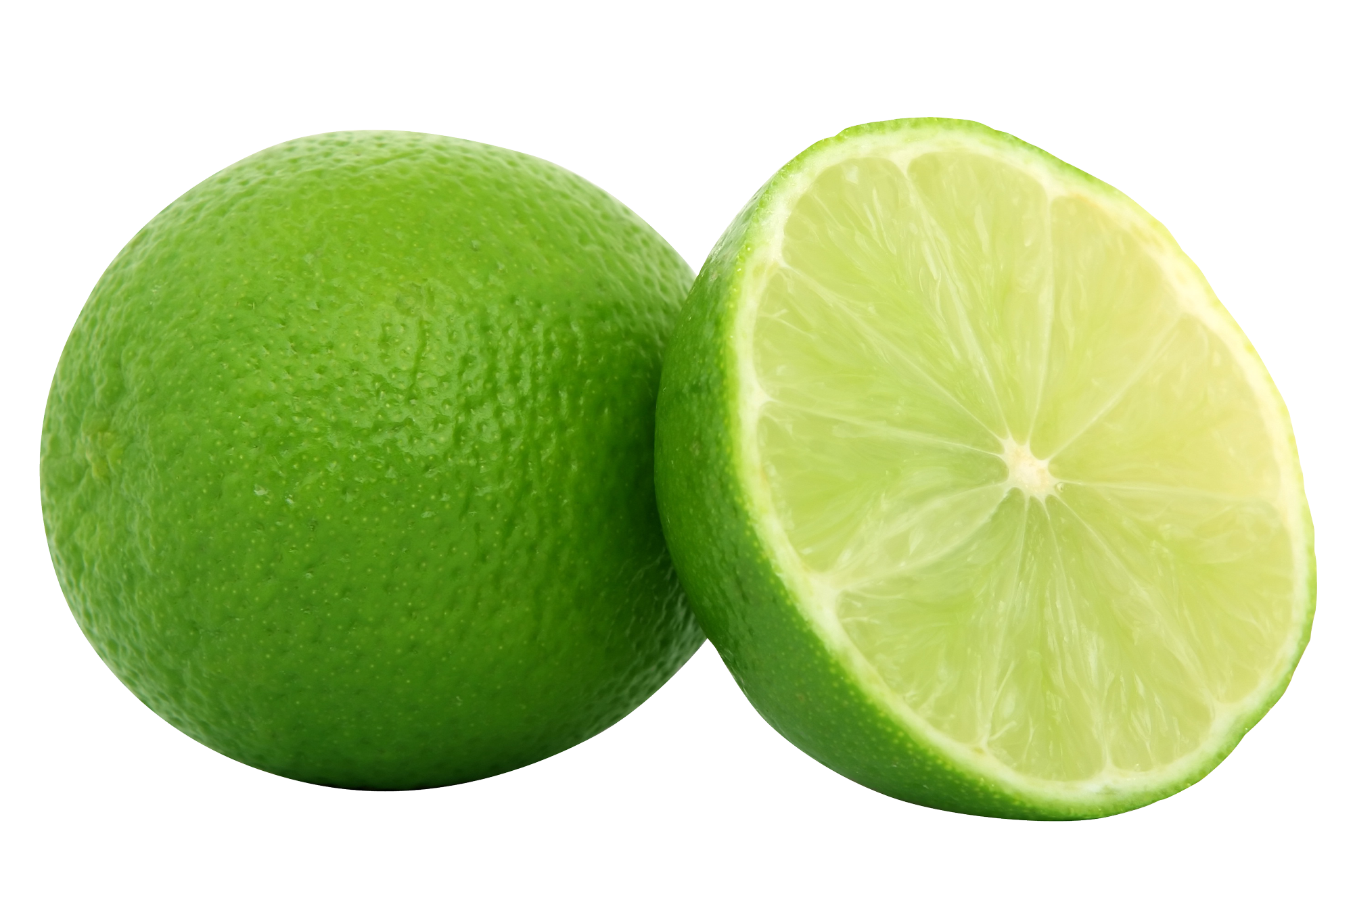
sour
هذه الصورة بواسطة كاتب غير معروف مرخصة بالاسم CC BY-NC
هذه الصورة بواسطة كاتب غير معروف مرخصة بالاسم CC BY-NC
هذه الصورة بواسطة كاتب غير معروف مرخصة بالاسم CC BY-NC

Slide 44
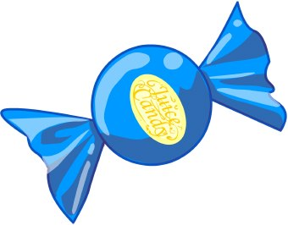
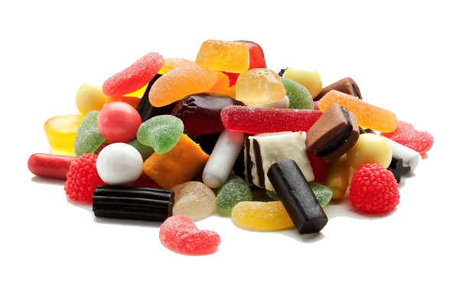
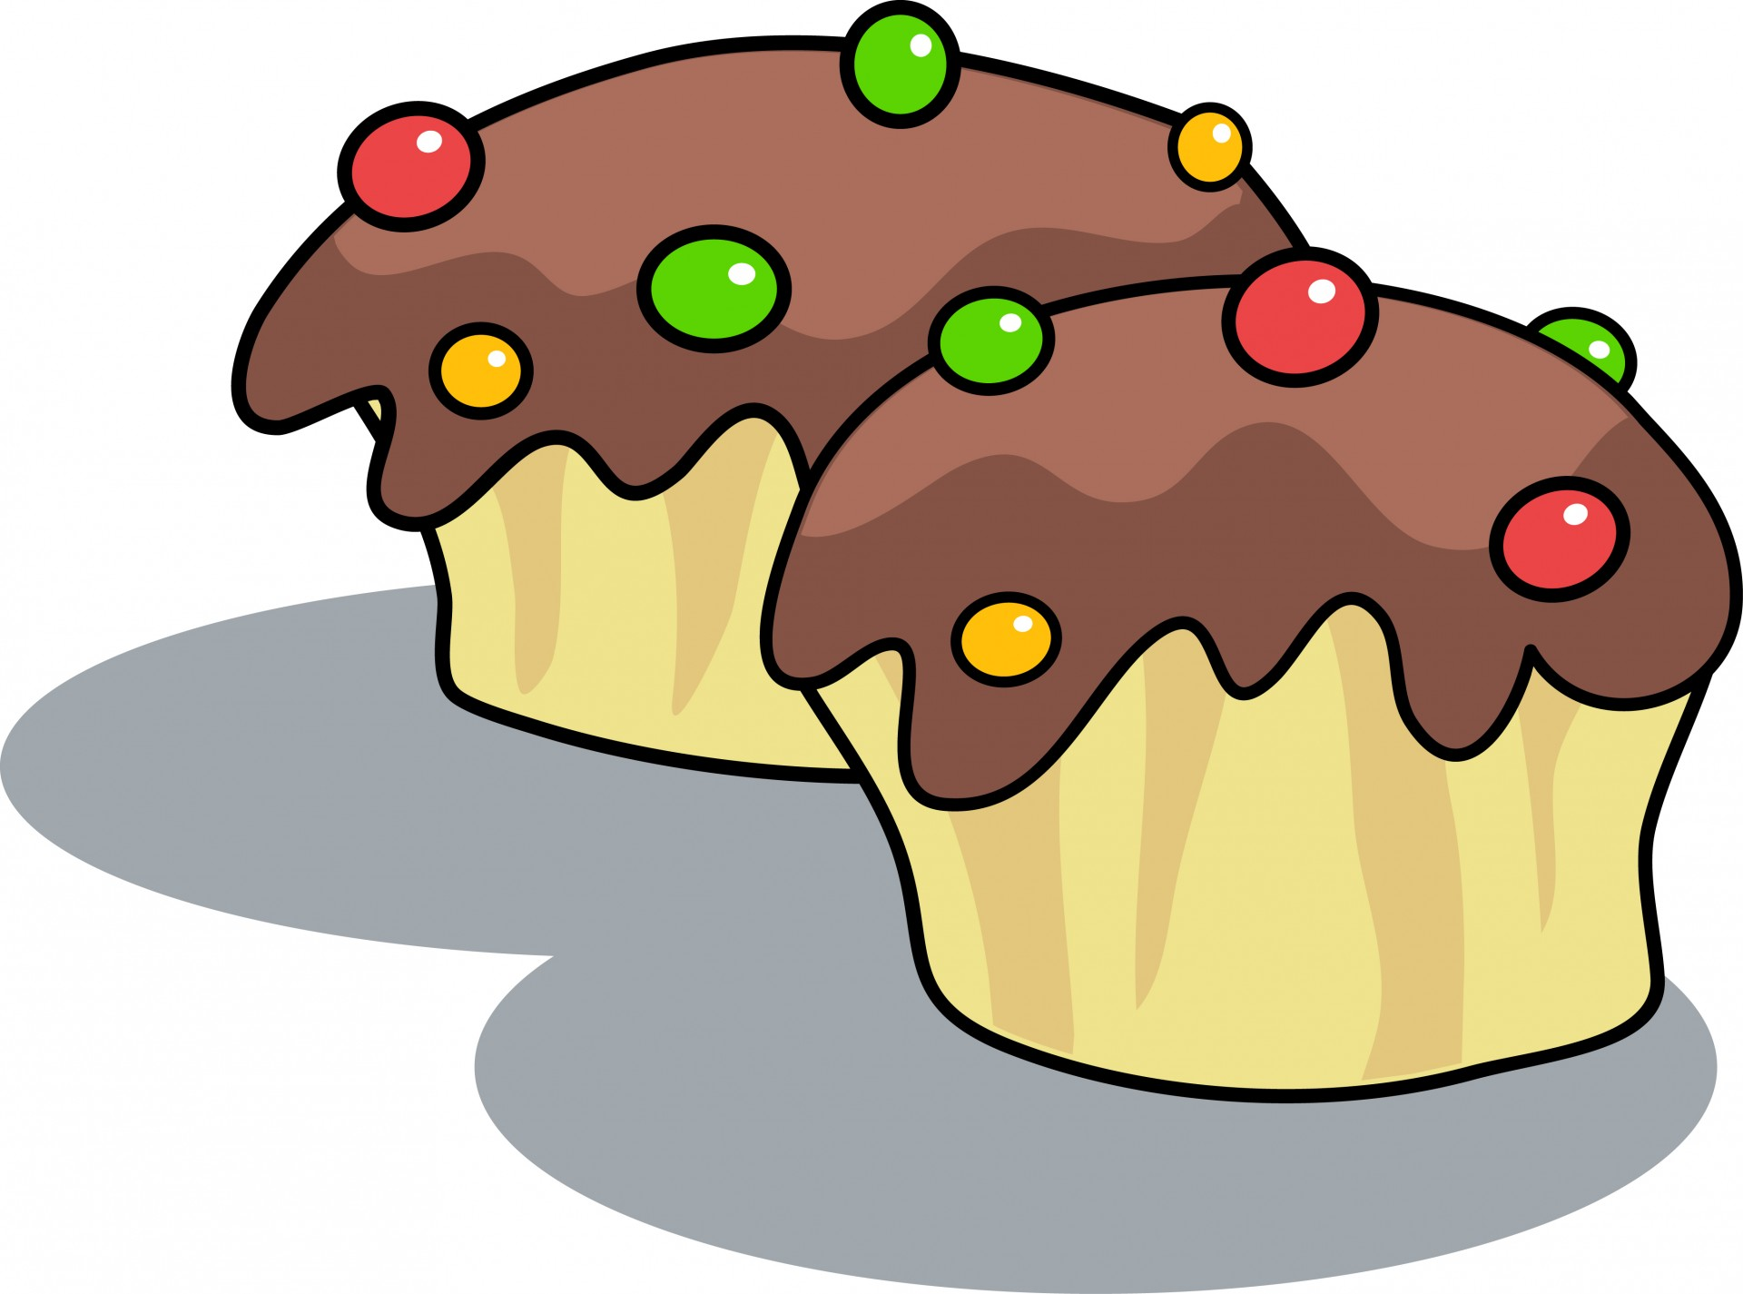
sweet

Slide 45
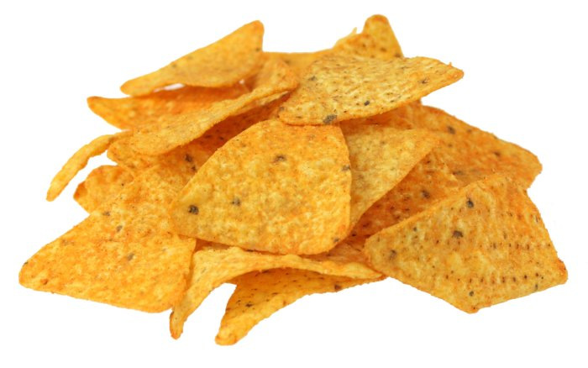
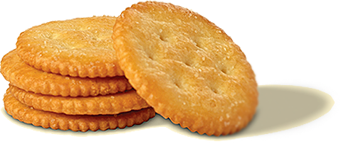
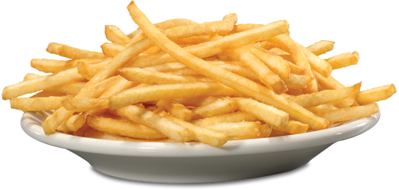
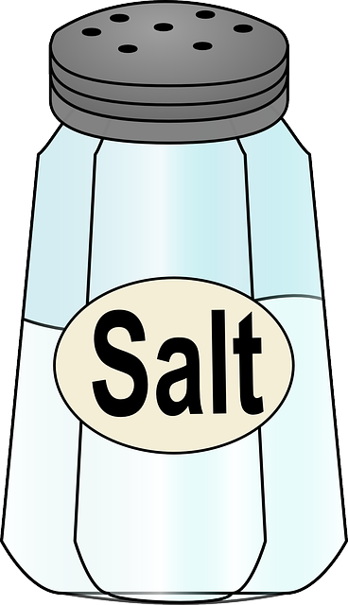
salty

Slide 46
Choose the correct answers

Slide 47
It tastes sour.
cake
lemon
sweet
chips

Slide 48
It tastes sweet.
cake
lemon
peanuts
chips

Slide 49
It tastes salty.
cake
lemon
sweet
chips

Slide 50
Fatma Al.Muslhi

Slide 51
Fatma Al.Muslhi

Slide 52
Fatma Al.Muslhi

Slide 53
Fatma Al.Muslhi

Slide 54
chocolate
honey
lemons
lime
chips
peanuts
Fatma Al.Muslhi

Slide 55
Fatma Al.Muslhi

Slide 56
Fatma Al.Muslhi

Slide 57
Fatma Al.Muslhi

Slide 58
Fatma Al.Muslhi

Slide 59
sour
sweet
salty
sour
salty
Fatma Al.Muslhi

