Slide 1
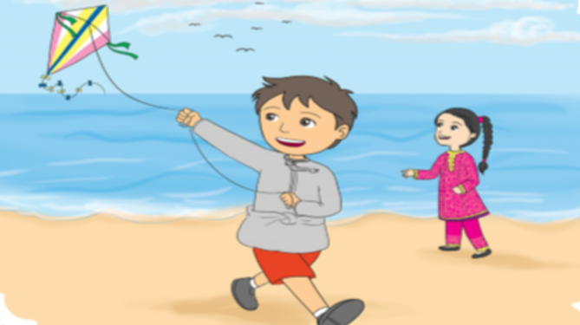
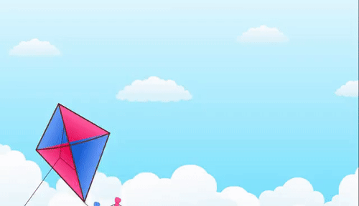

Jolly Phonics
Reading 4
Time to fly a kite
Day: Wednesday
Date: 31st of March 2021

Slide 2
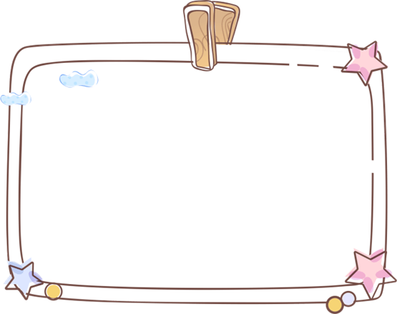


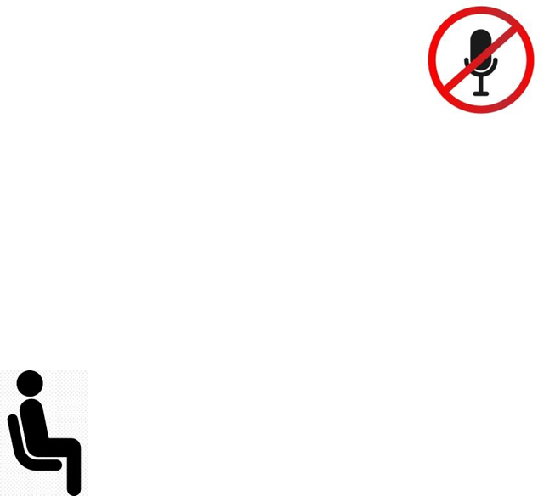


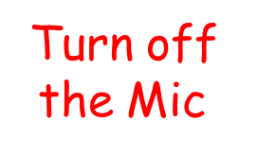
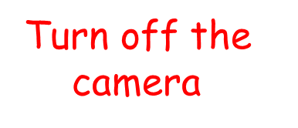
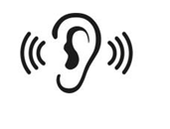
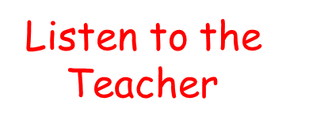

Slide 3
Learning Objectives:
To recognize alternative spelling i-e, igh and y for the sound ie.
To read short text.
To blend and segment words.

Slide 4
About the Lesson:
Revision
Warm up (video)
Reading (text)
Follow up
Homework

Slide 5


Warm up:
https://drive.google.com/file/d/1foQmSbTXok6bvg7xI9HVtXv5NwI_nN2C/view?usp=sharing

Slide 6
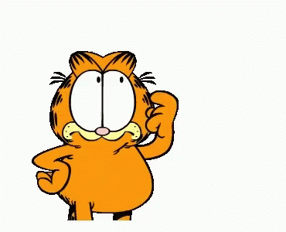
Revision:
https://www.liveworksheets.com/da1488233pp

Slide 7




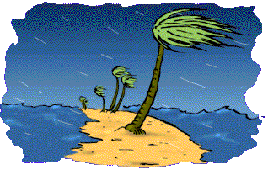
i-e | igh | y
time | high | fly
kite | higher | windy

Slide 8




segmenting
fly
high
f
l
y
h
igh

Slide 9
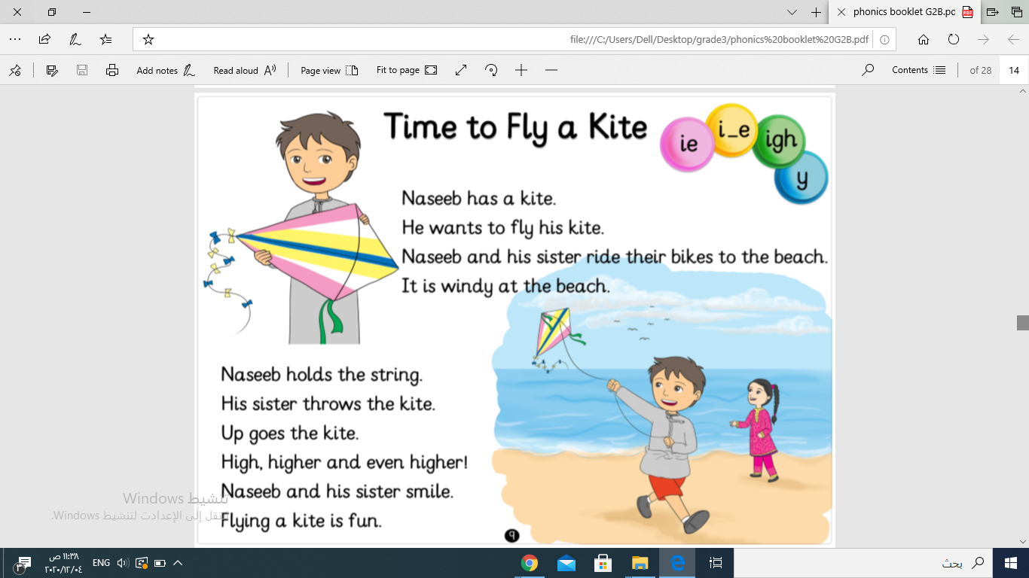

Slide 10
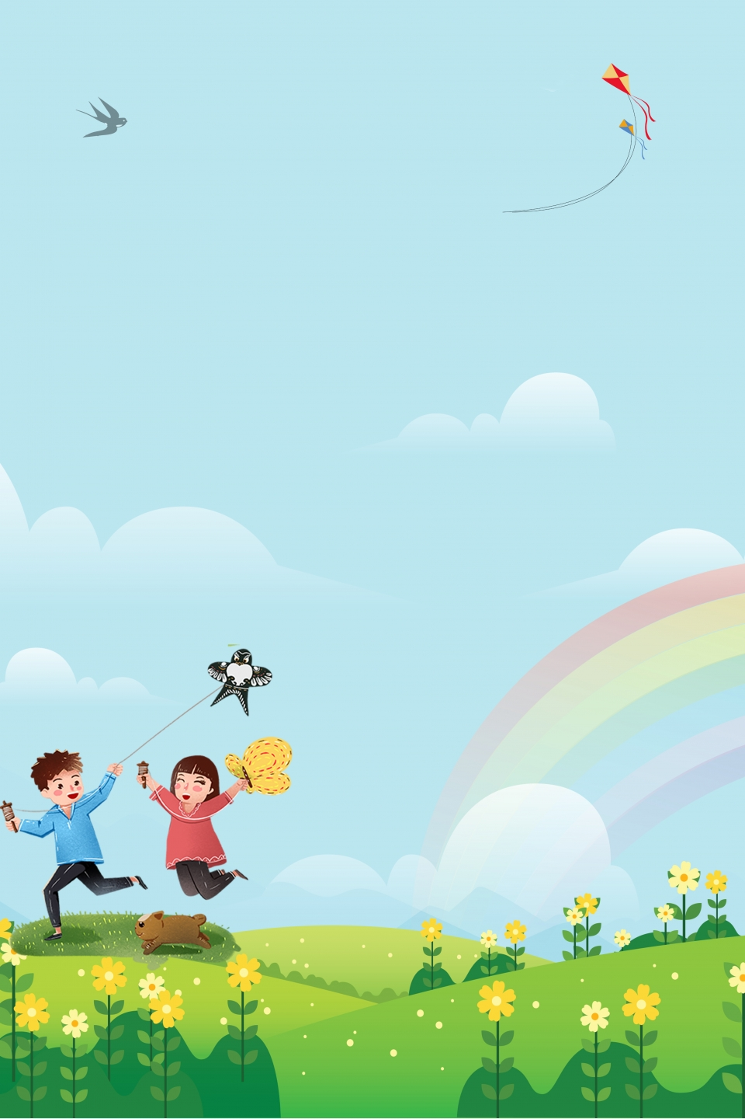

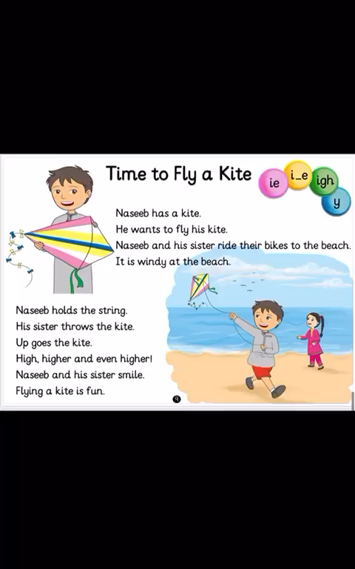
https://drive.google.com/file/d/1hYAOL69AQUbI1dHtWjuYbvAv9FERVHFv/view?usp=sharing

Slide 11


Tricky words:
https://www.yout-ube.com/watch?v=R087lYrRpgY

Slide 12
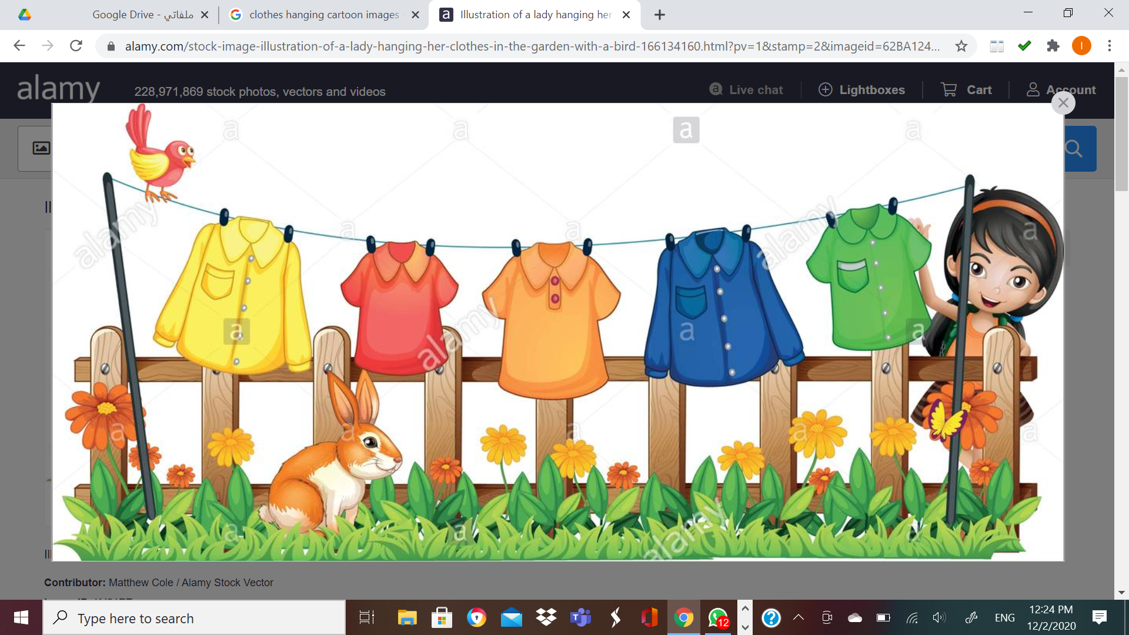
Find out
Tricky Words
it
their
the
a
is

Slide 13
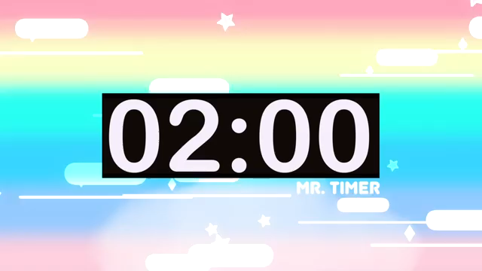
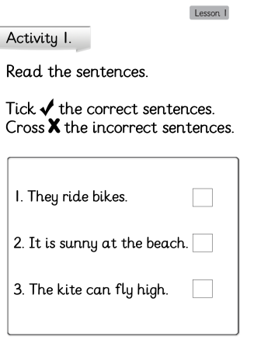

Follow up 1:

Slide 14
Follow up 2:
https://www.liveworksheets.com/eu1303031qa

Slide 15
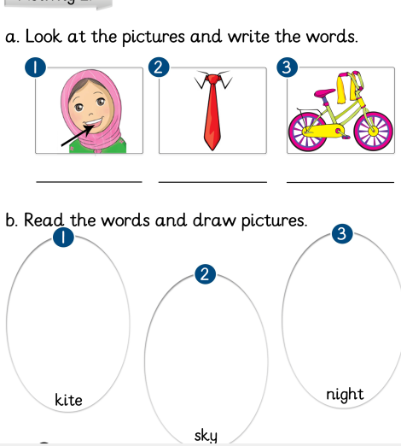

Homework:

Slide 16



