Slide 1
Unit 1: Free Time
L4-8

Slide 2
Objectives
By the end of the lesson, pupils will be able to:
ask and answer questions What does Maha collect? [comics]
classify words into groups
unscramble letters to form names of animals
listen and identify the correct pictures
complete sentences using the correct words

Slide 3
Warm up
Play the game:
https://wordwall.net/ar/resource/11379229/i-collect

Slide 4
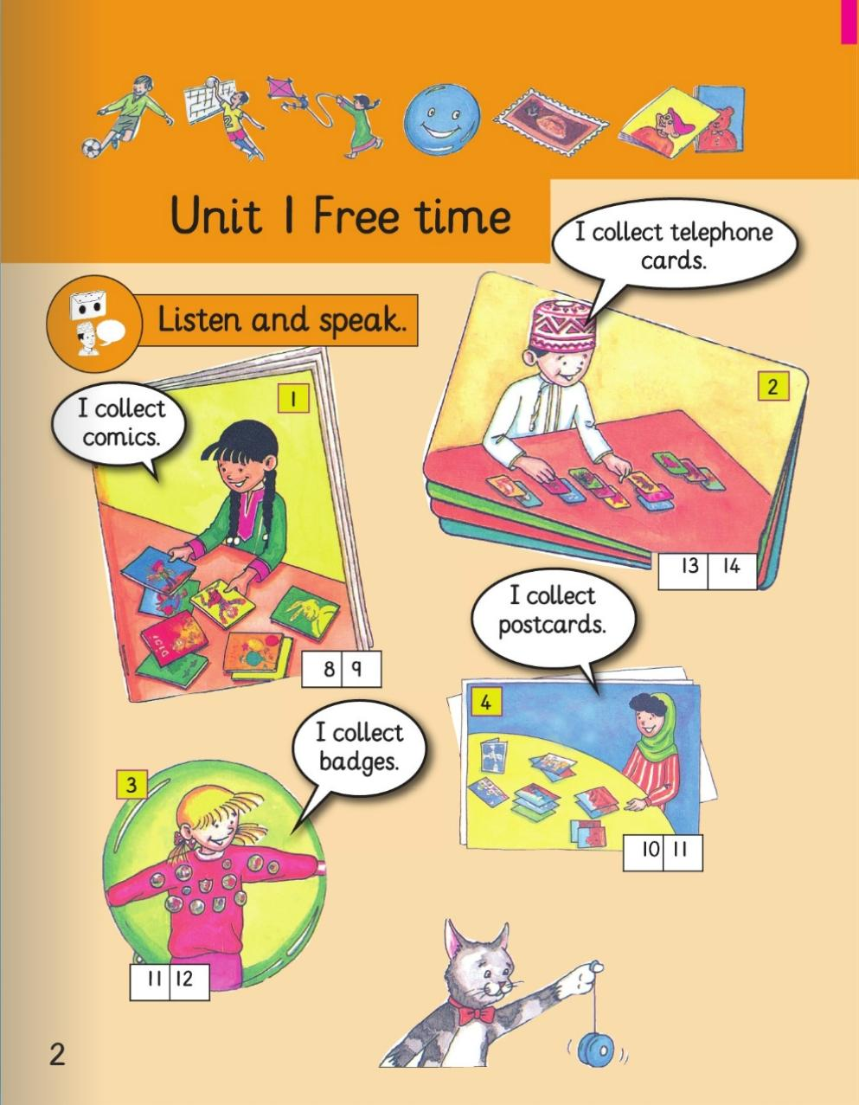
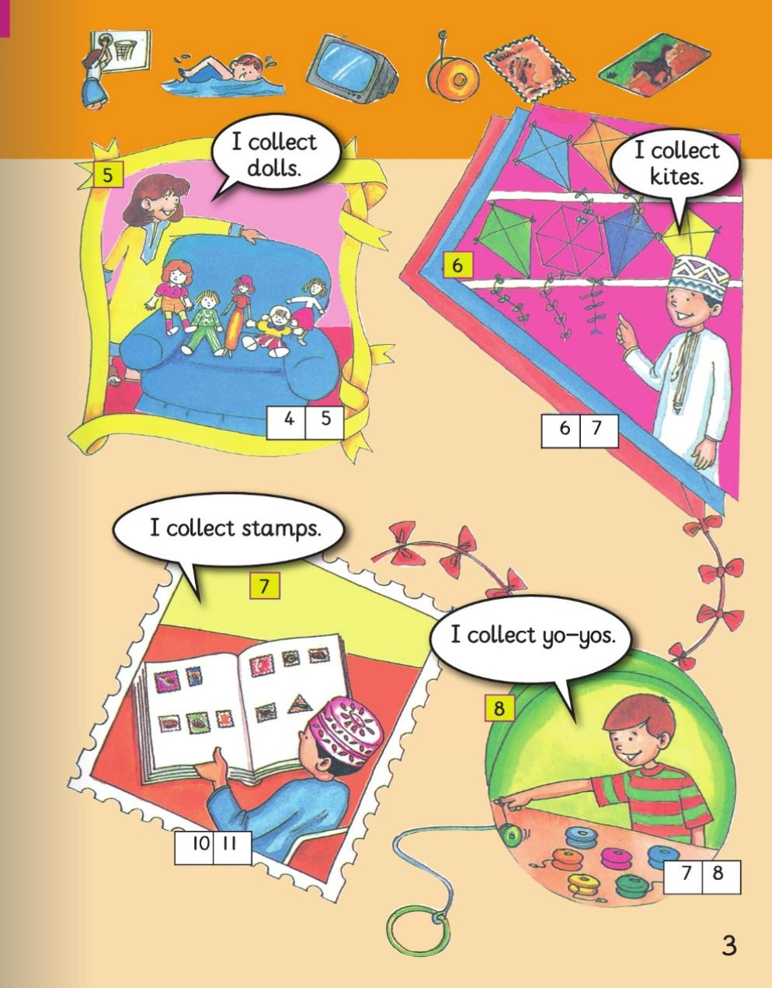
Look at your Classbook, Page 2-3 and answer the questions
What does Maha collect?
What does Saeed Collect?
What does Vicky collect?
What does Maryam collect?
What does Fatma collect?
What does Sami collect?
What does Bader collect?
What does Paul collect?

Slide 5
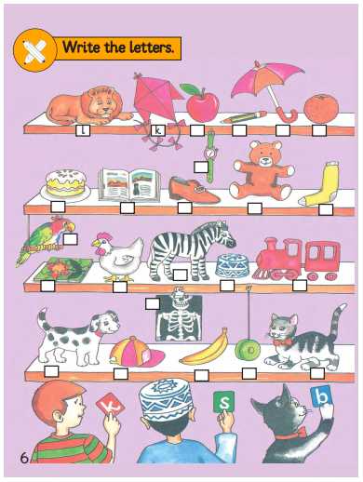
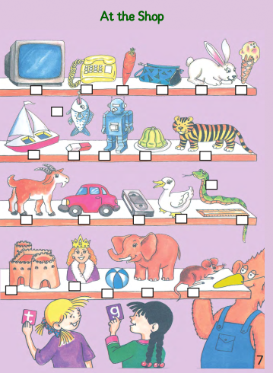
Look at your Classbook, Page 6-7
What can you see?
What toys can you see?
What school objects can you see?
What food can you see?

Slide 6
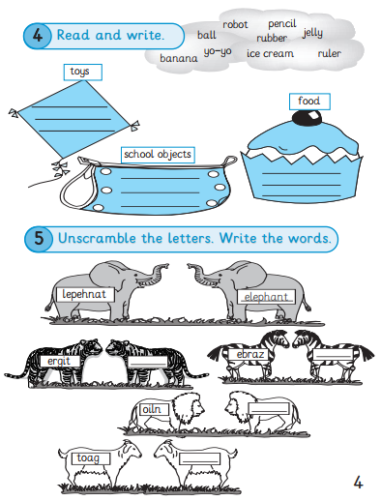
Open your Skills book, Page 4
Complete activity 1 and 2

Slide 7
Check your answers
robot
yo-yo
ball
pencil
ruler
rubber
banana
jelly
ice cream
tiger
zebra
lion
goat

Slide 8
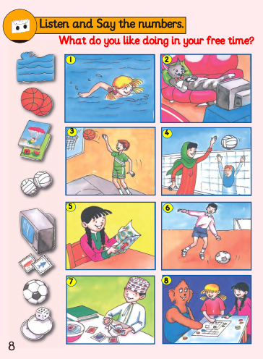
Open your Classbook, Page 8
Listen and look at the pictures
https://ict.moe.gov.om/video/video/2/English/QR-2B/e2b8L1_6.mp4
Which picture?

Slide 9
The answers
Picture 6
Picture 2
Picture 1
Picture 3
Picture 5
Picture 7
Picture 4
Picture 8

Slide 10
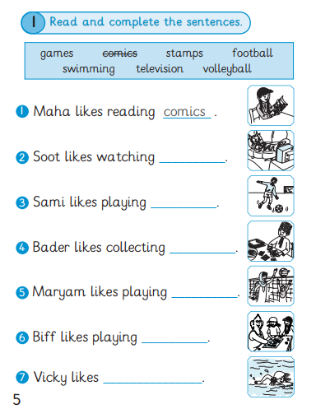
Open your Skills book, Page 5
Complete the activity

Slide 11
television
football
Check your answers
stamps
volleyball
games
swimming

Slide 12
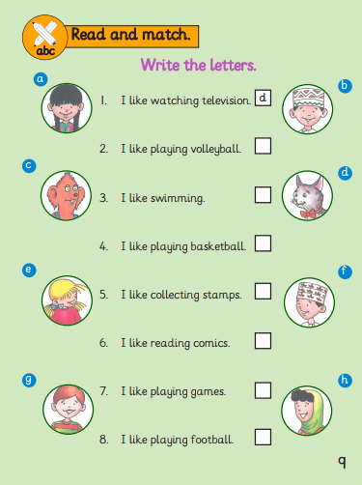
Homework

