Slide 1
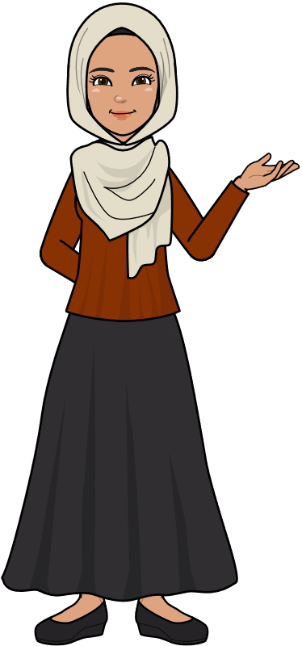
Grade 2B
Unit 3
Lesson 1-4
Fatma Al.Muslhi

Slide 2
Objectives
1- Revise the parts of the body.
2- listen to and follow oral instructions .
3- Read and match sentences to pictures.
4- Understand the meanings of adjectives.
5- Complete descriptions with the correct adjectives .
6- Make sentences using I can see ...
7- Complete sentences with the correct adjectives .
8- understand the concept of opposites.
Fatma Al.Muslhi

Slide 3
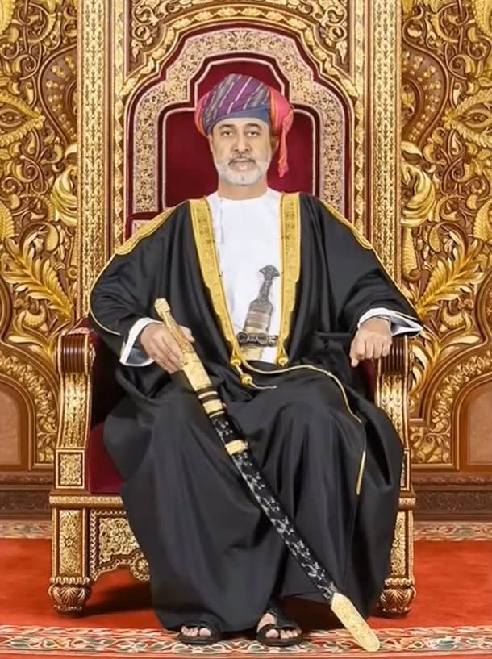
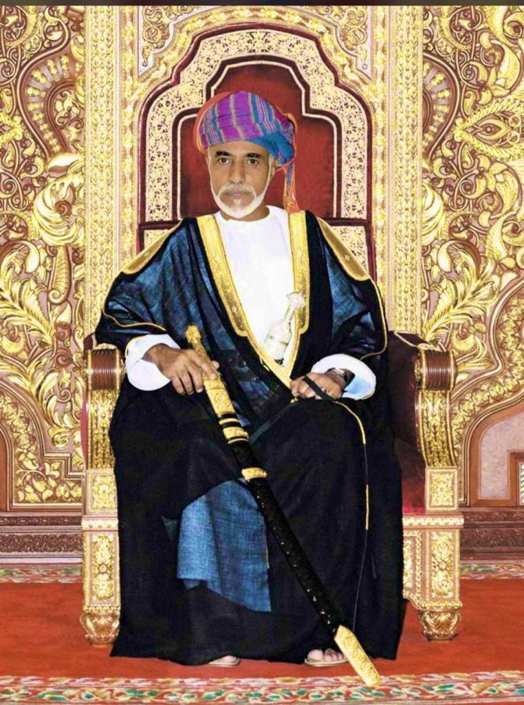
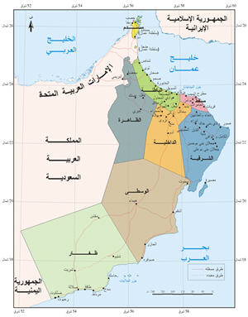
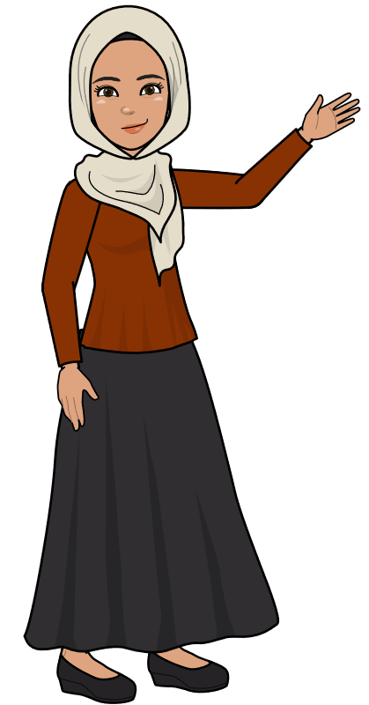
Five Senses
Fatma Al.Muslhi
T. Fatma Al.Muslhi

Slide 4
My Face
revision
Fatma Al.Muslhi

Slide 6
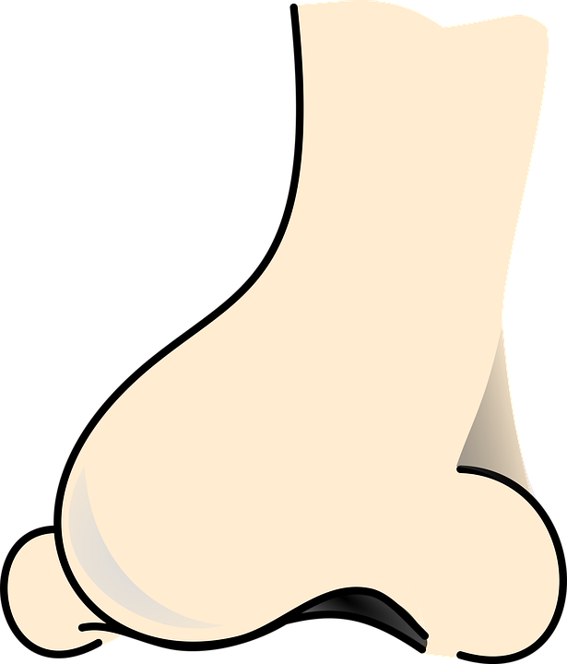
My Face
eyes
ears
mouth
nose
Fatma Al.Muslhi

Slide 7
Fatma Al.Muslhi

Slide 8
Fatma Al.Muslhi

Slide 9
Fatma Al.Muslhi

Slide 10
Fatma Al.Muslhi

Slide 11
Fatma Al.Muslhi

Slide 12
Fatma Al.Muslhi

Slide 13
Fatma Al.Muslhi

Slide 14
Fatma Al.Muslhi

Slide 15
New Words
elbow-tongue-knee
Fatma Al.Muslhi

Slide 16
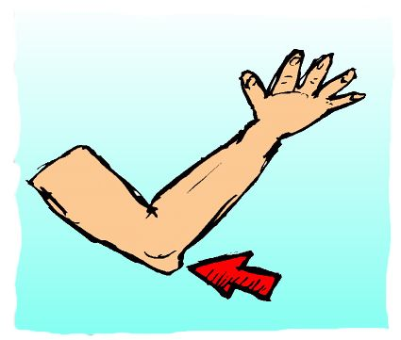
1
2
3
4
5
6
7
8
9
Fatma Al.Muslhi

Slide 17
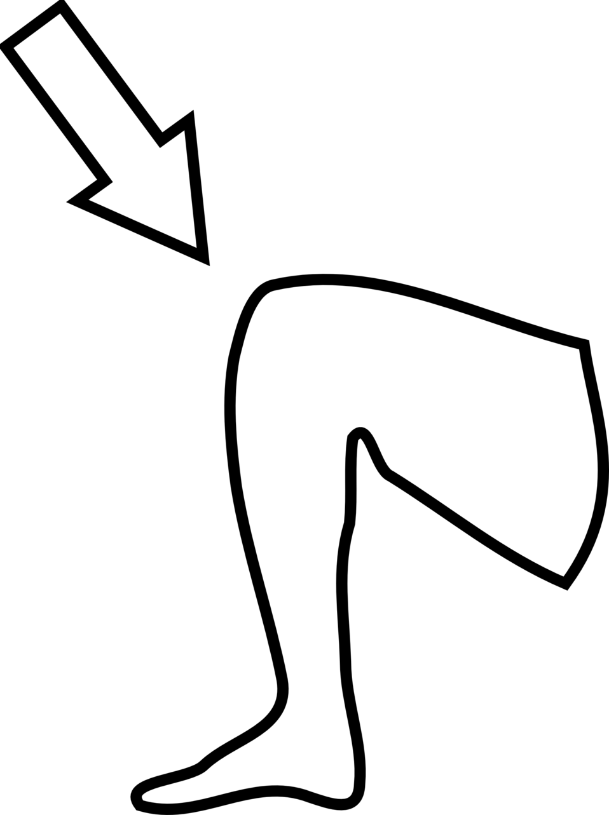
1
2
3
4
5
6
7
8
9
Fatma Al.Muslhi

Slide 18
1
2
3
4
5
6
7
8
9
Fatma Al.Muslhi

Slide 19
Fatma Al.Muslhi

Slide 20
Fatma Al.Muslhi

Slide 21
ear
eye
tongue
nose
arm
elbow
leg
knee
toe
feet
Fatma Al.Muslhi
Click on the rectangles to show the answers

Slide 22
Fatma Al.Muslhi

Slide 23
Fatma Al.Muslhi

Slide 24
Fatma Al.Muslhi

Slide 25
Fatma Al.Muslhi

Slide 27
Put your hands on
Your head.
Fatma Al.Muslhi

Slide 28
Touch your knees
Fatma Al.Muslhi

Slide 29
Put your nose
On your knees.
Fatma Al.Muslhi

Slide 30
Touch your toes.
Fatma Al.Muslhi

Slide 31
Put your elbows
on your knees
Fatma Al.Muslhi

Slide 32
Put your foot
on your head
Fatma Al.Muslhi

Slide 33
2
1
4
3
Fatma Al.Muslhi
Click on the squares to show the answers

Slide 34
The 5 Senses
Fatma Al.Muslhi

Slide 35
I can see...
Fatma Al.Muslhi

Slide 36
I can hear...
Fatma Al.Muslhi

Slide 37
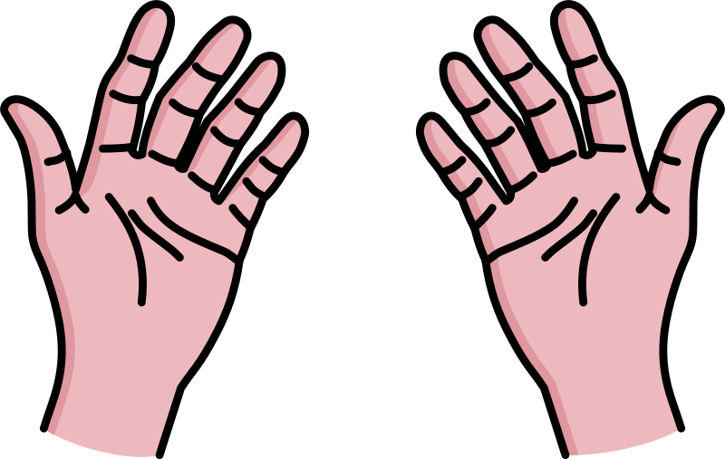
I can feel...
Fatma Al.Muslhi

Slide 38
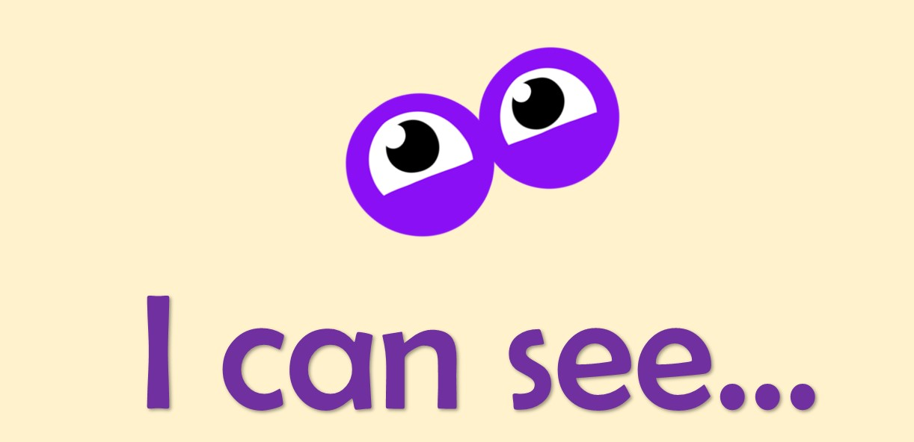
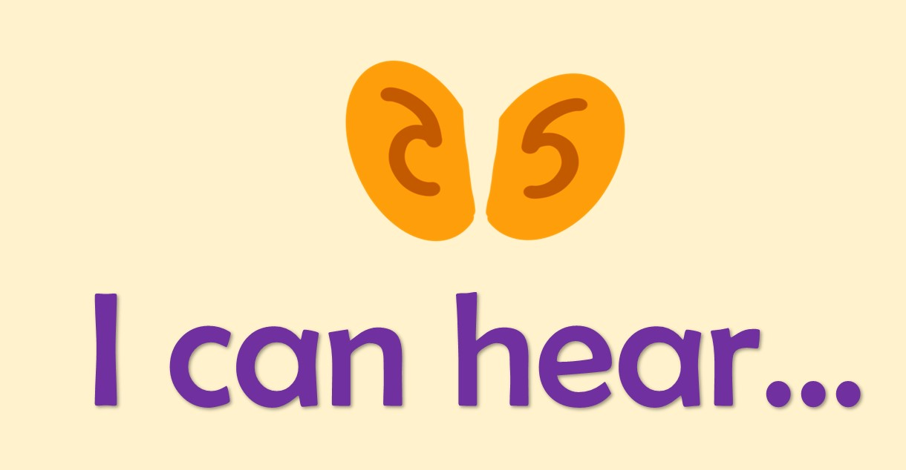
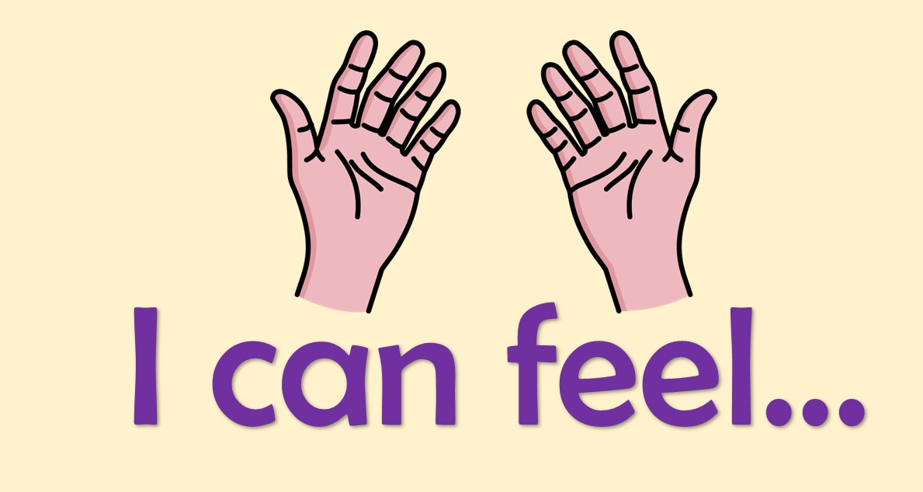
Fatma Al.Muslhi

Slide 39
I can see...
Fatma Al.Muslhi

Slide 40
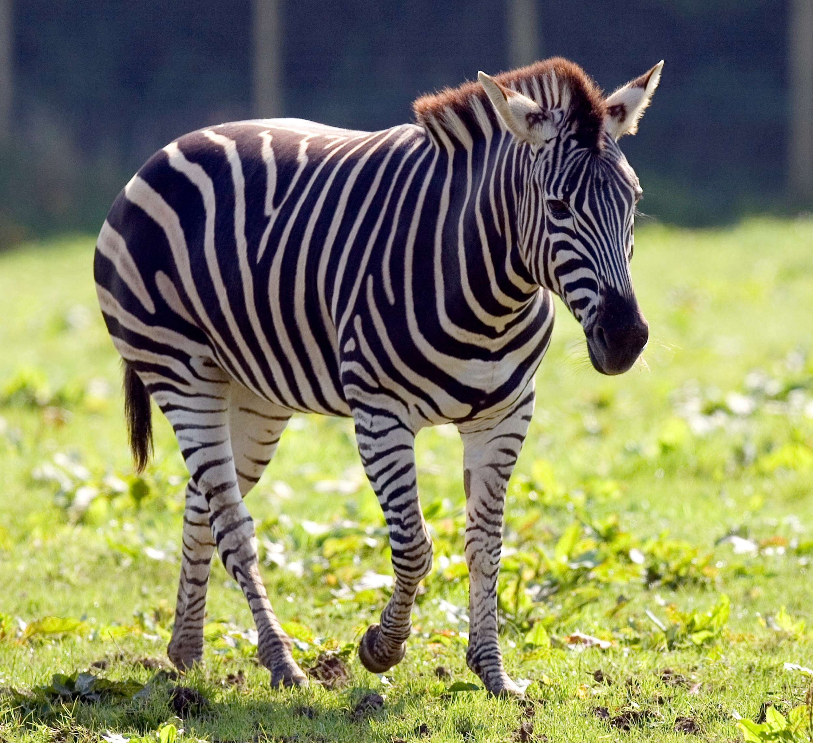
Fatma Al.Muslhi

Slide 41
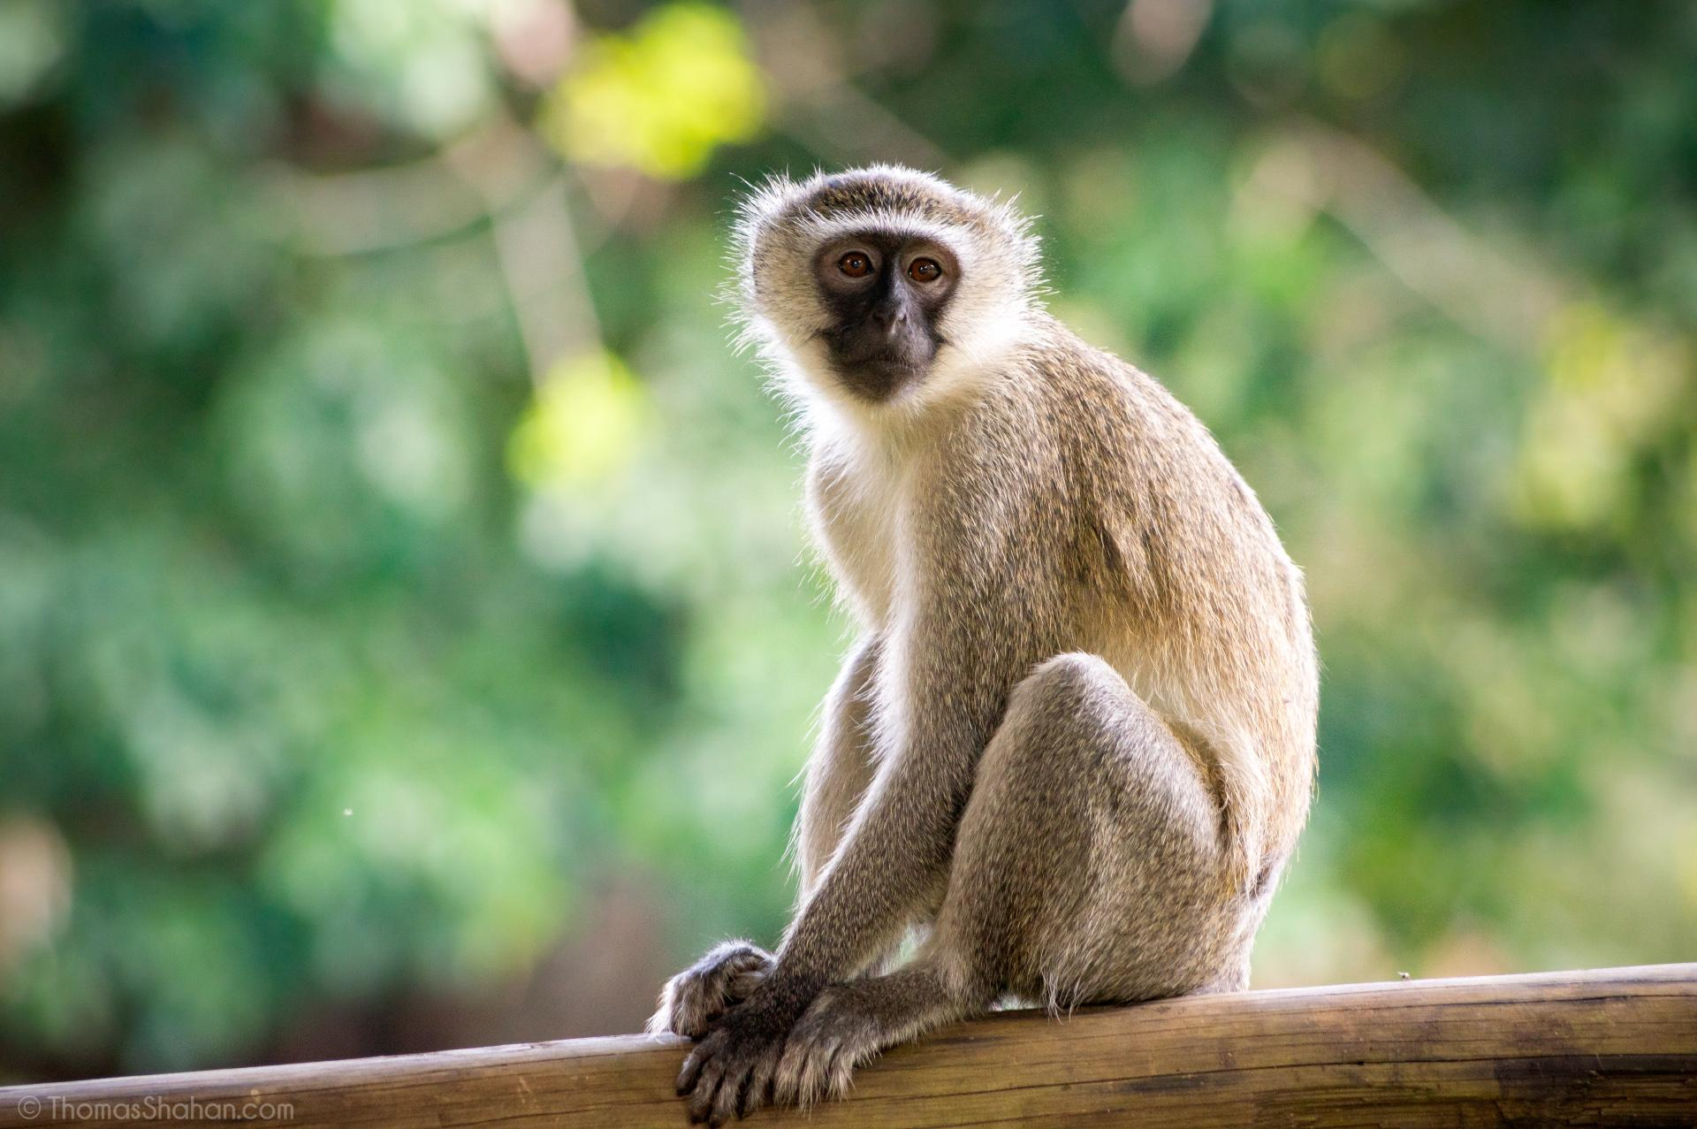
Fatma Al.Muslhi

Slide 42
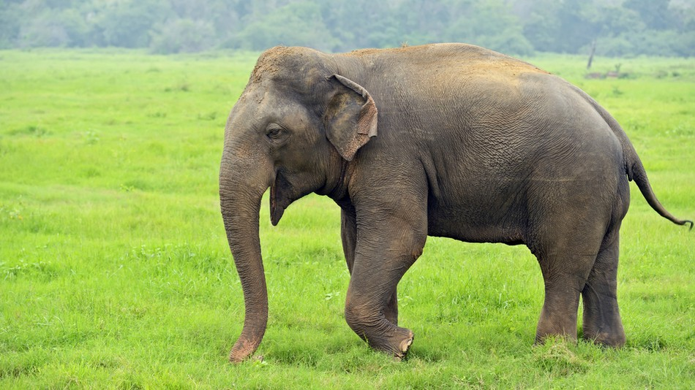
Fatma Al.Muslhi

Slide 43
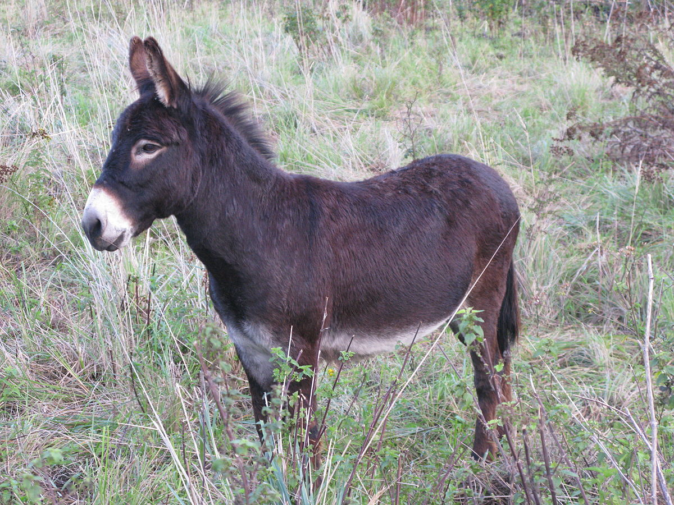
Fatma Al.Muslhi

Slide 44
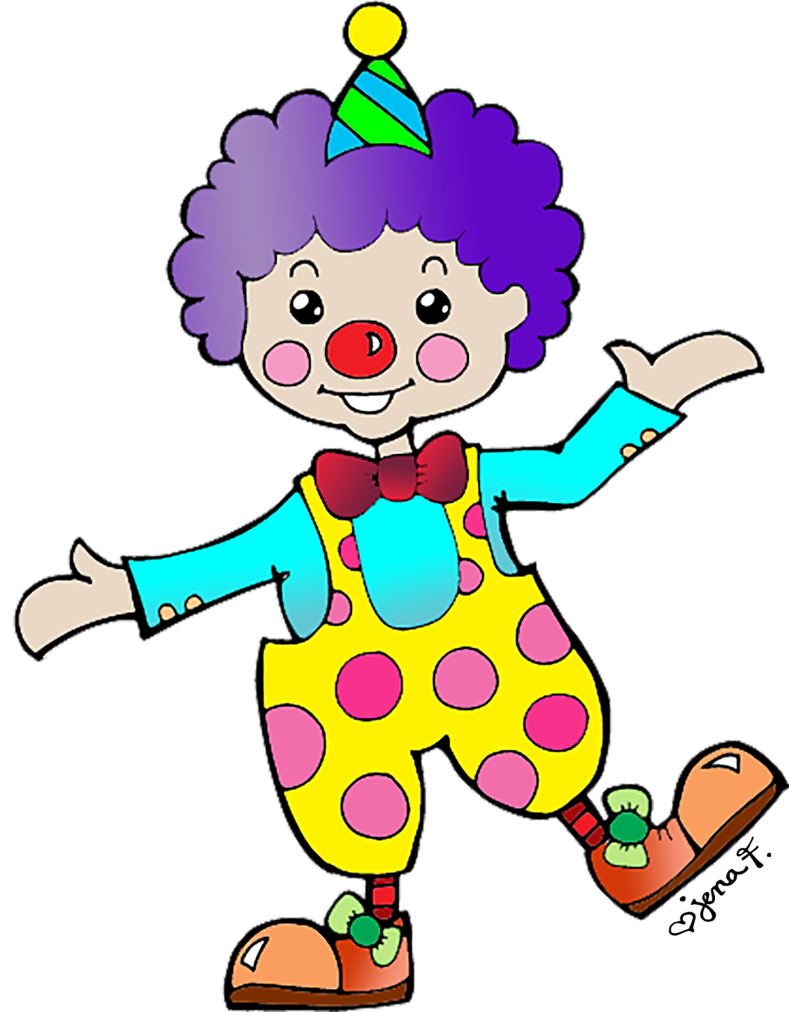
Fatma Al.Muslhi

Slide 45
Fatma Al.Muslhi

Slide 46
Fatma Al.Muslhi

Slide 47
Fatma Al.Muslhi

Slide 48
Fatma Al.Muslhi

Slide 49
Fatma Al.Muslhi

Slide 50
I can see a
_________ clown.
happy
I can see a
_________ clown.
sad
Fatma Al.Muslhi

Slide 51
I can see a
_________ clown.
thin
I can see a
_________ clown.
fat
Fatma Al.Muslhi

Slide 52
I can see a
_________ clown.
tall
I can see a
_________ clown.
short
Fatma Al.Muslhi

Slide 53
tall
happy
thin
short
sad
fat
Fatma Al.Muslhi

Slide 54
Fatma Al.Muslhi

Slide 55
Fatma Al.Muslhi

Slide 56
Fatma Al.Muslhi

Slide 57
Fatma Al.Muslhi

Slide 58
short
sad
fat
happy
Fatma Al.Muslhi

Slide 59
sad
happy
tall
short
fat
thin
Fatma Al.Muslhi

