Slide 1
Time to Fly a Kite
Jolly Phonics
Reading 4
Lessons 1+2

Slide 2
Objectives
Ps will be able to:
1. Recall previously taught sounds.
2. Recognize the alternative spellings of ie.
3. Read the text correctly.
4. Blend and segment words
5. Apply segmenting to from words
6. Demonstrate understanding by identify correct sentences.

Slide 3
Warm up
Let’s read these words.
1. see | 2. pray | 3. boat
4. blow | 5. sea | 6. snail

Slide 4
1
2
3
4
5
6
7
8
9
10

Slide 5
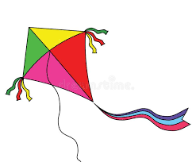
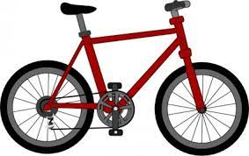
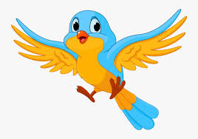
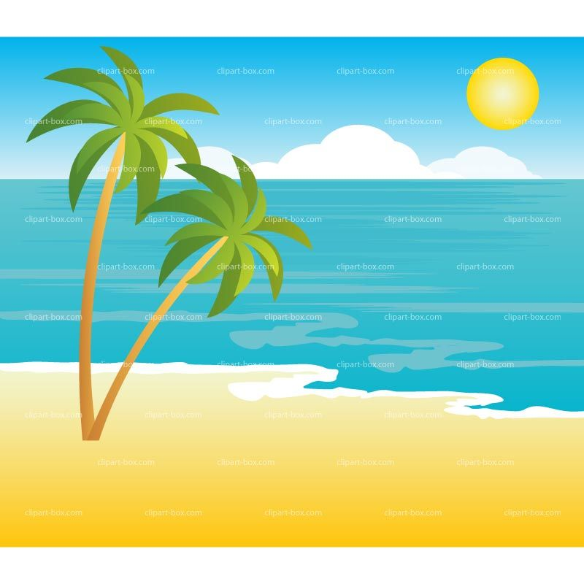
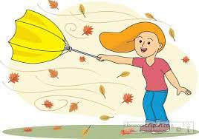
New words
kite
bike
smile
fly
beach
windy
string
high

Slide 6
Blending Activity
igh c ie i_e l t y r k b
Let’s form the words
1
2
3
4
i e
t
ie
l
b
k
igh
t
c
r
y

Slide 7
Segmenting Activity
How many sounds in these words
1. sky | 2. bright | 3. pie
4. lies | 5. fry | 6. high
2
4
2
3
2
2

Slide 9
smile
tie
bike

