Slide 1
UNIT: 1 LESSON : 1- 3
free time
Teacher : AMAL al wahaibi

Slide 2
Lesson aims:
Ch. Will be able to:
1.Listen to and join in with a song.
2. Revise letters names.
3.Talk about free time activities.

Slide 4
song

Slide 5
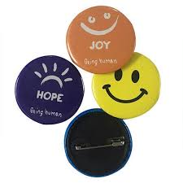
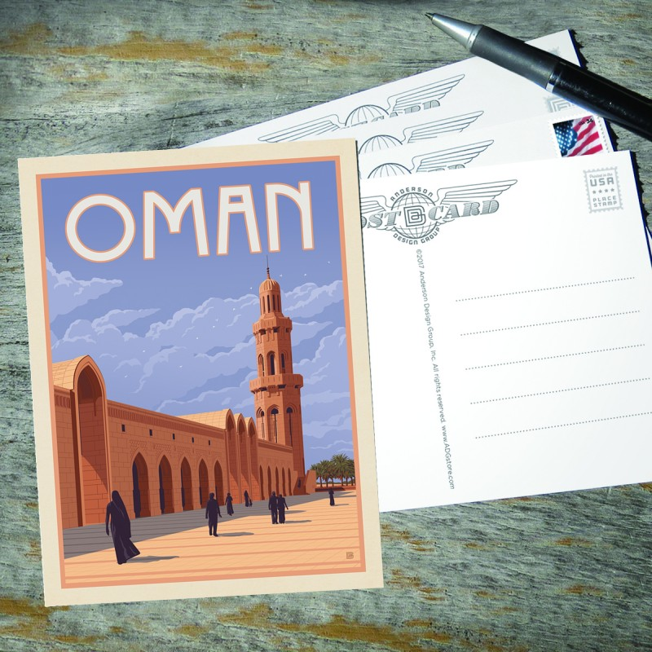
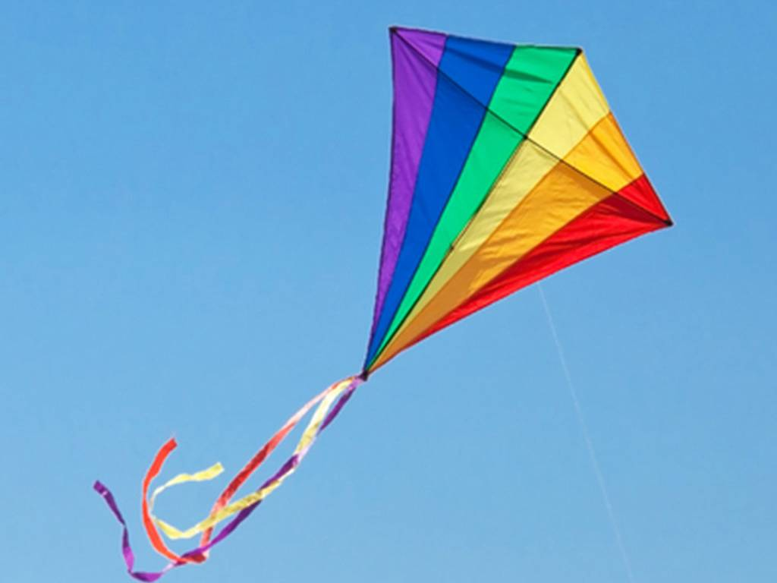
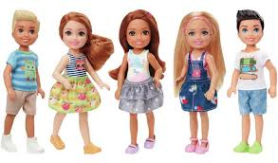
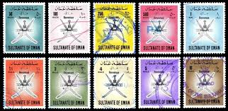
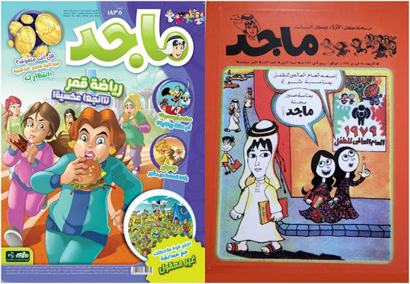
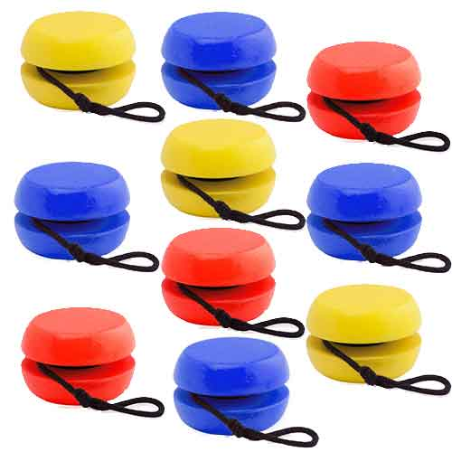
Telephone cards
badges
postcards
kite
dolls
stamps
comics
Yo-yos

Slide 6
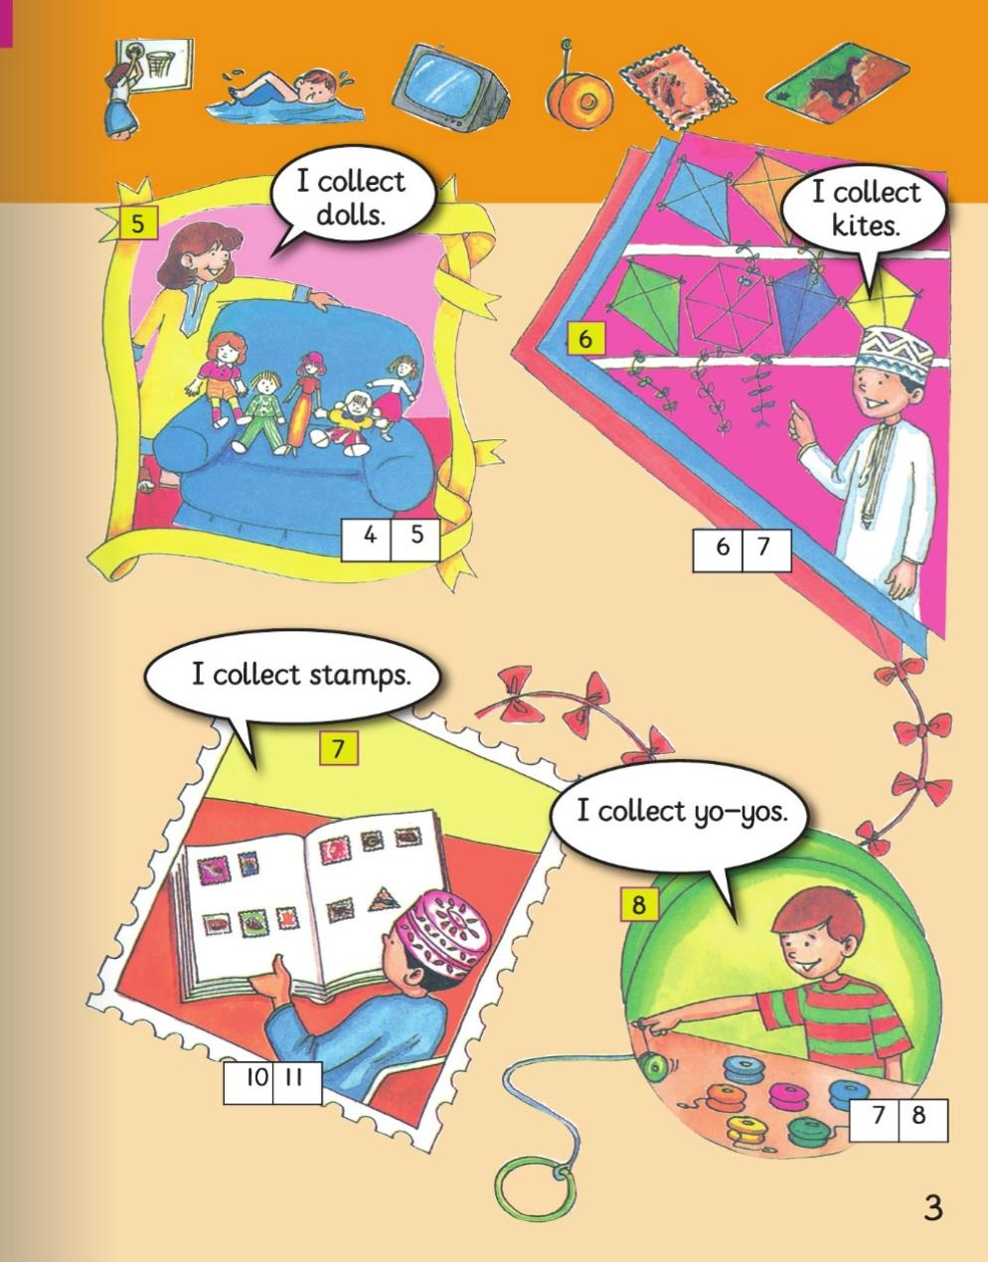

Slide 7
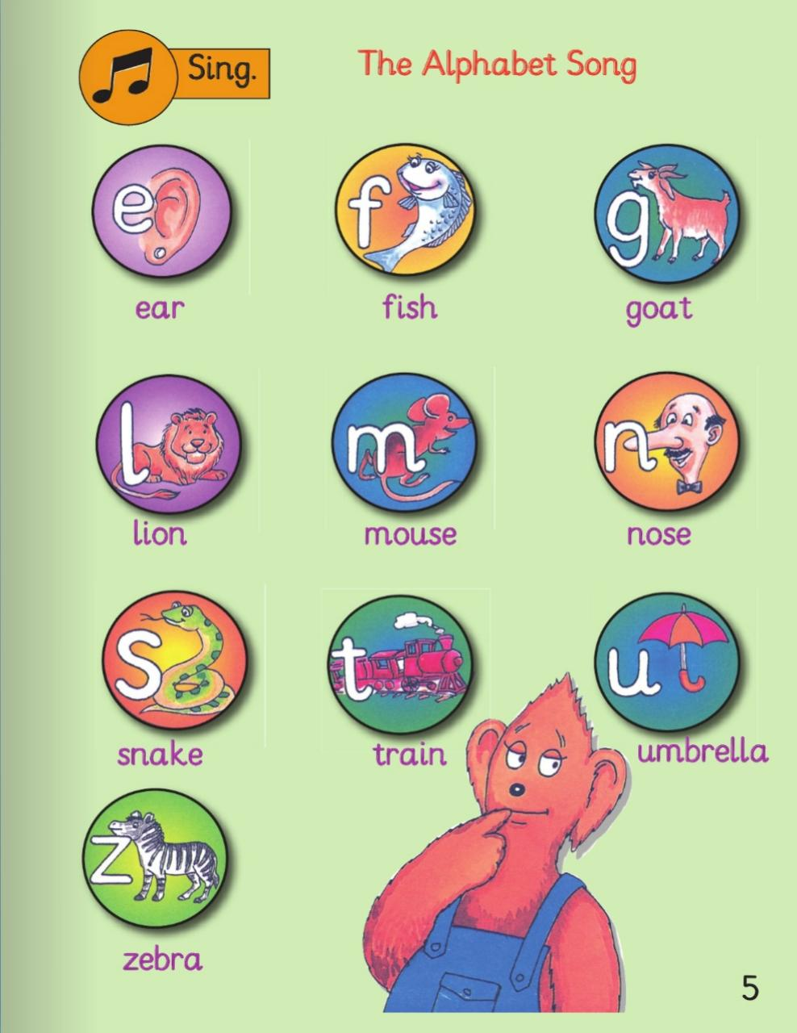

Slide 9
Homework

