Slide 1

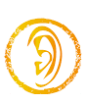



Grade 2B
Unit(3):Five Senses
L(1-4)
Done by: T.Najla AL-Tobi

Slide 2
Objectives:
Students will be able to:
Listen to and join in with songs.
Revise body parts.
Label a picture using parts of the body.
Revise colours.
Recognize the meanings of adjectives (happy, sad, thin, fat, tall. Short)
Read and match sentences to pictures.
Recognize the concept of opposite and complete a chart using opposite words.
Complete descriptions with the correct adjectives.
Complete sentences with the correct adjectives.

Slide 3

Warm up: Head Shoulders Knees & Toes Song

Slide 4

Parts of the body
01
02
03
04
05
06

Slide 5
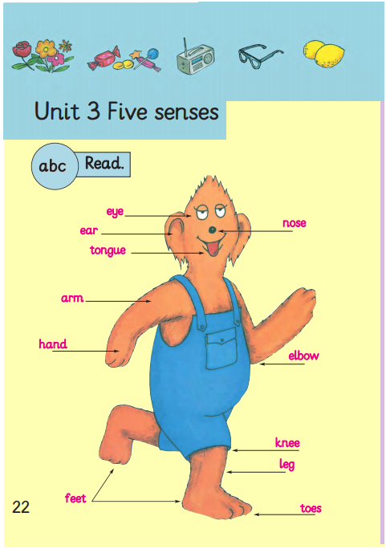
Open your Class Book, page 22.

Slide 6
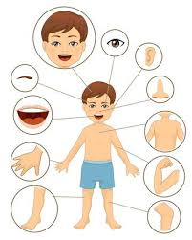
Parts of the body
head
eye
ear
eyebrow
nose
mouth
body
hand
arm
leg
knee
foot
toe

Slide 7
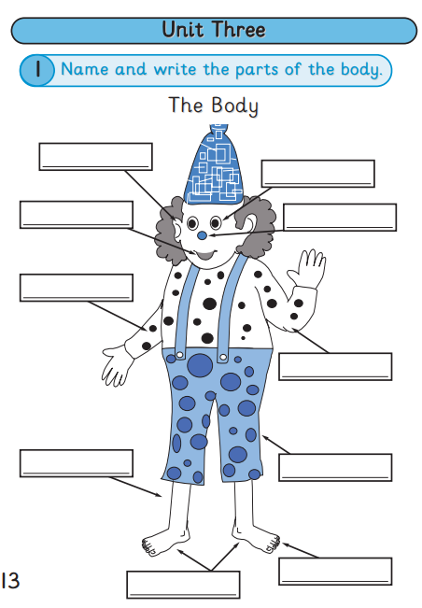
Open your Skills Book, page 13.

Slide 8


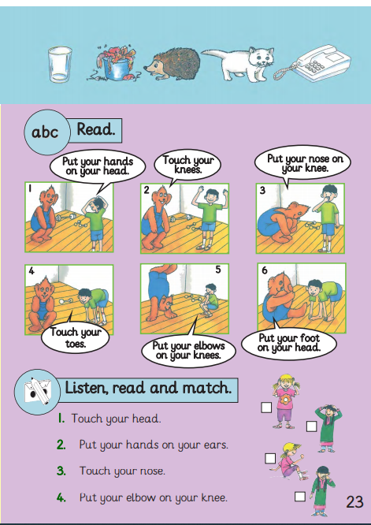
Open your Class Book, page 23.
Listen and match instructions with pictures

Slide 9
Open your Class Book, page 23.

Slide 10

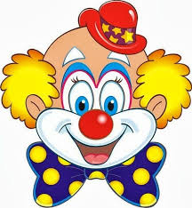
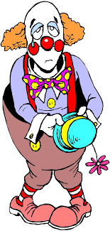
happy clown
sad clown

Slide 11
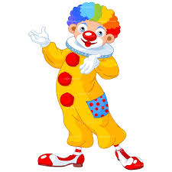
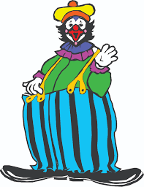
thin clown
fat clown

Slide 12
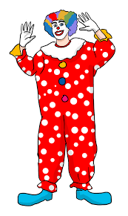
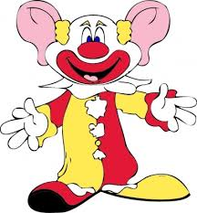
short clown
tall clown

Slide 13
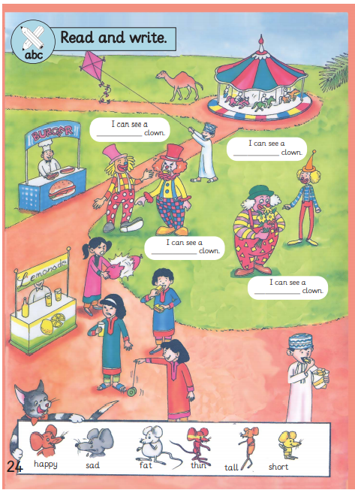
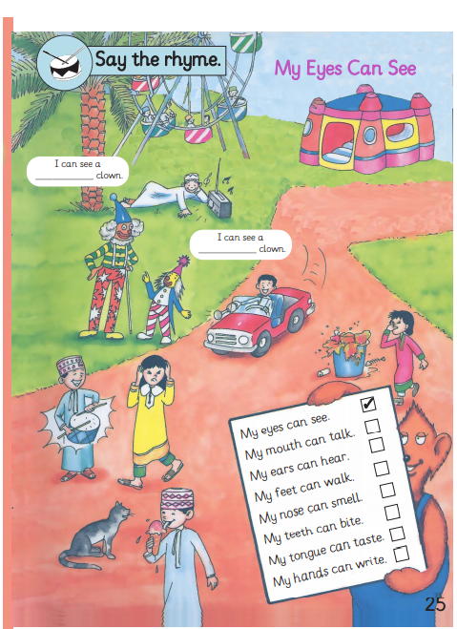
Open your Class Book, page 24-25.
What colour is the sad clown’s hat?
What colour is the short clown’s hat?
What colour is the fat clown’s hat?
Read and write adjectives of clowns

Slide 14
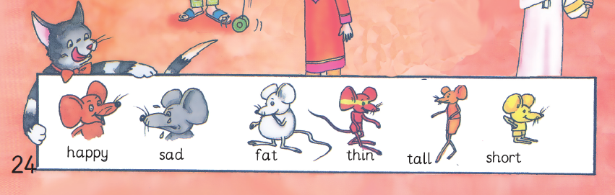

Slide 15
Supportive activities
https://www.liveworksheets.com/yg158pu
https://www.liveworksheets.com/fb507437vr

Slide 16
Thanks

