Slide 1
Grade 2B
Unit 2
Lesson 6-8

Slide 2
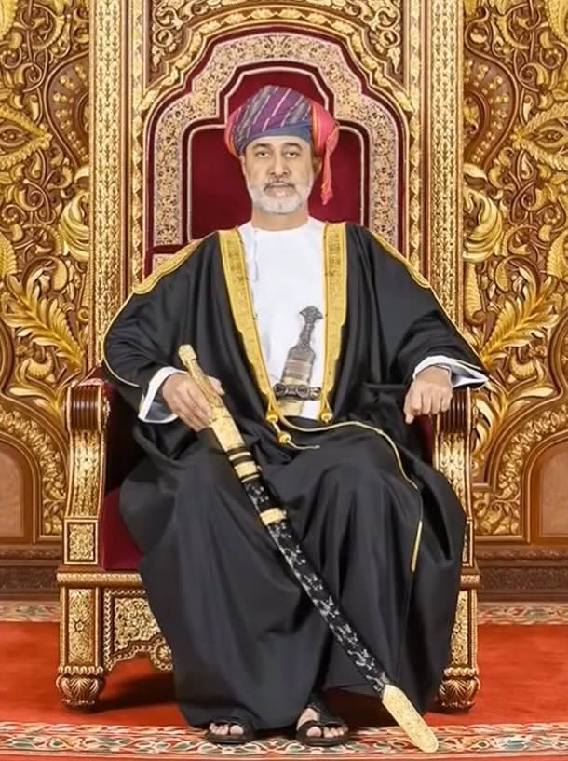
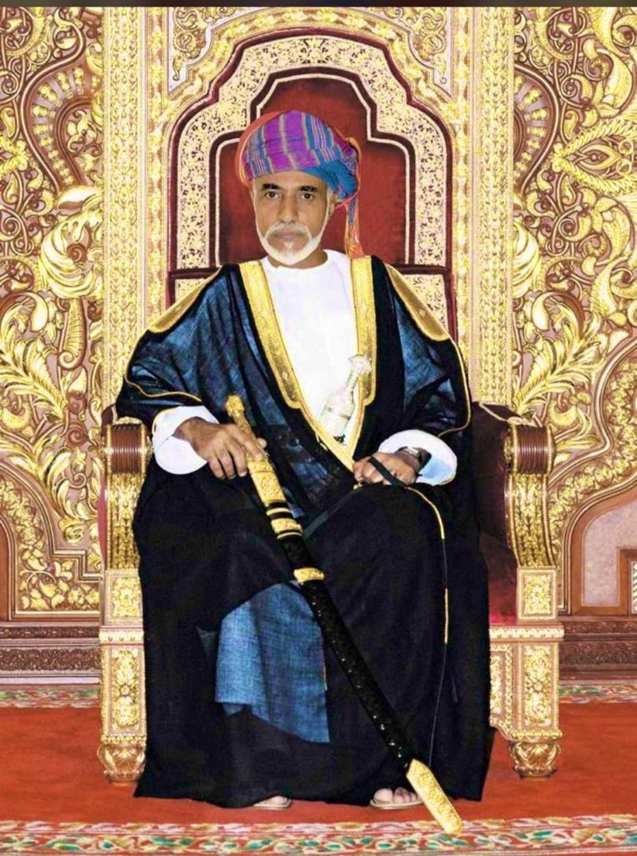
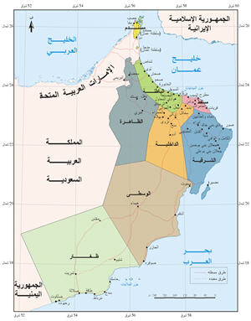
Animals
T. Fatma Al.Muslhi

Slide 3
can
can’t

Slide 7
A crocodile can swim.
A kangaroo can jump.
A camel can’t fly.
A giraffe can’t climb trees.

Slide 14
can
can’t
can’t
can
can’t

Slide 15
can swim .
can’t fly .
can’t sing .
can run .

Slide 18
Write sentences using can or can’t
elephant
fly
The ___________ can’t _____ .
elephant
swim
The __________ can’t _____ .

Slide 19
Write sentences using can or can’t
parrot
The ___________ can _____ .
The __________ can’t _____ .

Slide 20
Write sentences using can or can’t
crocodile
The ___________ can _____ .
The __________ can’t _____ .

Slide 21
Write sentences using can or can’t
kangaroo
The ___________ can’t _____ .
The __________ can’t _____ .

Slide 22
Write sentences using can or can’t
kangaroo
The ___________ can’t _____ .
The __________ can’t _____ .

Slide 23
Write sentences using can or can’t
kangaroo
The ___________ can’t _____ .
The __________ can’t _____ .

