Slide 1
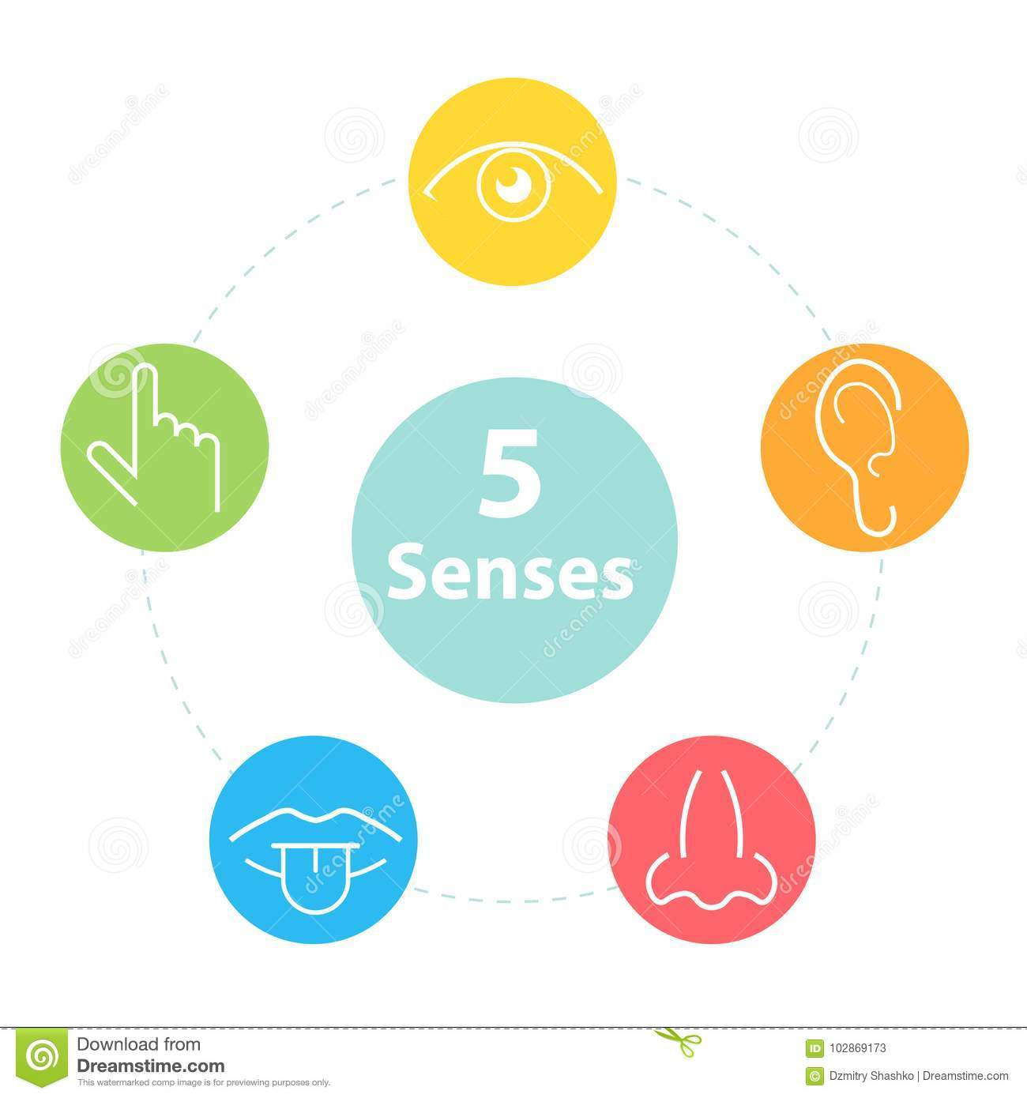
Sultanate of Oman
Ministry of Education
English For Me
Grade : 2
Unit : 3
Lesson:6-10
Done by: T. Ahad Hilal AL.Jabri.

Slide 2
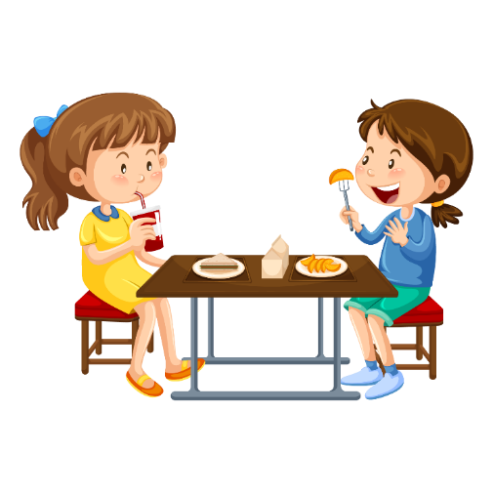
Lesson Rules
https://www.pngegg.com/ar
مصدر الصور
أحافظ على نظافتي الشخصية
Always keep clean
أشارك مع المعلم الأنشطة
Participate with the teacher
أجلس في مكان هادئ
Sit in a quite place
ألتزم بوقت الحصة
Be on Time
أتناول الإفطار قبل الحصة
Eat breakfast before the lesson
أستأذن عند الذهاب الى دورة المياه
Ask for permission to go to toilet
أستأذن عند الإجابة
Raise my hand to participate

Slide 3
https://www.pngegg.com/ar
مصدر الصور
Five senses \L6-10
Lesson’s Aims:
1.Talk about sounds.
2.Complete sentences.
3.Listen and identify sounds.
4.Recall shapes.
5.Recogize objects according to how they feel.
6.Guess food according to what they smell.
7.Recognize the meaning of sweet, sour and salty.

Slide 4
Watch the video about the five senses
https://youtu.be/vXXiyIGqliE

Slide 5
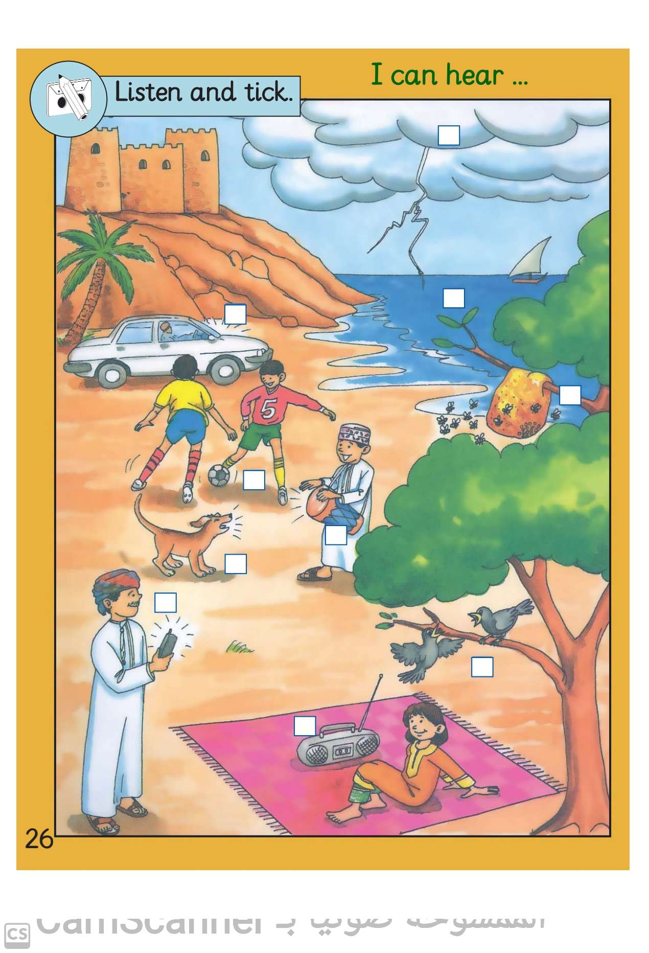
What can you see in the picture?
thunder
sea
a car
a ball
bees
a dog
a drum
a mobile phone
birds
a radio

Slide 6
Read the sentences and match them to the pictures.

Slide 7
1.Now Listen and put .
2.What did you hear?
https://ict.moe.gov.om/audio/sound/2/English/P1/G2A%20L3.3.mp3

Slide 8
Watch the video.
https://youtu.be/q4FAhOfcEs8

Slide 9
Let’s play together
https://www.liveworksheets.com/ob183680tn

Slide 10
Open p.29 of the Class Book.
1. Draw the shapes in the boxes.

Slide 11
Open p.29 of the Class Book.
2. Name the shapes in the boxes.

Slide 12
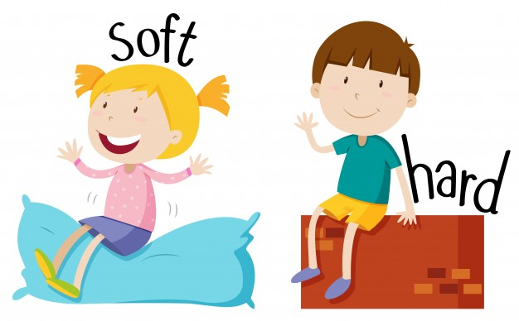
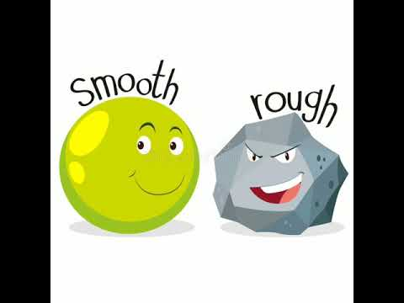
Learn new words.

Slide 13
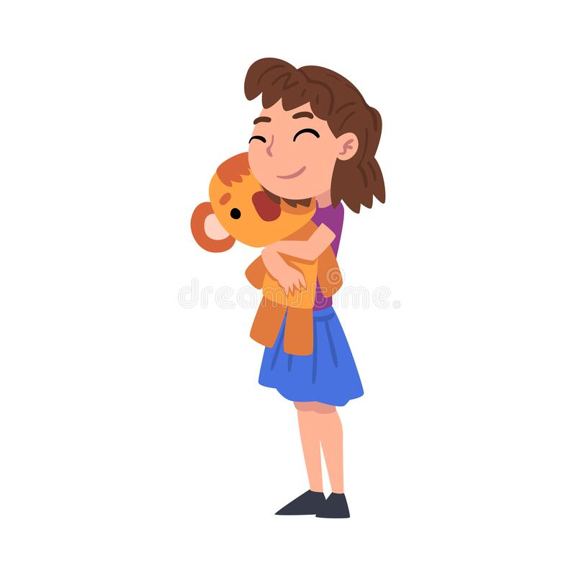
What does it feel like?
It feels soft.

Slide 14
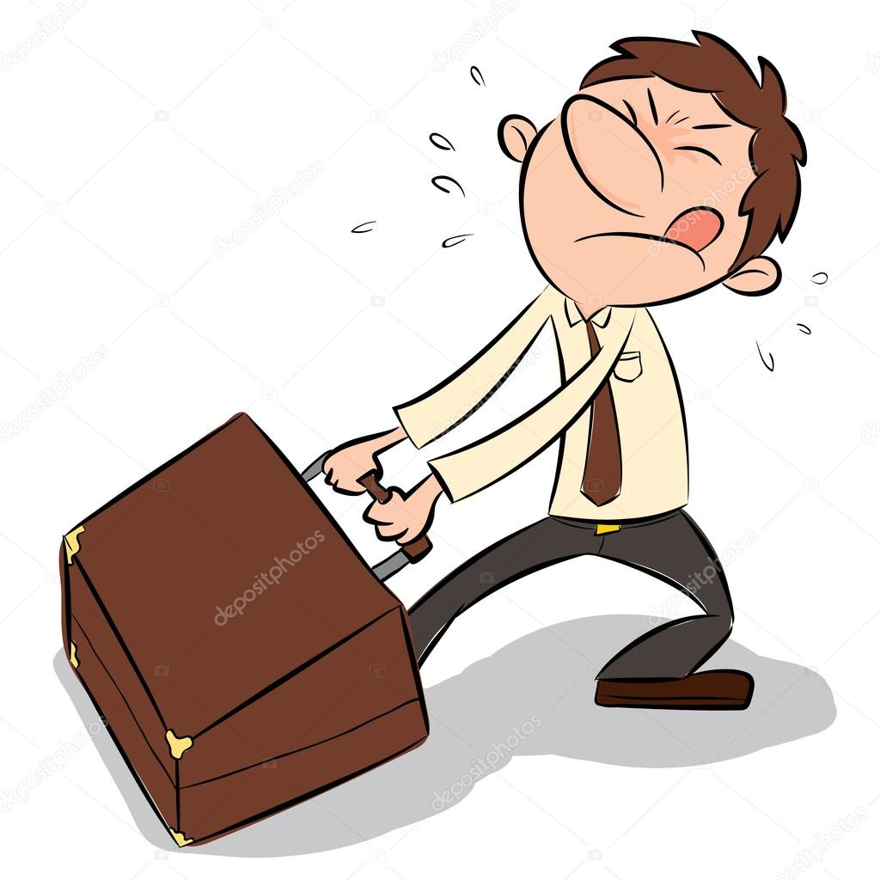
What does it feel like?
It feels hard.

Slide 15
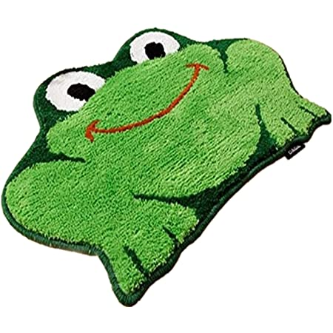
What does it feel like?
It feels smooth.

Slide 16
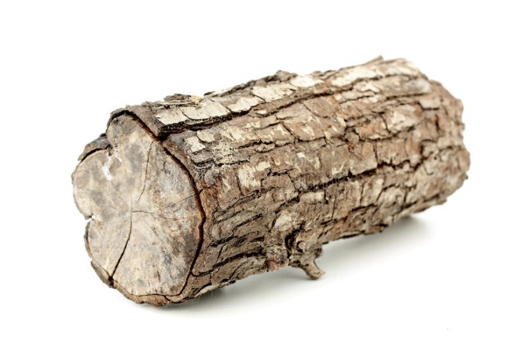
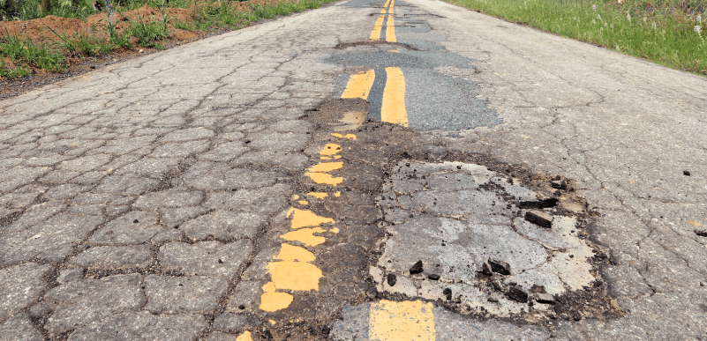
What does it feel like?
It feels rough.

Slide 17
What does it feel like?
It feels soft and smooth.

Slide 18
What does it feel like?
It feels hard and rough.

Slide 19
Open p.29 of the Class Book and do it.

Slide 20
Open p.18 of the Skills Book and do activity 3 .

Slide 21
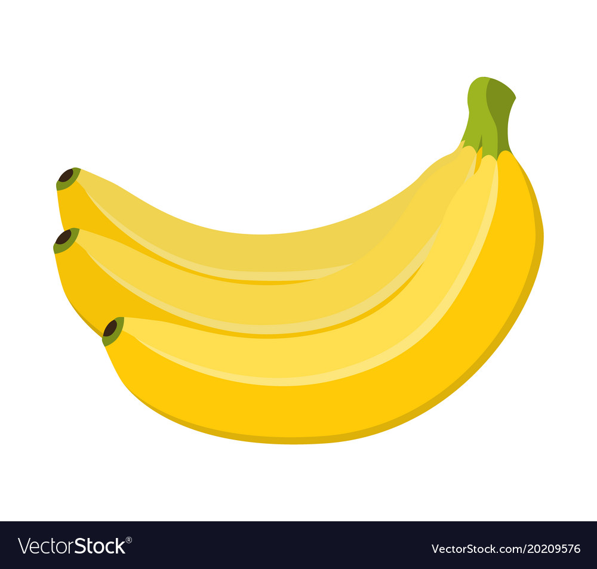
Let’s learn new words.
an apple
an orange
a banana

Slide 22
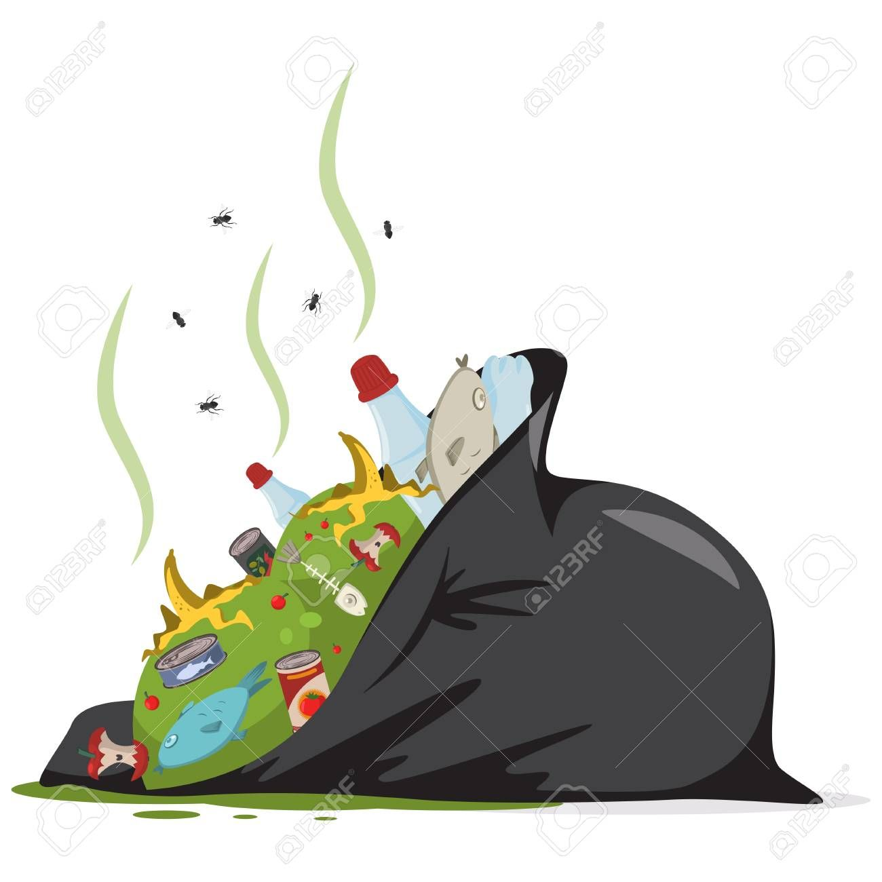
Let’s learn new words.
rubbish
flowers

Slide 23
Open p.30 of the Class Book and do activity 2.
banana

Slide 24
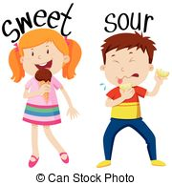
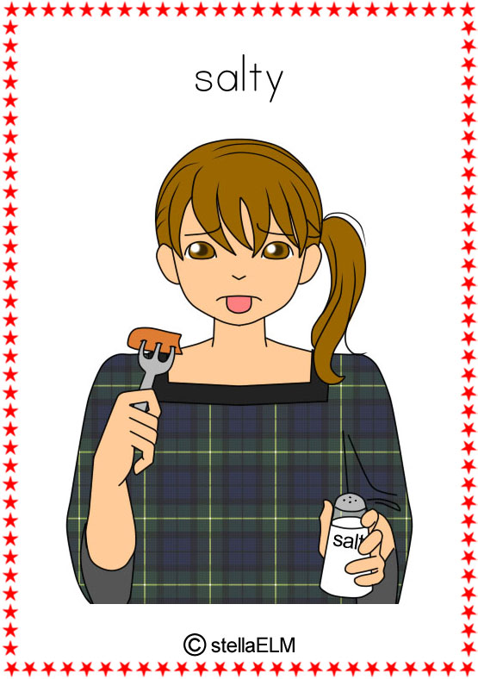
Now study these words.

Slide 25
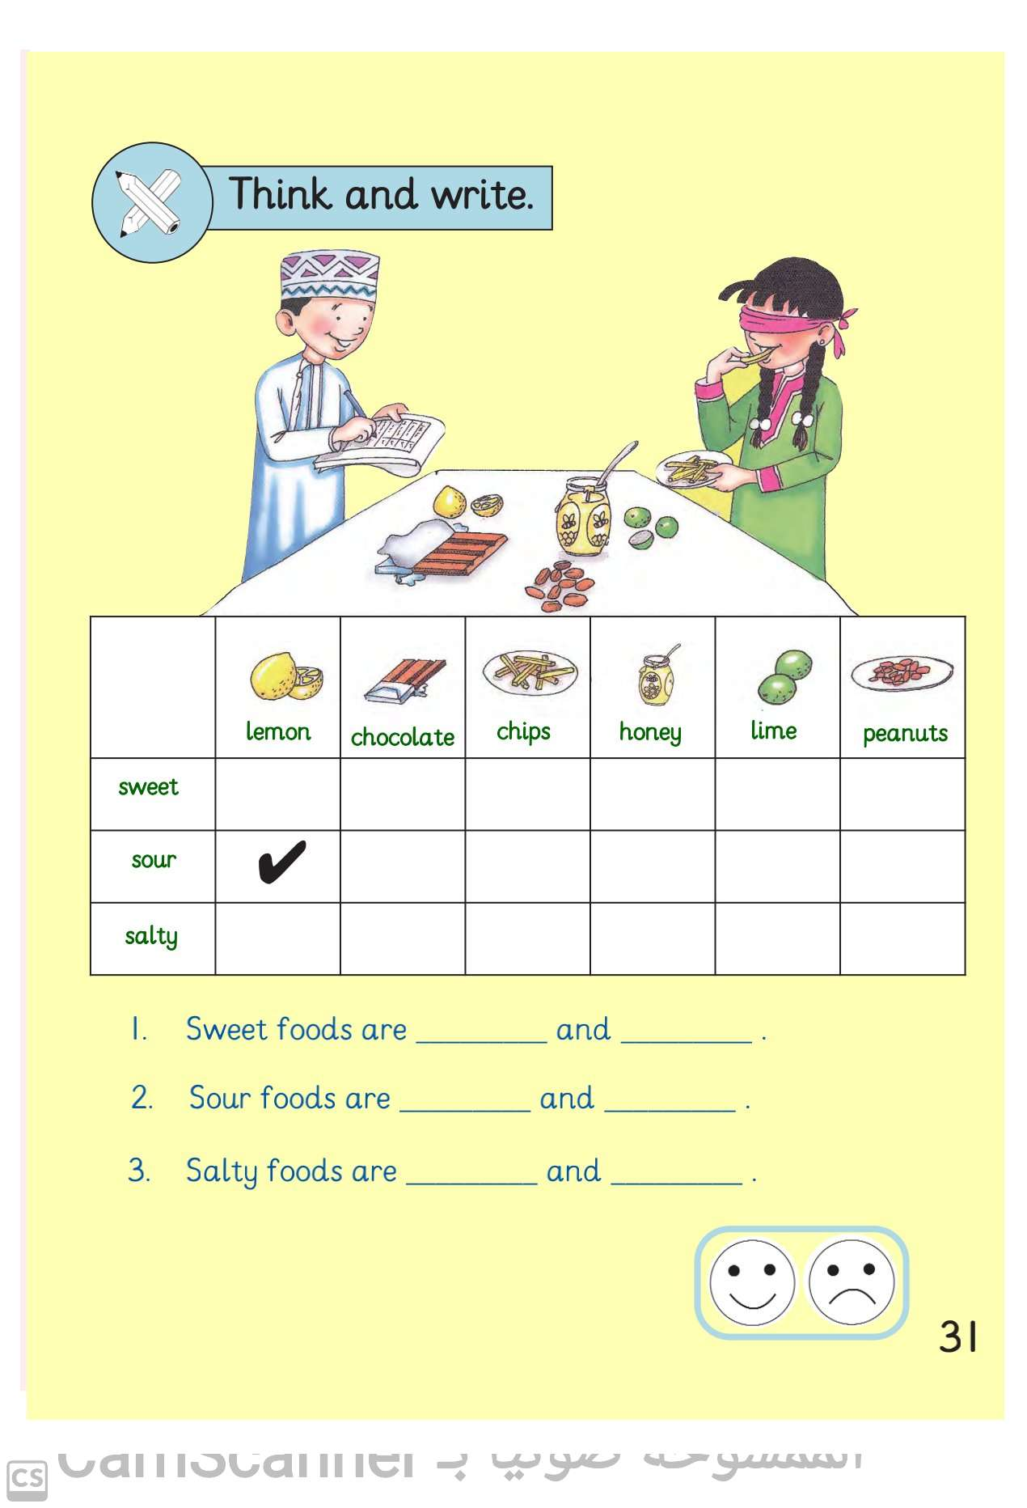
Listen and put a .
https://ict.moe.gov.om/audio/sound/2/English/P2/G2B%20L3.6.mp3
31

Slide 26
Now read and complete the sentences.
chocolate
honey

Slide 27
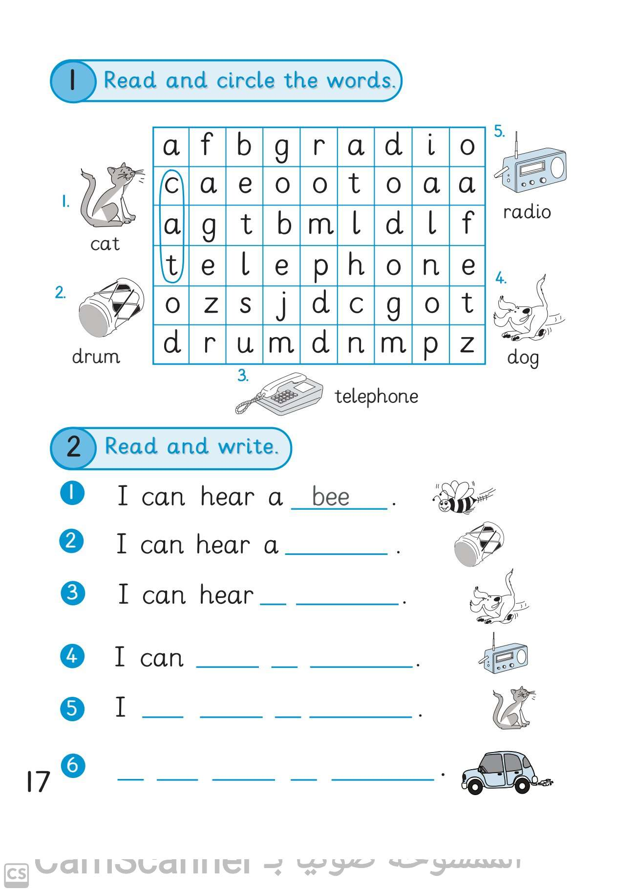
Homework

